Slide 1


Session 1:
Building a Community of Learners
Summer Intensive: Day 1
Center for Innovation in Teaching and Learning
Join by Web
Go to PollEv.com
Enter TAYLORCHESSON087

Slide 2
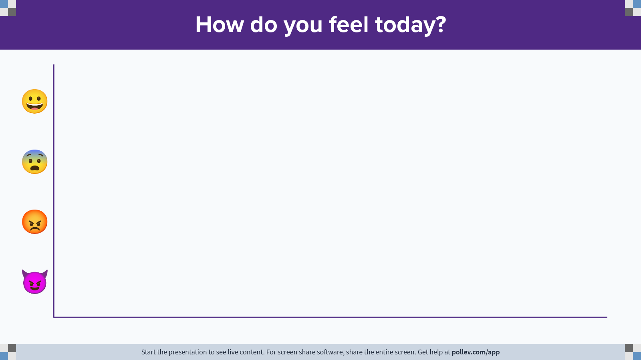
Notes:
Poll Title: Do not modify the notes in this section to avoid tampering with the Poll Everywhere activity.
More info at polleverywhere.com/support
How do you feel today?
https://www.polleverywhere.com/multiple_choice_polls/addDYeyjLYUN5u96NOQ92?state=opened&flow=Default&onscreen=persist

Slide 3

Session 1 Agenda
Pre-Assessment
Get to Know Your Instruction Designers
and Technology Specialists
Teaching Philosophy
OLC Rubric

Slide 4

Pre-Assessment
Qualtrics
Confidence Rating of OLC Rubric
What are you looking to get from this training?
What is your biggest success as a teacher?
Do you have any questions about the training?
How to Access:
iLearn Announcement
Email

Slide 5

Get to Know Your Instructional Designers and Technology Specialists!
This will quiz you on fun and interesting facts about your CITL Instructional Designers (Heather & Taylor) and Technology Specialists (Lauren & Kelvin).
Let's see how well you know us.
Join at www.kahoot.it
This Photo by Unknown Author is licensed under CC BY-NC-ND

Slide 6
Taylor’s Teaching Approaches
10th Grade English
  Grouping
  Relevant Learning
K-4 Librarian
  Accessibility to Tech Tools
  Resource Availability
9-12 Media Specialist
  I like helping teachers!
  Just-in-Time Learning
  Training for a Purpose
Why do I need to know this?
How do I get there?
Hurry! I need help NOW!
How can I help others?

Slide 7
1. Course Overview and Information
1. | Course Overview and Information
1. | Course includes Welcome and Getting Started content.
2. | An orientation or overview is provided for the course overall, as well as in each module. Learners know how to navigate and what tasks are due.
3. | Course includes a Course Information area that deconstructs the syllabus for learners in a clear and navigable way.
4. | A printable syllabus is available for learners (PDF, HTML)
5. | Course includes links to relevant campus policies on plagiarism, computer use, filing grievances, accommodating disabilities, etc.
6. | Course provides access to learner success resources (technical help, orientation, tutoring).
7. | Course information states whether the course is fully online, blended, or web-enhanced.
8. | Appropriate methods and devices for accessing and participating in the course are communicated (mobile, publisher websites, secure content, pop-ups, browser issue, microphone, webcam).
9. | Course objectives/outcomes are clearly defined, measurable, and aligned to learning activities and assessments.
10. | Course provides contact information for instructor, department, and program.

Slide 8
2. Course Technology & Tools
2. | Course Technology & Tools
11. | Required skills for using technology tools (websites, software, and hardware) are clearly stated and supported with resources.
12. | Technical skills required for participation in course learning activities scaffold in a timely manner (orientation, practice, and application – where appropriate).
13. | Frequently used technology tools are easily accessed. Any tools not being utilized are removed from the course menu.
14. | Course includes links to privacy policies for technology tools.
15. | Any technology tools meet accessibility standards.

Slide 9
3. Design and Layout
3. | Design and Layout
16. | A logical, consistent, and uncluttered layout is established. The course is easy to navigate (consistent color scheme and icon layout, related content organized together, self-evident titles).
17. | Large block of information are divided into manageable sections with ample white space around and between the blocks.
18. | There is enough contrast between text and background for the content to be easily viewed.
19. | Instructions are provided and well written.
20. | Course is free of grammatical and spelling errors.
21. | Text is formatted with titles, headings, and other styles to enhance readability and improve the structure of the document.
22. | Flashing and blinking text are avoided.

Slide 10
3. Design and Layout (cont.)
3. | Design and Layout (continued)
23. | A sans-serif font with a standard size of at least 12 pt. is used.
24. | When possible, information is displayed in a linear format instead of as a table.
25. | Tables are accompanied by a title and summary description.
26. | Table header rows and columns are assigned.
27. | Slideshows use a predefined slide layout and unique slide titles.
28. | For all slideshows, there are simple, non-automatic transitions between slides.

Slide 11

Heather’s Teaching Approaches
Small liberal arts undergraduate experience = active classrooms
Graduate school x 2 = feminist linguistic theory and feminist pastoral care = communal classrooms
Professional development trainer for adults = aligned classrooms
Graduate school again = opportunities for engagement
Person-centered, trauma-informed
Learner-instructor, learner-content, learner-learner
What will happen next?!
All voices matter!
Learner-learner, learner-content, learner-instructor!

Slide 12
4. Content and Activities
4. | Content and Activities
29. | Course offers access to a variety of engaging resources that facilitate communication and collaboration, deliver content, and support learning and engagement.
30. | Course provides activities for learners to develop higher-order thinking and problem-solving skills, such as critical reflection and analysis.
31. | Course provides activities that emulate real world application of the discipline, such as experiential learning, case studies, and problem-based activities.
32. | Where available, Open Educational Resources, free, or low-cost materials are used.
33. | Course materials and resources include copyright and licensing status, clearly stating permission to share where applicable.
34. | Text content is available in an easily access format, preferably HTML. All text content is readable by assistive technology, including a PDF or any text contained in an image.
35. | A text equivalent for every non=text element is provided (“alt” tags, captions, transcripts, etc.).
36. | Text, graphics, and images are understandable when viewed without color. Text should be used as a primary method for delivering information.
37. | Hyperlink text is descriptive and makes sense when out of context (avoid using “click here”).

Slide 13
5. Interaction
5. | Interaction
38. | Expectations for timely and regular feedback from the instructor are clearly stated (questions, email, assignments).
39. | Expectations for interaction are clearly stated (netiquette, grade weighting, models/examples, and timing and frequency of contributions).
40. | Learners have an opportunity to get to know the instructor.
41. | Course contains resources or activities intended to build a sense of class community, support open communication, and establish trust (at least one of the following – Ice breaker, Bulletin Board, Meet Your Classmates, Ask a Question discussion forums).
42. | Course offers opportunities for learner-to-learner interaction and constructive collaboration.
43. | Learners are encouraged to share resources and inject knowledge from diverse sources of information in their course interactions.

Slide 14
6. Assessment and Feedback
6. | Assessment and Feedback
44. | Course grading policies, including consequences of late submissions, are clearly stated in the course information area or syllabus.
45. | Course includes frequent and appropriate methods to assess learners’ mastery of content.
46. | Criteria for the assessment of a graded assignment are clearly articulated (rubrics, exemplary work).
47. | Learners have opportunities to review their performance and assess their own learning throughout the course (pre-tests, automated self-tests, reflective assignments, etc.).
48. | Learners are informed when a timed response is required. Proper lead time is provided to ensure there is an opportunity to prepare an accommodation.
49. | Learners have easy access to a well-designed and up-to-date gradebook.
50. | Learners have multiple opportunities to provide descriptive feedback on course design, course content, course experience, and ease of online technology.

Slide 15
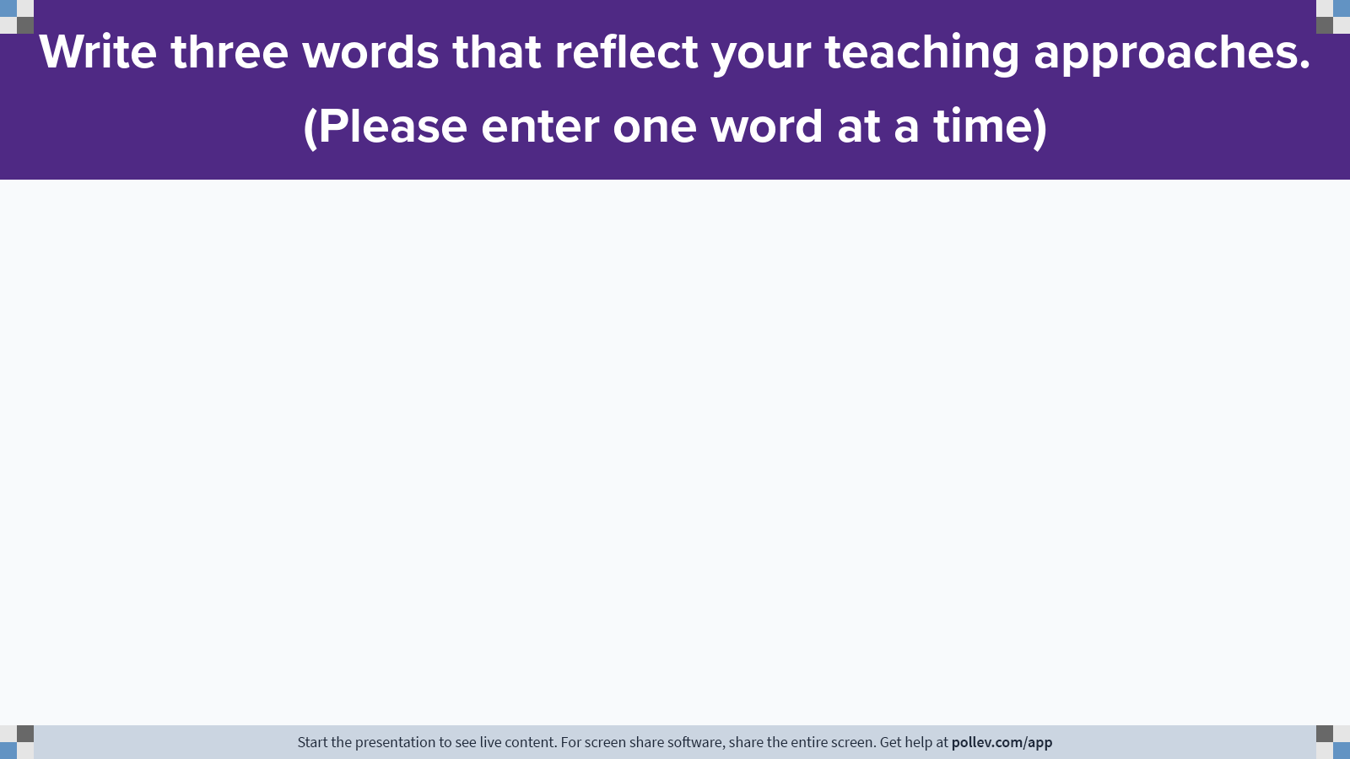
Notes:
Poll Title: Do not modify the notes in this section to avoid tampering with the Poll Everywhere activity.
More info at polleverywhere.com/support
Tell us three words that reflect your teaching philosophy. (Please enter one word at a time)
https://www.polleverywhere.com/free_text_polls/ccEVmmKr2op2g4bQvpPDG

