Slide 1

Session 4:
Design and Layout
Lauren Neal & Taylor Chesson
Center for Innovation in Teaching and Learning

Slide 2
Design and Layout
3. | Design and Layout
16. | A logical, consistent, and uncluttered layout is established. The course is easy to navigate (consistent color scheme and icon layout, related content organized together, self-evident titles).
17. | Large blocks of information are divided into manageable sections with ample white space around and between the blocks.
18. | There is enough contrast between text and background for the content to be easily viewed.
19. | Instructions are provided and well written.
20. | Course is free of grammatical and spelling errors.
21. | Text is formatted with titles, headings, and other styles to enhance readability and improve the structure of the document.
22. | Flashing and blinking text are avoided.

Slide 3
Design and Layout (cont.)
3. | Design and Layout (continued)
23. | A sans-serif font with a standard size of at least 12 pt. is used.
24. | When possible, information is displayed in a linear format instead of as a table.
25. | Tables are accompanied by a title and summary description.
26. | Table header rows and columns are assigned.
27. | Slideshows use a predefined slide layout and unique slide titles.
28. | For all slideshows, there are simple, non-automatic transitions between slides.

Slide 4

Session 4 Agenda
Logical Layout
Written Instructions
Content Organization Tools
Accommodation Tools

Slide 5

Logical Layout
Is my course easy to navigate?
How is content organized?

Slide 6
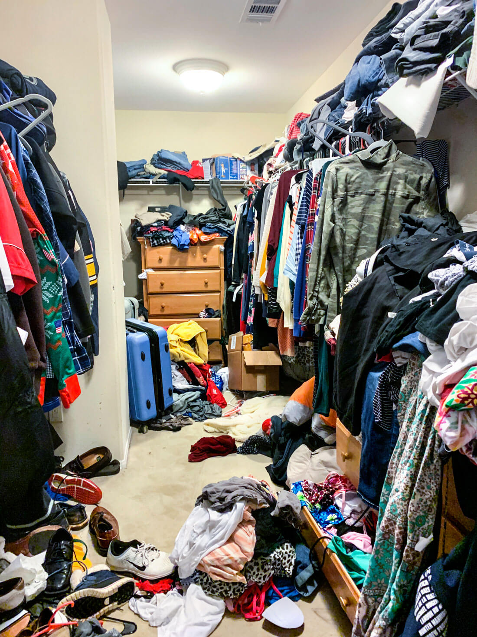
This Photo by Unknown Author is licensed under CC BY-ND
Notes:
Can you find my pair of white flip flops?

Slide 7
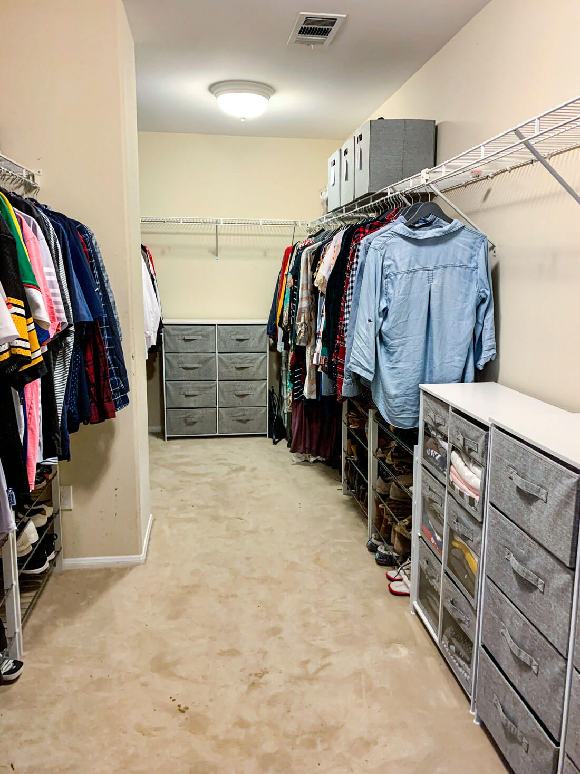
This Photo by Unknown Author is licensed under CC BY-ND
Notes:
What are some things this person had to do to make the closet look this way?
Can you find my pair of white flip flops?

Slide 8
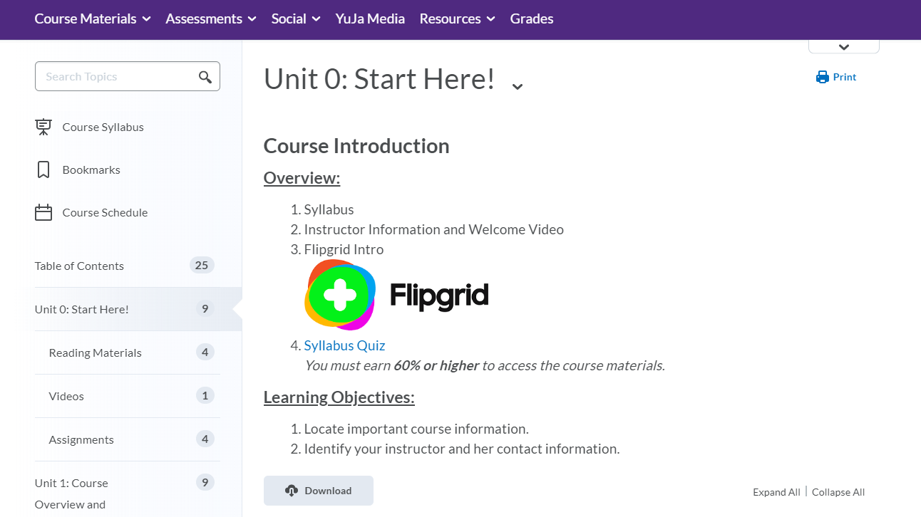

Slide 9
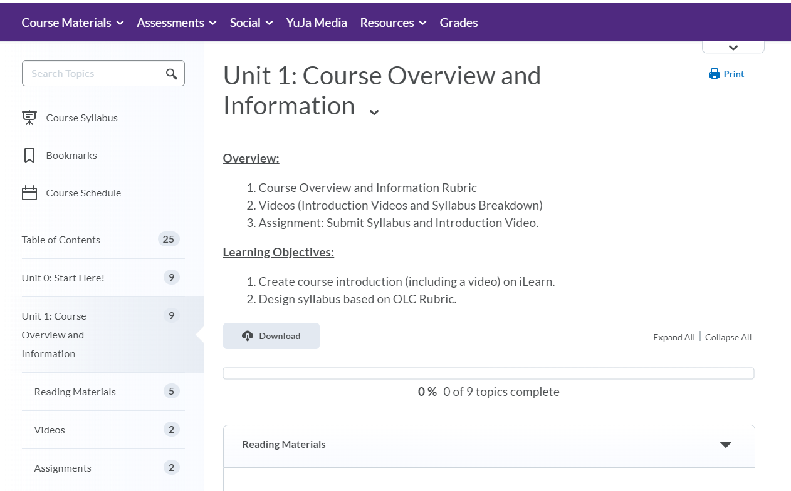

Slide 10

Written Instructions
Are instructions provided on each module and assessment?
How do I write good instructions?

Slide 11
Tips for Writing Clear Instructions
Write an introduction.
Break down the task into clear, logical steps.
Use imperative mood for clarity.
Use simple, easy-to-understand language.
Proofread Instructions.
Source

Slide 12

How to Make an Apple Pie
Mix together the flour and the salt.
Chill the butter and water.
Add the butter to the flour and cut it with a pastry blender until it resembles coarse
crumbs.
Add enough water until the dough barely hangs together.
Cut the dough in half and make two balls.
Wrap the dough in plastic wrap and refrigerate.
Peel the apples.
Core and quarter the apples and cut into 1/4-inch slices.
Mix the apples with sugar, lemon juice, cinnamon, and a small amount of flour.
Roll out one of the pieces of pie dough into a circle slightly larger than your pie pan.
Fold the pie dough in half and lift it into the pie pan.
Press the dough into the pan.
Fill the pie dough with the apple mixture.
Roll the other piece of dough into a circle.
Place the dough on top of the pie and crimp the edges.
Cut steam holes in the top crust.
Bake the pie for 45 minutes in a 350° oven.
Notes:
That’s a lot of steps, right? A bit much for someone to process. If they know a
lot about baking, they’ll be able to parse that information in a way that makes
sense, but if the learner doesn’t have a lot of context for pie-making, then this
list is likely to overwhelm them quickly.
There’s no cue to tell them when to stop reading the new information for a
moment and process the existing information. There’s also no higher-level
organization for the material—it’s just a long list of steps. Which is why you
want to look for opportunities to chunk that information:
Source: Design for How People Learn: 2nd Ed. By Julie Dirksen (2016)

Slide 13

How to Make an Apple Pie
I. Prepare the dough
Mix together the flour and the salt.
Chill the butter and water.
Add the butter to the flour and cut it with a pastry
blender until it resembles coarse
crumbs.
Add enough water until the dough barely hangs together.
Cut the dough in half and make two balls.
Wrap the dough in plastic wrap and refrigerate.
II. Prepare the filling
Peel the apples.
Core and quarter the apples and cut into 1/4-inch slices.
Mix the apples with sugar, lemon juice, cinnamon, and a small amount of flour.
III. Assemble the pie
Roll out one of the pieces of pie dough into a circle
slightly larger than your pie pan.
Fold the pie dough in half and lift it into the pie pan.
Press the dough into the pan.
Fill the pie dough with the apple mixture.
Roll the other piece of dough into a circle.
Place the dough on top of the pie and crimp the edges.
IV. Bake the pie
Cut steam holes in the top crust.
Bake the pie for 45 minutes in a 350° oven.
Notes:
Even just chunking the steps into four categories makes the whole procedure
much easier for people to process and remember. Chunking isn’t magically
going to allow the learner to remember the whole recipe, but it will help them to
focus on a single section at any one time, and the steps in an individual chunk
are a more realistic quantity of information to hold in working memory.
Working memory acts as a gatekeeper for long-term memory, so if the initial
information overloads working memory, it’s unlikely to make the transition to
long-term memory.
Source: Design for How People Learn: 2nd Ed. By Julie Dirksen (2016)
What are some ways to break this down even better?

Slide 14

Content Organizations Tools
Dates
Descriptions
Release Conditions
Linking Tools
Course Builder

Slide 15
Using Dates & Descriptions
Why use Dates and Descriptions?
Dates
  Provide a timeline and set expectation of completion.
    Start Date – only visible at that point
    Due Date – provides an expected completion date
    End Date – content is no longer available
Descriptions
  Provide an overview and/or objectives of the module or topic.
  Provide a timeline of how long the module should take to complete.
  Personalize with replace strings.
    These can be used in other areas too! :)
    View the replace strings available

Slide 16
Using Release Conditions
Why use Release Conditions?
Make sure students are completing the required work prior to accessing new information.
Make sure they understand the topic or subject.
Provide access to materials and assessments for specific sections or groups.

Slide 17
Using Links to Other Tools & Integrations
When designing, consider your setup!
Provide links to existing assessments and resources such as assignments, quizzes, checklists, etc.
Have the resources chunked with all the content and resources grouped together for a topic.
Make Content a one-stop area to follow the course structure.

Slide 18
Using the Course Builder
Course Builder, what's that??
A visual way of building the course.
Build and outline, add content, and/or re-use previous items.
Some things are not able to be done in this view.
Linking to external systems like YuJa, Teams, some publishers, etc.

Slide 19

Accommodations Tools
Accommodations vs Special Access
SensusAccess
HTML Templates
YuJa Media Transcripts & Captions
Testing Options (AEC)

Slide 20
Accommodations vs Special Access
Accommodations
This relates to a student who has gone through the AEC and needs a specific accommodation.
A student needs additional time on all tests/quizzes.
A student needs to take a test in an alternate location.
Captions must be provided.
Special Access
This relates to more of a specific request or individual situation.
A student will miss a test/assignment and needs an alternate day/time or additional attempts.
Learn more about dealing with accommodations and special access in iLearn.

Slide 21
SensusAccess
This tool can be used external to courses or linked within a course for students to use.
SensusAccess is a tool that converts documents in the course to accessible formats.
MP3 Audio (multiple languages and speed options)
DAISY full text and audio (multiple languages)
Braille (multiple formats)
E-book (epub, epub3, mobi and includes font size option)
Accessibility conversion (txt or pdf)
BeeLine Reader for faster reading (html, pdf, tagged pdf)
Translation (multiple languages)
External URL: https://www.tntech.edu/awesomeaccess/sensus.php

Slide 22
Adding SensusAccess to Content
Go to Content
Select the module where you would like to add the link
Select the Existing Activities drop-down
Choose External Learning Tools
Select SensusAccess-Convert a document
A link will be created where students can choose a document from the course to quickly convert.

Slide 23
HTML Templates
Why use templates?
Accessible
Easy to create and update
Consistent look and feel
Need some help getting started?

Slide 24
YuJa Media: Transcripts and Captions
Why is captioning and transcription important?
Accessibility
Compliance with legal requirements (Section 508)
Improved audience comprehension
Flexible viewing in sound-sensitive environments
Enhanced video search and user experience
Helps ESL learners

Slide 25
YuJa Media: Transcripts and Captions
Transcripts and Captions are auto-generated upon processing.
Human captioning is available for students registered with the AEC.
You can edit captions easily in the Edit area.
Editing the captions updates the transcripts
Transcripts are searchable

Slide 26
Testing Options
Have a student who needs to use accessibility software?
We can help with setup and information.
Contact the Accessible Education Center for more help.
  Exam Info
  Document Accessibility
  Human Captioning (not the standard)
Students can test in the AEC or the Testing Center if needed.

Slide 27

Questions?

