Slide 1
Session 5: Content and Activities
Heather Rippetoe Center for Innovation in Teaching and Learning

Slide 2
Content and Activities
4. | Content and Activities
29. | Course offers access to a variety of engaging resources that facilitate communication and collaboration, deliver content, and support learning and engagement.
30. | Course provides activities for learners to develop higher-order thinking and problem-solving skills, such as critical reflection and analysis.
31. | Course provides activities that emulate real world application of the discipline, such as experiential learning, case studies, and problem-based activities.
32. | Where available, Open Educational Resources, free, or low cost materials are used.
33. | Course materials and resources include copyright and licensing status, clearly stating permission to share where applicable.
34. | Text content is available in an easily access format, preferably HTML. All text content is readable by assistive technology, including a PDF or any text contained in an image.
35. | A text equivalent for every non=text element is provided (“alt” tags, captions, transcripts, etc.).
36. | Text, graphics, and images are understandable when viewed without color. Text should be used as a primary method for delivering information.
37. | Hyperlink text is descriptive and makes sense when out of context (avoid using “click here”).

Slide 3
Session 5 Agenda
What are 21st century skills?
How can our assessments foster 21st century skill development?
What digital tools can students use to practice and demonstrate 21st century skills?

Slide 4
What are 21st Century Skills?
Where did they originate?
How are they important for students? For education?

Slide 5
Helen Soule, Partnership for 21st Century Skills
Notes:
“There is a resemblance between ways of knowing, doing and being within a digitally-mediated society and what are often called “twenty first century skills” (Bearman, Nieminen, and Ajjawi, 2022, p. 8).

Slide 6
More about the 4Cs
Care et al., 2018

Slide 7
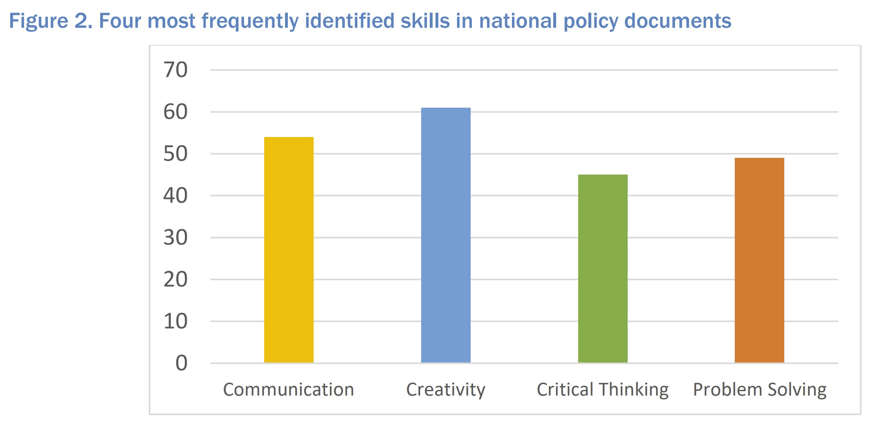
What are the 21st century skills?
Care et al., 2018
Notes:
The 4 C's

Slide 8
"Digital literacy competencies"
Critical thinking
Creativity
Collaboration
Communication
Information literacy
Media literacy
Technology literacy
Flexibility
Leadership
Initiative
Productivity
Social skills
Silber-Varod, Eshet-Alkalai, & Geri, 2019

Slide 9
And there's more.
Ericksen, 2020
Notes:
“twenty first century skills”. […] were conceptualised in the last few decades of the twentieth century (Bybee 2009). At this time, it was recognised that knowledge production was accelerating exponentially and routine cognitive and mechanical work would be increasingly assumed by machines; education should therefore develop skills necessary for an increasingly automated world.[…] These also appear similar to the types of graduate attributes, often called generic attributes, that universities seek to develop within their students" (Bearman, Nieminen, and Ajjawi, 2022, p. 8).

Slide 10
How can our assessments foster 21st century skill development?
Are our current assessments enough?
How do I design assessments to encourage creativity over consumption?

Slide 11
Agree or disagree?
“Some kinds of assessments are no longer relevant to contemporary workplaces which are immersed in digital technologies.”
Bearman, Nieminen, and Ajjawi, 2022
Notes:
Remember that some of our students will have jobs that don't even have names yet.
“[…] there is a need to prompt educators and researchers to consider how assessment and feedback designs can connect our students to a digital world.”

Slide 12
From "Reimaging the student experience—A new focus for assessment"
David Boud, 2022
Notes:
From "Reimaging the student experience—A new focus for assessment. A keynote at #SEDA2022.

Slide 13
What do your students need to be able to do beyond your course?

Slide 14
Digital Creativity
"At the intersection of digital technology and creativity is the emerging domain of digital creativity (Lee and Chen 2015). Digital creativity is the use of ‘digital tools and technologies to explore creative ideas and new ways of displaying your ideas, research, or work’ (University of York 2019, 1). Digital creativity involves the use of digital technology to open up new ways of thinking, to create new juxtapositions and ways of communicating data and historical materials."
Janse van Rensburg, Coetzee, & Schmulian, 2021, p. 1-2

Slide 15
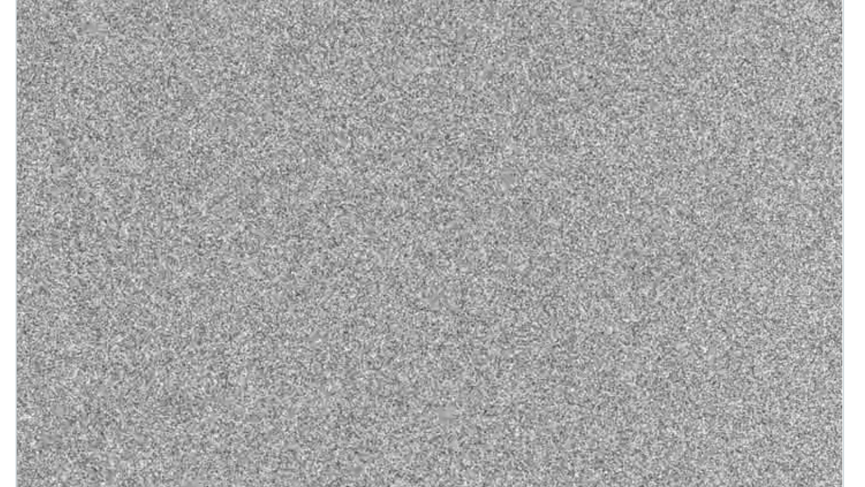
Creative storytelling?
One Million Lost

Slide 16
What digital tools are you already using?

Slide 17
What digital tools can students use to practice and demonstrate 21st century skills?
What are some free, low-barrier to entry tools?
What are some things to consider when creating digital creativity assignments?

Slide 18
Create Comix
Sample comic

Slide 19
Timetoast
Timeline without pictures
Timeline with pictures

Slide 20
Piktochart
My first picktochart

Slide 21
Canva
My first Meme

Slide 22
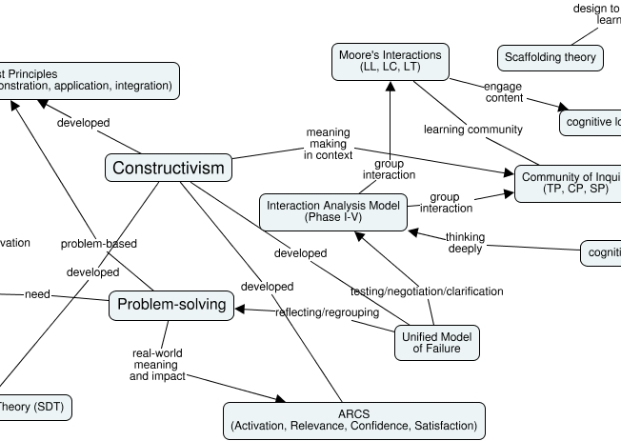
Cmap Cloud
https://cmapcloud.ihmc.us/
Notes:
Hrppetoe@memphis.edu

Slide 23
Storyjumper (preferred) & Storybird
My Storyjumper Book
My Storybird Book
Notes:
Hrppetoe@memphis.edu

Slide 24
Bulbapp
My portfolio of digital tools

Slide 25
Recommendations for designing the assessment
Acknowledge
Acknowledge that tech-savvy students may still have a learning curve with digital tools
Share
Share the learning outcome
Give
Give sufficient time
Give
Give an example of a finished product
Include
Include a grading rubric

Slide 26
References
Battlle for Kids. (2019). Framework for 21st Century Learning Definitions. https://drive.google.com/file/d/11xmPMltqhDZuuV7vrgBU7LDavSMeUBiM/vie
Bearman, M. Nieminen, J. H., & Ajjawi, R. (2022). Designing assessment in a digital world: An organizing framework. Assessment & Evaluation in Higher Education. https://doi.org/10.1080/02602938.2022.2069674
Care, E., Kim, H., Vista, A., and Anderson, K. (2018). Education system alignment for 21st century skills: Focus on assessment. Brookings. ED592779.pdf
Common Sense Education. (2016). Introduction to 21st Century Skills with Helen Soulé. https://youtu.be/6-NF1FQz2Mk
Ericksen, K. (2020). The 21st Century Skills Today’s Graduates Need to Succeed. The 21st Century Skills Today's Graduates Need to Succeed - Collegis Education — Tech-Enabled Higher Ed Solutions

Slide 27
References, continued
Ferrell, G., Smith, R., & Knight, S. (2018). Designing learning and assessment in a digital age. Designing learning and assessment in a digital age | Jisc
Janse van Rensburg, C., Coetzee, S.A., & Schmulian, A. (2021). Developing digital creativity through authentic assessment. Assessment & Evaluation in Higher Education. https://doi.org/10.1080/02602938.2021.1968791
Silber-Varod, V., Eshet-Alkalai, Y., & Geri, N. (2019). Tracing research trends of 21st-century learning skills. British Journal of Educational Technology (50)6, 3099-3118. https://doi.org/10.1111/bjet.12753

