Slide 1
Session 6: Interaction
Heather Rippetoe Center for Innovation in Teaching and Learning

Slide 2
Interaction Rubric
5. | Interaction
38. | Expectations for timely and regular feedback from the instructor are clearly stated (questions, email, assignments).
39. | Expectations for interaction are clearly stated (netiquette, grade weighting, models/examples, and timing and frequency of contributions).
40. | Learners have an opportunity to get to know the instructor.
41. | Course contains resources or activities intended to build a sense of class community, support open communication, and establish trust (at least one of the following – Ice breaker, Bulletin Board, Meet Your Classmates, Ask a Question discussion forums).
42. | Course offers opportunities for learner-to-learner interaction and constructive collaboration.
43. | Learners are encouraged to share resources and inject knowledge from diverse sources of information in their course interactions.

Slide 3
Session 6 Agenda
What is important about learner-learner interaction?
How do discussions support learner-learner interaction?

Slide 4
What is important about learner-learner interaction?
Where did learner-learner theory originate?
How does learner-learner interaction benefit students?

Slide 5
What is learner-learner interaction?

Slide 6
What's a Community of Practice (Lave & Wenger, 1991)?
Share similar interests
Collectively develop new practices and knowledge through interaction and activities
Membership grows and thrives on interaction
Draper, 2015, p. 111

Slide 7
Categories of collaboration a.k.a. Three levels of knowledge (Draper citing Thompson & Fine (1999) and Monero (2009))
Collaboration Level/Level of Knowledge Sharing | Characteristics
Lowest/Consensus Knowledge | “[...] sharing information, clarifying understanding, and exchanging information without the transformation of an individual’s perspective”
Medium/Common Ground | "[…] dependent upon interaction to help facilitate mutual understanding, beliefs, knowledge, and assumptions [...] that helps to facilitate shared meaning within the group. Through dialogue and activity, students seek to ground other students’ contributions by asking questions or providing evidence in an attempt to understand meaning"
Highest/Common Knowledge | “ […] encompassing skills in conceptualizing, analyzing, synthesizing, evaluating, applying, and reconstructing information into knowledge as well as the disposition to apply these skills.”
(Draper, 2015, p. 110)
Notes:
Notice how this kind of corresponds to Bloom's taxonomy.

Slide 8
What's the effect on students?
"[…] allows students to build camaraderie and engage in social reinforcement"
"[…] thought to lead to deeper thinking […] and better student outcomes"
“[...] despite the view of interactions as a critical component for learning, the degree of its effect on learning is unclear"
More frequent interactions "may contribute to the reduction of students’ feelings of isolation and disconnection”
Notes:
“The potential for interaction between learners is what makes an online distance course different from traditional correspondence study or self-paced, independent learning” (Smith, 2005, p. 1)
Two reasons for learner-learner interaction:
Create community
Allow learners to contribute their valuable information an experience to the community

Slide 9
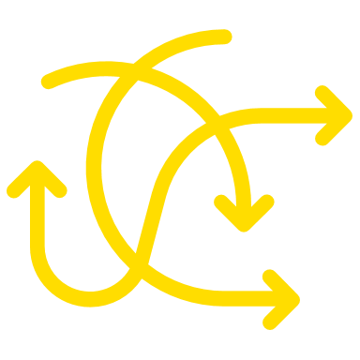
Instructor as facilitator
“The role of the teacher as facilitator requires an approach of working with learners to promote learner–learner collaboration and knowledge building rather than teaching to them in a teacher-to-learner transmission of knowledge” (Smyth, 2011, p. 114).
“Knowledge-building activities are not an inherent characteristic of communities and require facilitation for individual members to achieve deep understanding through knowledge convergence and the collective advancement of knowledge” (Draper, 2015, p. 111).

Slide 10
How do discussions support learner-learner interaction?
What are Smith's "successive levels"?
How do I design effective discussions?

Slide 11
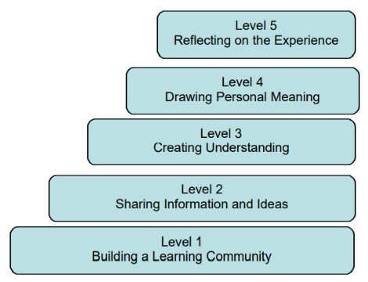
Smith's successive levels (2005)
Create discussions that, throughout the semester, move from Level 1 to Level 5

Slide 12
How do I design and facilitate effective discussions?
Share netiquette information
Post expectations
Learning objectives/purpose (btw, socialization is ok!)
Prompts
Prompts generating the greatest participation all shared two key characteristics, namely clear guidelines and the opportunity for everyone to have a unique response” (Paz Dennen, 2005, p. 139
"Prompts" can also include structure for responding, such as PQP
Deadlines
Assessment information
Connect to other course assessments/activities
Participate
Respond publicly in the threads
Respond privately via email
Respond to the whole group after discussion has closed
"[…] an instructor need not be a frequent contributor to an online discussion in order to have a presence” (Paz Dennen, 2005, p. 143)
Consider using the Groups tool
Notes:
“Design and facilitation must work together in order to ensure learner participation, which in turn will impact performance” (Paz Dennen, 2005, p. 129).
“The structure, or lack of structure, in a given assignment affected both how eager and apt students were to participate ” (Paz Dennen, 2005, p. 137).
“In cases where instructor expectations were not clear […] student participation floundered. Students did not know how much they were to contribute or what their messages should look like” (Paz Dennen, 2005, p. 139).
Using groups in discussions may be beneficial if it leads to more responses, as some literature suggests not getting a response can be demotivating at best or evoke feelings of wrongness or alienation at worst; “When a note is ignored some students develop the belief that their note was not valuable or helpful to the group discussion. Such beliefs may lead to feelings of disconnection and isolation; therefore validation from peers is critical in preventing or minimizing such feelings” (Phirangee, 2016, p. 27).

Slide 13
Using Groups can help discussions.
“If designed well, small discussion groups can: ·
Reduce the number of postings learners have to work through.
Add variety to the program.
Increase the value of participation (provide more input and feedback per learner).
Help lessen the isolation an online learner feels by creating a small network.
Promote learner-to-learner interaction with less reliance on the teacher."
Draper, 2015, p. 115

Slide 14
Project Zero's "Visible Thinking Routines"
Notes:
In addition to providing learners with expectations of quality and quantity, clear discussion instructions or prompts, when present, helped the students in these classes to complete their assignments with less stress” (Paz Dennen, 2005, p. 139).

Slide 16
Generic weekly post
Each week, you will comment on one of the following (your choice)....
One thing that you struggled with this week and/or would like more resources to learn about this topic. OR
One thing that was important for you to learn this week and how it is relevant to your career/other coursework/research/personal growth.
Notes:
This is one place where "must post first" is not always helpful.

Slide 17
How does group work support learner-learner interaction?
One resource: David Buck @Elon
What are our own experiences?

Slide 18
References
Buck, David. (2020). Collaborative Projects and Assignments. Collaborative Projects and Assignments - Center for Engaged Learning
Draper, D. C. (2015). Collaborative Instructional Strategies to Enhance knowledge Convergence. The American Journal of Distance Education (29)5, 109-125. DOI: 10.1080/08923647.2015.1023610
Goforth, Jennie. (2022) SoTL Showcase: Making Collaborative Projects Work. Elon University / Today at Elon / SoTL Showcase: Making Collaborative Projects Work
Moore, M. G., (1989). Editorial: Three Types of Interaction. The American Journal of Distance Education (3)2 p. 1-7. https://doi.org/10.1080/08923648909526659
Paz Dennen, V. (2005). From Message Posting to Learning Dialogues: Factors Affecting Learner Participation in Asynchronous Discussion. Distance Education (26)1, 127-148.

Slide 19
References, continued
Phirangee, K. (2016). Students’ Perceptions of Learner-Learner Interactions that Weaken a Sense of Community in an Online Learning Environment. Online Learning (20)4, p. 13-33).
Smith, Lyn. (2005). Promoting Learner-to-Learner Interaction in Online Distance Education. Making Distance Education Work: Understanding Learning and Learners At a Distance. chap10.pdf (learnerassociates.net)
Smyth, Robyn. (2011). Enhancing Learner-Learner Interaction Using Video Communications in Higher Education: Implications from Theorising About a New Model. British Journal of Educational Technology (42)1, 113-127.
Weimer, M. (2013). Student Recommendations for Encouraging Participation. Tips for Encouraging Student Participation in Classroom Discussions. Layout 2 (facultyfocus.com)

