Slide 1

Session 7:
Assessment and Feedback
Heather Rippetoe
Center for Innovation in Teaching and Learning

Slide 2

Assessment and Feedback
6. | Assessment and Feedback
44. | Course grading policies, including consequences of late submissions, are clearly stated in the course information area or syllabus.
45. | Course includes frequent and appropriate methods to assess learners’ mastery of content.
46. | Criteria for the assessment of a graded assignment are clearly articulated (rubrics, exemplary work).
47. | Learners have opportunities to review their performance and assess their own learning throughout the course (pre-tests, automated self-tests, reflective assignments, etc.).
48. | Learners are informed when a timed response is required. Proper lead time is provided to ensure there is an opportunity to prepare an accommodation.
49. | Learners have easy access to a well-designed and up-to-date gradebook.
50. | Learners have multiple opportunities to provide descriptive feedback on course design, course content, course experience, and ease of online technology.

Slide 3

Session 7 Agenda
Classroom Assessment Techniques (CATs)
CATs for instruction
How CATs benefit students
Digitizing CATs

Slide 4

What are CATs?
Who are the CATs gurus?
What do CATs assess?

Slide 5


Who are the CATs gurus?
Angelo & Cross (1993). Classroom Assessment Techniques: A Handbook for College Teachers, 2nd Edition.

Slide 6

What do CATS assess?
Course-related knowledge and skills
Learner attitudes, values, and self-awareness
Learner reactions to instruction
Learner reactions to class activities, assignments, and materials
Learner reactions to teachers and teaching
Notes:
“CATs come in many [99] forms, ranging from those aimed at assessing prior knowledge to understanding the level of mastery of such things as critical thinking, but all are designed to gather information about both the learner and the instructor and to provide feedback loops to both these parties” (Cross & Palese, 2015, p. 98-99).
“Instructors can select or modify the CAT depending on the information they need and to fit the context of their classroom” (Hanson & Florestano, 2020, p. 49). And what we need is information both on student learning and instruction methods.

Slide 7
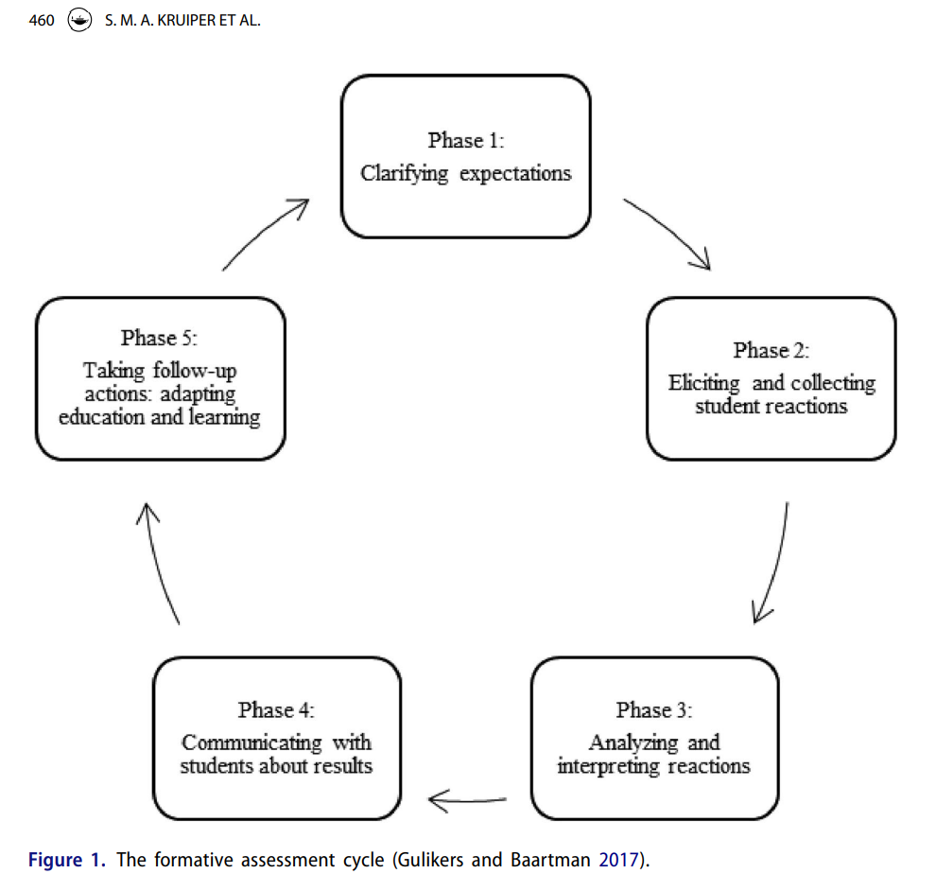
What's the CATs cycle?
Kruiper et al, 2022

Slide 8
Interesting notes ...
CATs are often “underutilized” (Hanson & Florestano, 2020, p. 49).
CATs help move from a teaching-centered to a student-centered classroom (Cross & Palese, 2015; Hanson & Florestano, 2020).

Slide 9

CATs for instruction
Why assess instruction?
Which CATs assess instruction?

Slide 10
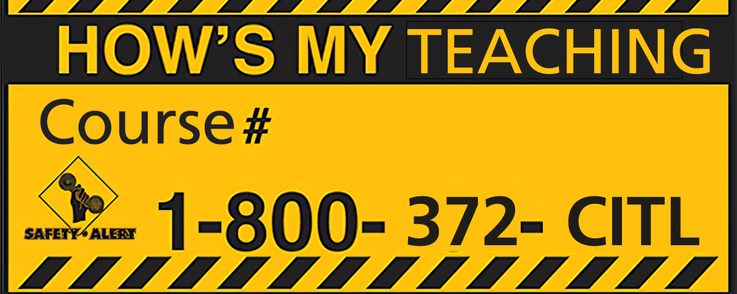
Notes:
Bumper sticker analogy made by Steadman 1998, qtd in Cross & Palese 2015.

Slide 11
Why assess instruction?
Increase faculty feedback literacy (Carless, 2022)
Inform course curriculum design (p. 54) - go ahead and work them in to your course schedule. Know when and which ones you will use throughout the semester.
Encourage effective teaching and reflection (p. 54) -- “CATs remind instructors that teaching is an ongoing process of inquiry, experimentation, and reflection.”
Improve classroom environment
Carless, 2022; Hanson & Florestano, 2020
Notes:
There is some literature noting that “feedback literacy” among faculty could be improved, particularly around how faculty seek, receive, and incorporate feedback from peers and others (Carless, 2022).

Slide 12

Which CATs assess instruction?
Learner reactions to instruction
Learner reactions to class activities, assignments, and materials
  Critical incident questionnaire (Brookfield)
  RSQC2
  Group work evaluations
  Reading rating sheets
  Assignment assessments
  Exam evaluations
Learner reactions to teachers and teaching
  Teacher-designed feedback forms (Angelo & Cross, 1993). See Forms A & B (Vanderbilt) for an example.
  The SGID
Notes:
Don't ask about what you can't/won't change.
Consider assigning points
Don't make more work for yourself.

Slide 13

How CATs benefit students
Why is it important to share results with students?
What does assessing instruction model for students?

Slide 14

What does assessing instruction model for students?
Encourages student-centered design (Angelo & Cross, 1993; Hanson & Florestano, 2020)
Demonstrates/models information gathering as professional development and opportunity improvement (Angelo & Cross, 1993, Marx, 2019)
Models process (Hanson & Florestano, 2020)
Provides just-in-time information for adaptation (Marx, 2019)

Slide 15

Digitizing CATs
How can we use iLearn for CATs?
How can we use Qualtrix for CATs?

Slide 16
References
Angelo, T.A. & Cross, K. P. (1993). Classroom Assessment Techniques: A Handbook for College Teachers. 2nd Ed. Jossey-Bass. Critical Incident Questionnaire — Stephen D. Brookfield (stephenbrookfield.com)
Brookfield, S. D. (n.d). Critical Incident Questionnaire. Critical Incident Questionnaire — Stephen D. Brookfield (stephenbrookfield.com)
Carless, D. (2022). Feedback Literacy for Academics. Feedback Literacy for Academics - Social Contexts and Policies of Education (SCAPE) (hku.hk)
Cross, T. & Palese, K. (2015). Increasing learning: Classroom assessment techniques in the online classroom. American Journal of Distance Education (29)2, 98-108, https://doi.org/10.1080/08923647.2015.1023594
Kruiper, S. M., Leenknecht, M. J., & Slof, B. (2022). Using scaffolding strategies to improve formative assessment practice in higher education. Assessment & Evaluation in Higher Education (47)3. 458-476. https://doi.org/10.1080/02602938.2021.1927981
Marx, R. (2019). Soliciting and utilizing mid-semester feedback. Vanderbilt University Center for Teaching. https://cft.vanderbilt.edu/guides-sub-pages/student-feedback/

