Slide 1

Session 2:
Course Overview and Information
Taylor Chesson
Instructional Design Specialist
Center for Innovation in Teaching and Learning

Slide 2
Course Overview and Information
1. | Course Overview and Information
1. | Course includes Welcome and Getting Started content.
2. | An orientation or overview is provided for the course overall, as well as in each module. Learners know how to navigate and what tasks are due.
3. | Course includes a Course Information area that deconstructs the syllabus for learners in a clear and navigable way.
4. | A printable syllabus is available for learners (PDF, HTML)
5. | Course includes links to relevant campus policies on plagiarism, computer use, filing grievances, accommodating disabilities, etc.
6. | Course provides access to learner success resources (technical help, orientation, tutoring).
7. | Course information states whether the course is fully online, blended, or web-enhanced.
8. | Appropriate methods and devices for accessing and participating in the course are communicated (mobile, publisher websites, secure content, pop-ups, browser issue, microphone, webcam).
9. | Course objectives/outcomes are clearly defined, measurable, and aligned to learning activities and assessments.
10. | Course provides contact information for instructor, department, and program.

Slide 3

Session 2 Agenda
Introduction Announcement
Welcome Video
Course Information
Syllabus

Slide 4

Introduction Announcement
What do I include in an introduction announcement?
How do I format it so students want to read it?

Slide 5
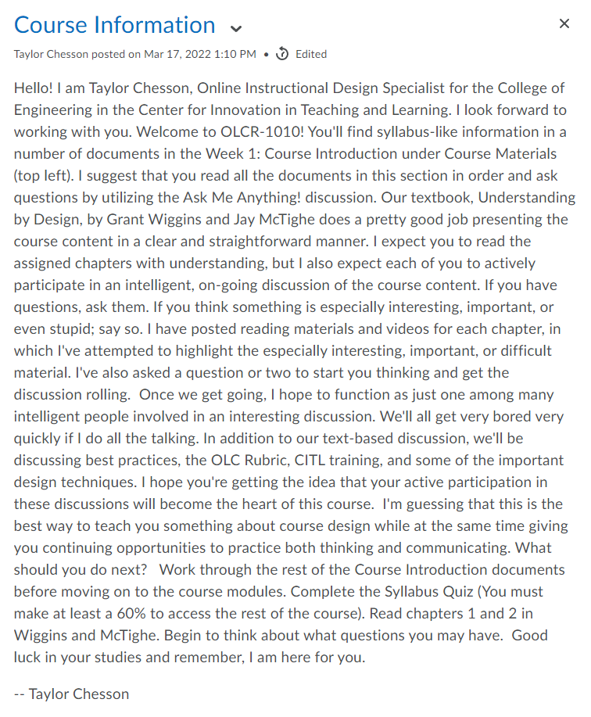
Welcome Announcement:
Bad Example
Turn and Talk
With a neighbor, discuss the following:
What is wrong with the announcement?
What would you do to fix it?

Slide 6
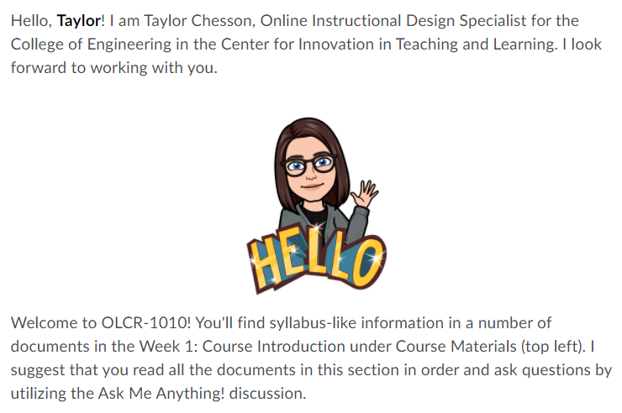
Introduction Announcement
{firstname}
Search for natural breaks in the text.
Insert Images

Slide 7
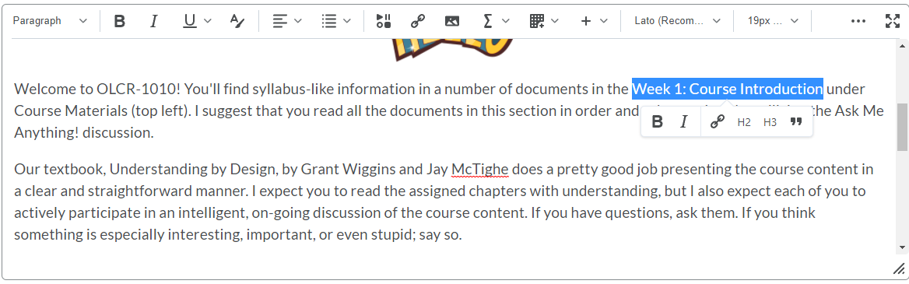
Hyperlink to Course Contents

Slide 8
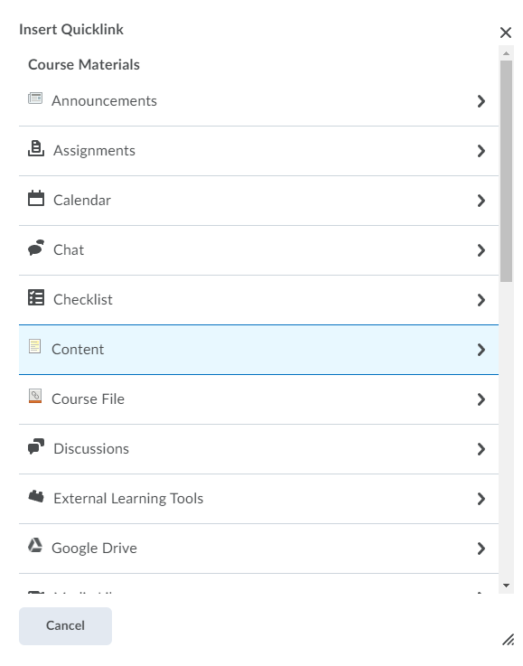
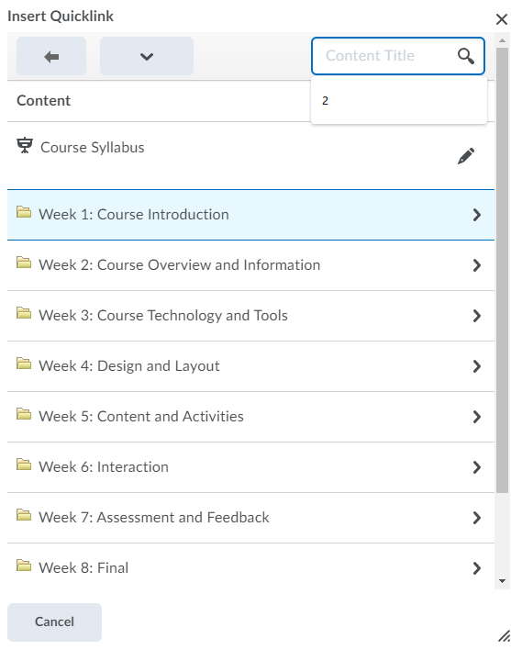
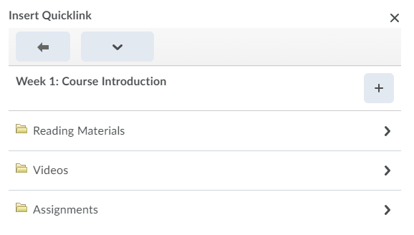
Hyperlink to Course Contents

Slide 9
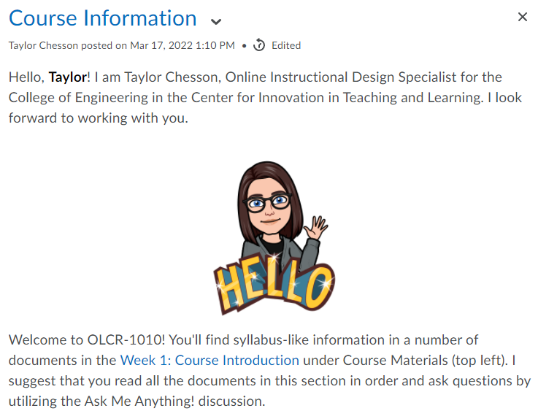
Hyperlink to Course Contents

Slide 10

Welcome Video
What information do I include in an introductory video?
Why do I need to have an introductory video for an in-person class?

Slide 11

Video Tips
Short and Engaging
Relaxed Body Language
  Smile
  Eye Contact
  Natural Hand Gestures
Script
  Ohio State University
  TTU CITL Example
Notes:
Short and Engaging: Remember, you want to motivate your students and not overload them with too much information. Short and concise is best. Try to make your videos no longer than ten minutes.
Relax: Show your personality and speak naturally. You should talk about why you enjoy the subject matter and include a little about your professional experience.
The video does not have to be perfect.
You can stumble over your words and correct yourself. It is simply a way for students to see you.
You do not have perfect speech in class, so you do not have to have a perfect edited video.
Body Language
Remember to smile!
Make eye contact with the camera, not your computer screen.
There are times I was looking down in the video (because I was reading a script), but try to make eye contact throughout most of the video.
Use natural hand gestures like you would when talking in person with someone.
Consider using a script

Slide 12
What to Include in Script
  Instructor Introduction
    Welcome!
    Introduce yourself, your title, and field of expertise
    Personal Information
  Course Introduction
    Course name and how it falls in the program curriculum
    Importance and relevance for students
    Expectations for participation and assignment submission
Notes:
Consider creating a script
Instructor Introduction
Welcome!
Introduce yourself, your title, and field of expertise (educational & work background)
Personal Information (family information, hobbies, etc.)
Course Introduction
Course name and how it falls in the program curriculum
Importance and relevance for students
Expectations for participation and assignment submission
Script Writing Help:
Ohio State University
My Video Script

Slide 13

Why?
Introduces students
to you
States course purpose
and objectives
Helps orient students
to course layout
Notes:
What are some things you notice about this video that make it a good example? Video, lighting, pacing, etc. (Stop at 1:10)

Slide 14

Module Introduction Videos
Sparks the interest of students
States module objectives and assignments for the week
Offers “face time” in online courses

Slide 15

Course Information
Why do I need a separate section for course information?
What do I include in Course Information?

Slide 16
Why Do I Need a Separate Intro Section?
Define the instructor’s role and responsibility to learners.
Explain the roles and responsibilities of the learners.
Provide clear learning objectives/outcomes.
Establish course expectations and plans for evaluation, assessment, and feedback.
Describe course activities and familiarize learners with how the course functions.
Provide information on how, when, and where course communications and interactions with the instructor and between learners will take place.
OLC 1.3
Notes:
Simunich, Robins, and Kelly (2015) found that courses with high levels of findability, based on careful development and placement of course information materials, have a direct impact on learner perceptions of course quality, experience, and successful learning outcomes.
Creating an area in the course for Course Information/Syllabus materials, provides the opportunity to present course information into well-labeled smaller chunks of information for the learners to easily access and review. The intent is to enable learners to find varied, discrete course information details easily and quickly with a scan of document heads and subheads, or one or two clicks, rather than having the information buried in obscure nested folders/documents, or a convoluted and lengthy syllabus .pdf.

Slide 17
Unit 0: Course Information
Course Welcome
Instructor Contact Information and Office Hours
Instructor Expectations
Schedule and Due Dates
Required Texts and Associated Materials
Learning Activity Overview
Interaction Guidelines
Grading and Assignment Rubrics
Campus Policies and Resources
Strategies for Success
Ask a Question
(Open Discussion Forum)
Resources:
OLC 1.3
Examples
Notes:
Simunich, Robins, and Kelly (2015) found that courses with high levels of findability, based on careful development and placement of course information materials, have a direct impact on learner perceptions of course quality, experience, and successful learning outcomes.
Creating an area in the course for Course Information/Syllabus materials, provides the opportunity to present course information into well-labeled smaller chunks of information for the learners to easily access and review. The intent is to enable learners to find varied, discrete course information details easily and quickly with a scan of document heads and subheads, or one or two clicks, rather than having the information buried in obscure nested folders/documents, or a convoluted and lengthy syllabus .pdf.

Slide 18
Unit 0: Course Information (Action Titles)
Welcome to (list the course name and number)
Get to Know Your Instructor
Learn What I Expect from You, and What You Can Expect From Me
Go through the Course Schedule
Review Required Texts and Associated Materials
Discover How to Communicate and Interact in this Course
Explore Campus Policies and Resources
Understand How to Succeed in this Course
Ask a Question (Open Discussion Forum)
Resources:
OLC 1.3
Examples
Notes:
Simunich, Robins, and Kelly (2015) found that courses with high levels of findability, based on careful development and placement of course information materials, have a direct impact on learner perceptions of course quality, experience, and successful learning outcomes.
Creating an area in the course for Course Information/Syllabus materials, provides the opportunity to present course information into well-labeled smaller chunks of information for the learners to easily access and review. The intent is to enable learners to find varied, discrete course information details easily and quickly with a scan of document heads and subheads, or one or two clicks, rather than having the information buried in obscure nested folders/documents, or a convoluted and lengthy syllabus .pdf.

Slide 19

Syllabus
What do I include in my syllabus?
How can I make my syllabus accessible?

Slide 20

What do I include in my syllabus?
TTU Course Syllabus Requirements
TTU Course Syllabus Information Guide
TTU Course Syllabus Template
Resources:
CITL
Provost

Slide 21
How can I make my syllabus accessible?
Accessible Education Center
Accessibility Resources

