Slide 1
Active Learning & Flipped Classroom
Taylor Chesson
Instructional Designer

Slide 2
Active
Learning

Slide 3
Active Learning is an umbrella term for learning tasks that require students to engage deeply with the course material.
Source: Bonwell and Eison
Notes:
Instructional activities involving students in doing things and thinking about what they are doing
This helps deepen understanding and transfer of information to other courses.

Slide 4
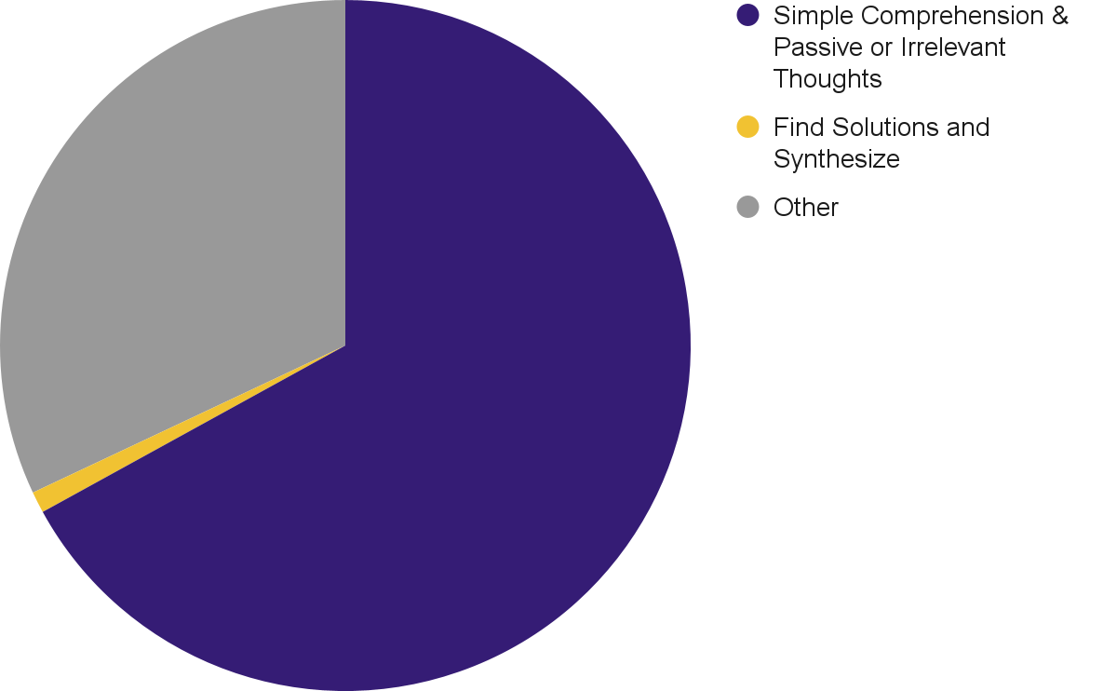
Why Not Just Lecture?
Good for
  Memorizing Facts
  Keeping with Tradition
  Sharing Information Quickly
Not good for
  Critical Thinking
  Fostering higher-level thinking
  Problem Solving
67%
1%
Source
Notes:
Research shows that lectures are not effective for fostering higher level thinking.
In fact, one study found 67% of students thoughts during a lecture were either related to simple comprehension of the subject, passive thoughts about the subject, or even irrelevant thoughts.
The study also indicated that during lectures, the learners' thoughts involved attempting to find solutions to problems or synthesize the subject matter only 1% of the time.

Slide 5
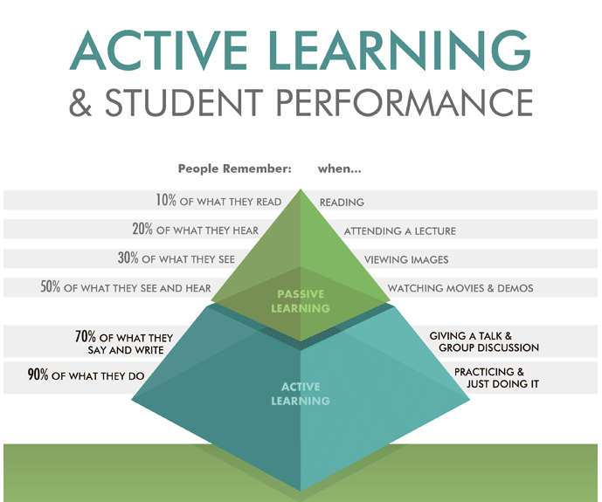
Source: Falcon

Slide 6
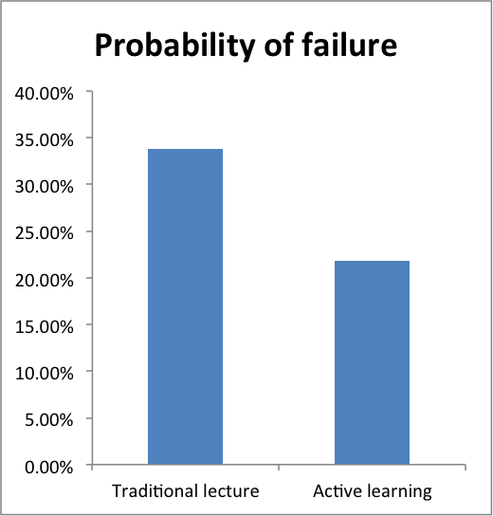
Why make the switch?
Increases Student
  Participation
  Engagement
  Retention
  Ownership in the Course
  Higher Level Thinking Skills
Decreases
  Lecture Time by Instructor
  Passive Learning
  Course Failure
Source
Notes:
In a study of 225 studies of meta-analysis, it was found that undergraduate students in classes with traditional stand and deliver lectures were 1.5 times more likely to fail than students in classes that use active learning techniques.

Slide 7

Retrieval Practice
Intersperse Active Learning and Explicit Instruction (Direct Instruction)
Initial Learning
Retrieval
Retrieval
Retrieval
Source:
Oakley et al
Notes:
Uncommon Sense Teaching: Practical Insights in Bran Science to Help Students Learn
Retrieval Practice: Pause for two or three minutes every 15 minutes, having students write everything they can remember from preceding class segment. Encourage questions. This approach prompts students to retrieve information from memory, which improves long term memory, ability to learn subsequent material, and ability to translate information to new domains.

Slide 8
50 Minute Lecture
Reflection or Thinking Activity
(5 min.)
Introduce New Topic or Revisit Previous Topic (10-15 min.)
Group Discussion or Application Activity (10-15 min.)
Introduce New Topic
(10-15 min.)
75 Minute Lecture:
In-Depth Group Activity
(15-20 min.)
Reflection Activity
(5 min.)
Notes:
Integrating Active Learning

Slide 9
Active Learning Strategies
Polling
Think-Pair-Share
Minute Paper
Small Group Discussions
Short Student Presentations
Source

Slide 10
Active Learning Strategies
Quick, easy formative assessment
Low Prep Time (<15 min.)
Things to consider:
  What information would you like from your students in real time?
  How will you use the poll results?
Possibles ways to use:
  Ice Breaker
  Check Background Knowledge
  Assess Opinion
  Pre- & Post- Assessment
  Course Feedback
Resources:
  Poll Everywhere
  Qualtrics
Polling
Think-Pair-Share
Minute Paper
Small Group Discussions
Short Student Presentations
Notes:
https://ctl.columbia.edu/resources-and-technology/teaching-with-technology/teaching-online/active-learning/

Slide 11
Active Learning Strategies
Think through the problem individually.
Pair with a partner to discuss.
Share findings with rest of class.
Low Prep Time (<15 min.)
Gives students the opportunity to:
  Process Information
  Apply Knowledge and Skills
  Consult & Collaborate with peers
Resources:
  Teams Break Out Rooms
  Teams Chat / Share Screen
Alternatives:
  Think, Pair, Repair
  Three-Step Interview
Polling
Think-Pair-Share
Minute Paper
Small Group Discussions
Short Student Presentations
Notes:
https://ctl.columbia.edu/resources-and-technology/teaching-with-technology/teaching-online/active-learning/
Three-Step Interview: Students work in pairs and take turns interviewing each other, and report what they learn to another pair.

Slide 12
Active Learning Strategies
Low Prep Time (<15 min.)
How to Implement:
  Write an open-ended prompt that students can respond to in <5 min.
  Activate poll or share link
  Give students 5 min. to respond.
  Discuss at end of class or beginning of next class.
Resources:
  iLearn Discussion Posts
  Microsoft Forms
  Poll Everywhere
Alternatives
  Muddiest / Clearest Point
  Ask a Question / Answer a Question
Polling
Think-Pair-Share
Minute Paper
Small Group Discussions
Short Student Presentations

Slide 13
Active Learning Strategies
Moderate Prep Time (15-60 min.)
How to Implement:
  Based on Learning Obj., develop a discussion prompt to assign
  Include Clear Instructions
  (group size, duration, expectations, etc.)
  Assign Roles
  (facilitator, timekeeper, notetaker, etc.)
  Allow time for Discussion
  Share Findings with class
Resources:
  Teams (Chat, Breakout Rooms, Share Screen)
  Microsoft Shared Documents
Alternatives
  Jigsaw
  Group Quizzes
Polling
Think-Pair-Share
Minute Paper
Small Group Discussions
Short Student Presentations
Notes:
Jigsaw: Students work in small groups. Each group becomes an expert in a different topic. New groups are formed, comprising at least one expert on each topic. In these new groups, each student teaches their peers the topic they became an expert on.

Slide 14
Active Learning Strategies
Moderate Prep Time (15-60 min.)
Allows students to
  Synthesize & Communicate Knowledge
  Link learning with own interests
  Learn from peers
How to Implement
  Identify Learning Obj.
  Assign Student Presentations
  Provide Specific Instructions
  Give Preliminary Feedback
  Set Clear Expectations for Audience
  Have Students Reflect on Learning
Alternatives:
  Book Club
  Student Group Presentations
Polling
Think-Pair-Share
Minute Paper
Small Group Discussions
Short Student Presentations
Notes:
FlipGrid? Walking through a problem - doesn’t take class time.

Slide 15

Flipped
Classroom

Slide 16
Students are introduced to content at home and practice working through it in class.
Source

Slide 17
10 Tips for Flipping
Rethink the Course
Use Backwards Design
Map Content
Rethink Your Assessments
Emphasize Engagement
Decide What Goes Where
Emphasize Community
Record Your Lectures
Schedule Everything
Take a Closer Look
Source

Slide 18
10 Tips for Flipping
Rethink the Course
Use Backwards Design
Map Content
Rethink Your Assessments
Emphasize Engagement
Don’t just move everything online
Reinvent Course
Increases
  Engagement
  Interaction

Slide 19
10 Tips for Flipping
Rethink the Course
Use Backwards Design
Map Content
Rethink Your Assessments
Emphasize Engagement
Begin with the end in mind.
Learning Outcomes
What do I want my students to know or be able to do at the end of this course, module, lecture, or class meeting?
Assessments
How will I know that students have learned these things?
Active Engagement
What are the best and most interesting ways to teach things?

Slide 20
10 Tips for Flipping
Rethink the Course
Use Backwards Design
Map Content
Rethink Your Assessments
Emphasize Engagement
Chunk content into subtopics
Classify and prioritize course content.
Efficiently group content
Organize your information
Use Concept Map
  Venn Diagram
  Flowchart
  T-Chart

Slide 21
10 Tips for Flipping
Rethink the Course
Use Backwards Design
Map Content
Rethink Your Assessments
Emphasize Engagement
Let students show what they know.
Multimodal
(diagram, infographics, comics, videos, podcasts, interviews)
Writing
(blogs, wikis, journals, articles, reviews)
Action
(Go and Report, perform, peer teach)

Slide 22
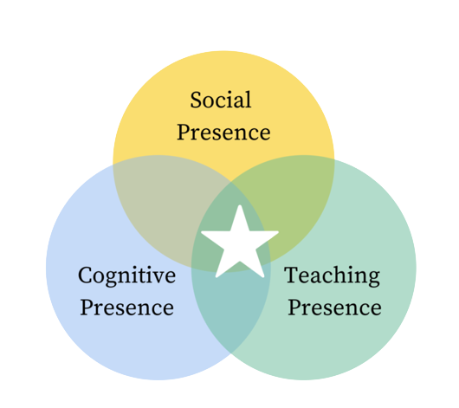
10 Tips for Flipping
Rethink the Course
Use Backwards Design
Map Content
Rethink Your Assessments
Emphasize Engagement
Make it a meaningful learning experience instead of students just going through the motions.
Turn teaching into learning
Community of Inquiry Model

Slide 23
Community of
Inquiry Model
 | What? | How?
Social Presence | The ability to assert one’s beliefs, feelings, and personality to establish relationships, trust, and open communication on and offline. | Build community with activities and icebreakers, encourage respectful discussion on and offline, and give learners time to work collaboratively on shared tasks.
Cognitive Presence | The ability to construct meaning through a combination of individual experience and reflection then social negotiation and collaborative constructivism. | Teach students how to work through the practical inquiry model-triggering event, exploration, integration, and resolution.
Teaching Presence | The ability to design, facilitate, and direct the social and cognitive presence to achieve high-quality learning outcomes for students. | Design online and offline learning to engage students in collaborative constructivism. Facilitate relationship building and provide individualized support. Guide the learning happening both on and offline.
Video Clip
Source

Slide 24
10 Tips for Flipping
Decide What Goes Where
Emphasize Community
Record Your Lectures
Schedule Everything
Take a Closer Look
What must be done in person?
Where do students
  struggle?
  fail?
  act bored?
Balancing Online & In-Class Activities
  Online
  (watching lecture videos, writing, project work)
  In-Person
  (teamwork, practicing, playing challenge games)

Slide 25
What students do…
Watch an online lecture
Review online course material
Read physical or digital texts
Participate in an online discussion
Perform research
Before Class
Skill practice (guided or unguided by the teacher)
In-person, face-to-face discussion with peers
Debate
Presentations
Station learning
Lab experiments
Peer assessment and review
During Class

Slide 26
10 Tips for Flipping
Decide What Goes Where
Emphasize Community
Record Your Lectures
Schedule Everything
Take a Closer Look
What are my students doing?
How are they connecting?

Slide 27
10 Tips for Flipping
Decide What Goes Where
Emphasize Community
Record Your Lectures
Schedule Everything
Take a Closer Look
Online work makes class time more productive
Mini lectures - one concept/idea
Pre-work before coming to class
Make mini lectures short (5-15 min.)
Doesn’t have to be perfect!
Use other resources
(LinkedIn Learning, SolidProfessor, etc.)

Slide 28
10 Tips for Flipping
Decide What Goes Where
Emphasize Community
Record Your Lectures
Schedule Everything
Take a Closer Look
Put everything in the syllabus
Include week-by-week plan *
  Both in-person and online plans
  Give time estimates
Show every due date and assignment
* If you are using iLearn, you can have all of your materials, assignments, etc. mapped out and use release conditions to pace student access.

Slide 29
10 Tips for Flipping
Decide What Goes Where
Emphasize Community
Record Your Lectures
Schedule Everything
Take a Closer Look
Use OLC Rubric as a checklist
Think like a student
Reread Instructions
Rubrics
  Save time
  Make grading easier

Slide 30
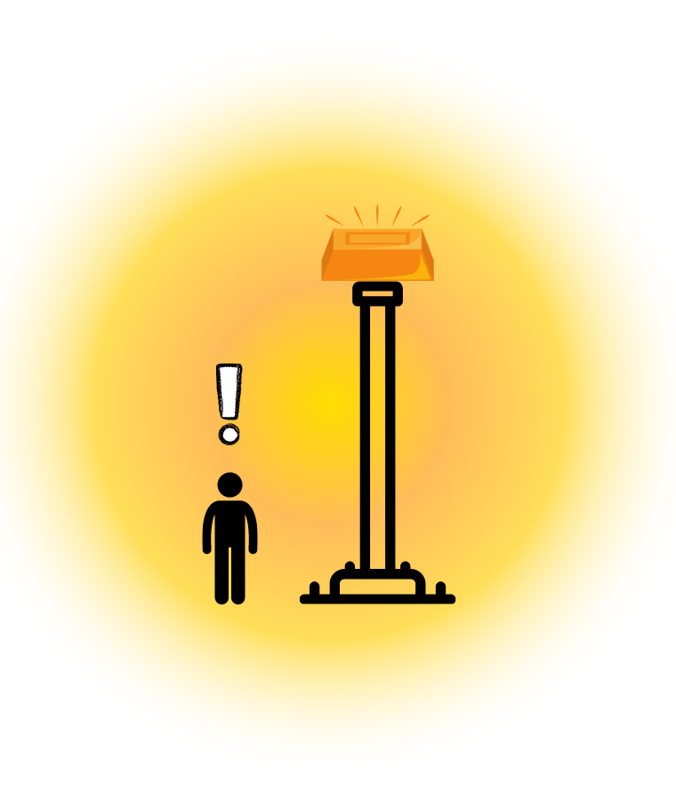

Scaffolding Instruction
Notes:
ZPD is defined as the range of tasks that a child can perform with help and guidance of others but cannot yet form independently.

Slide 31
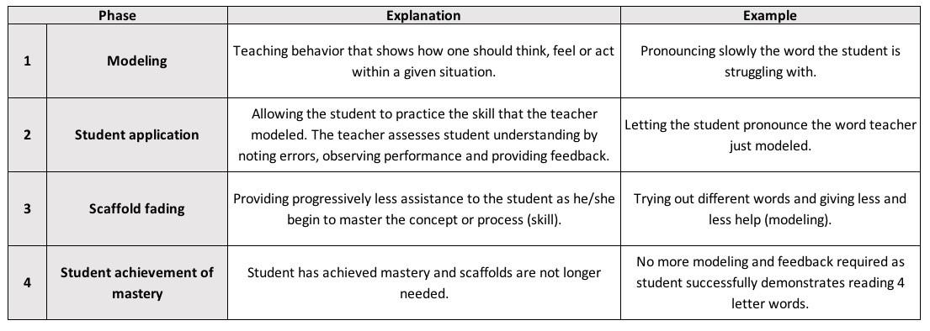
Scaffolding
Instructor works a problem/equation and “thinks aloud” through the steps.
Let the students practice the problem the teacher just modeled.
Students try out similar problems and teacher provides less and less help.
No more modeling and feedback required as student successfully demonstrates solving equations.
Source

Slide 32
Flipped Classroom
Benefits:
More engaged learning experience
Opportunities to teach and clarify
Self-directed learning experience
More choice = More equity for students
Improved access to content
Challenges:
Significant front end work by the instructor.
Equal support for all
Not engaging for all students
Plan ahead, pre-record, and stay organized

Slide 33
Sources
Active Learning:
“Active Learning for Your Online Classroom: Five Strategies Using Zoom.” Columbia University. (n.d), Web Address. Accessed 1 Mar. 2022.
Brame, C. (2016). Active learning. Vanderbilt University Center for Teaching. (n.d.), Web Address. Accessed 1 Mar. 2022.
Oakley, Beth, Rogowsky, Beth, and Sejnowski, Terrence J. Uncommon Sense Teaching : Practical Insights in Brain Science to Help Students Learn. 2021. Print.
Flipped Classroom:
Khare, Kriti. “Contextualizing Learning Using Scaffolding.” Medium. 27 Feb. 2018, Web Address. Accessed Mar. 3 2022.
Tucker, Catlin. “Developing a Community of Inquiry in Your Blended Classroom.” Dr. Catlin Tucker. 23 July 2019, Web Address. Accessed 2 Mar. 2022.
Wolf, Ava. “Tips for Transitioning to a Blended Course.” University of Illinois Urbana-Champaign. 15 Sept. 2020, Web Address. Accessed 2 Mar. 2022.

