Slide 1
Mathematical Tools in Online Environments
Taylor Chesson
Instructional Designer

Slide 2
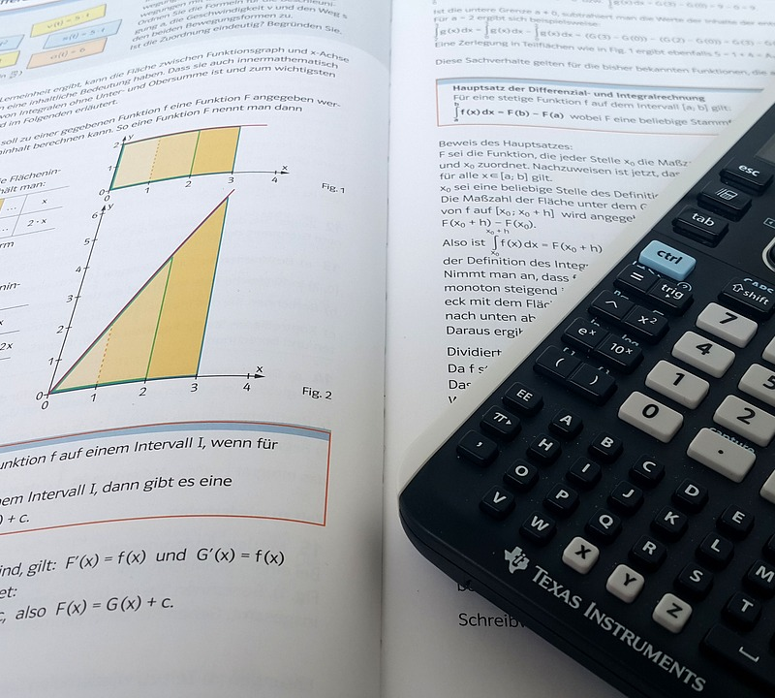
Tools:
Arithmetic Problems in iLearn
Mathpix.com
Using LaTex in iLearn

Slide 3
Arithmetic Problems in iLearn
1
2+2 Questions in Quizzes

Slide 4
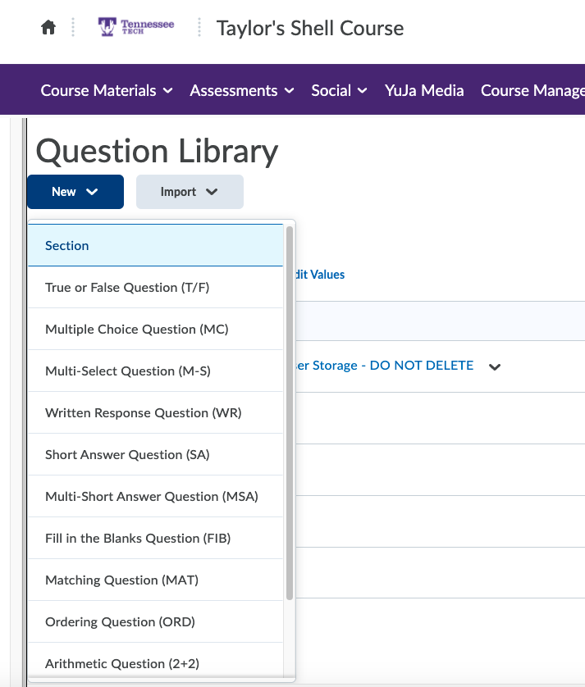
Assessments
>
Quizzes
>
Question Library
>
New
>
Arithmetic Question
2+2
iLearn
Arithmetic Problems in iLearn

Slide 5
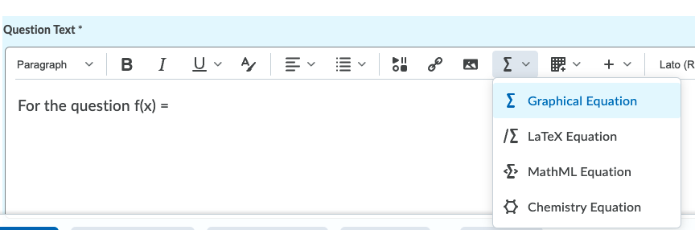
1 variable
Graphical Equation
Arithmetic Problems in iLearn
Notes:
Instructors can also use LaTeX or <E> Math ML (HTML for Math / Math Mark Up Language)

Slide 6
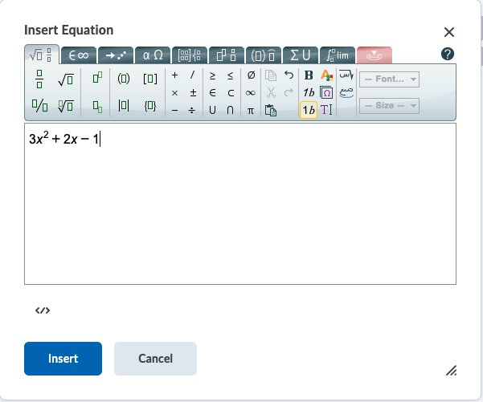
Graphical Equation
Arithmetic Problems in iLearn
Notes:
Lots of equation types on tabs. Most frequently used are on first page.

Slide 7
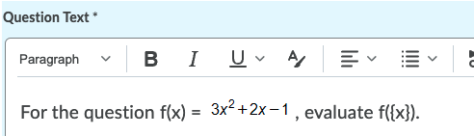
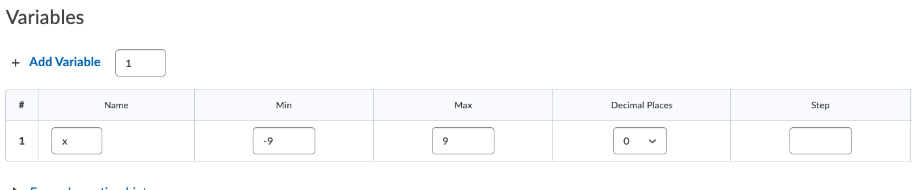
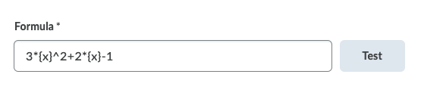
1 variable
Make sure your variables are in braces.
3*{x}^2+2*{x}-1
Formula Sheet 1 | Formula Sheet 2
Arithmetic Problems in iLearn
Notes:
If you need to edit it your graphical equation, you will need to click on it, then go back to E > Graphical Equation.
Variables (decimal places and steps)
Formula- https://documentation.brightspace.com/EN/le/question_library/instructor/create_arithmetic.htm

Slide 8
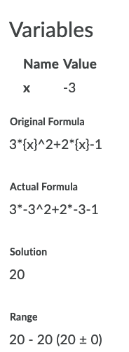
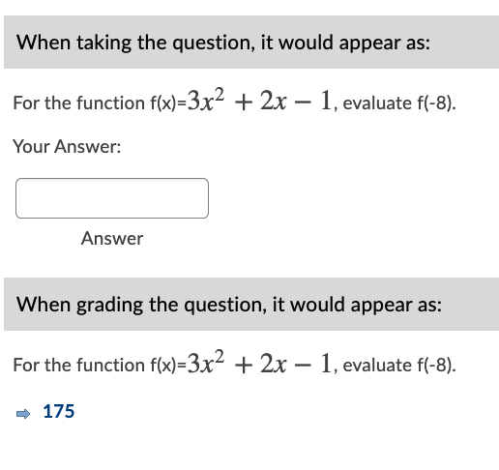
1 variable
Test:
Preview:
Arithmetic Problems in iLearn

Slide 9
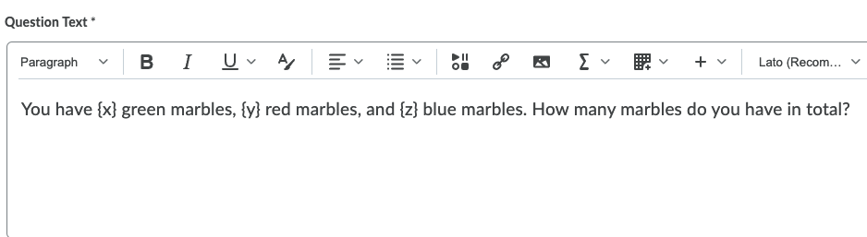
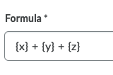
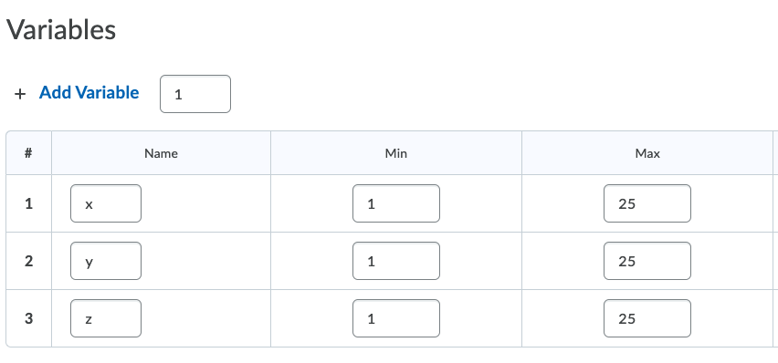
2+ variable
(Easy)
Make sure your variables are in braces.
Arithmetic Problems in iLearn

Slide 10
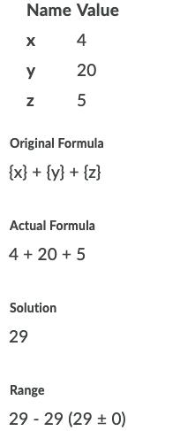
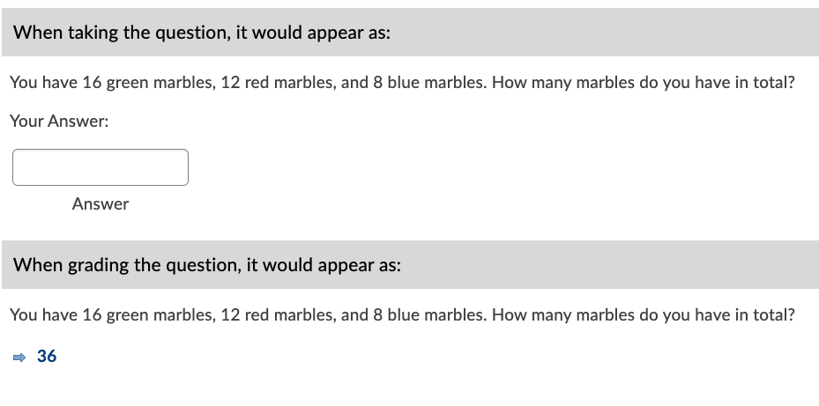
2+ variable
(Easy)
Test:
Preview:
Arithmetic Problems in iLearn

Slide 11
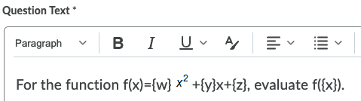
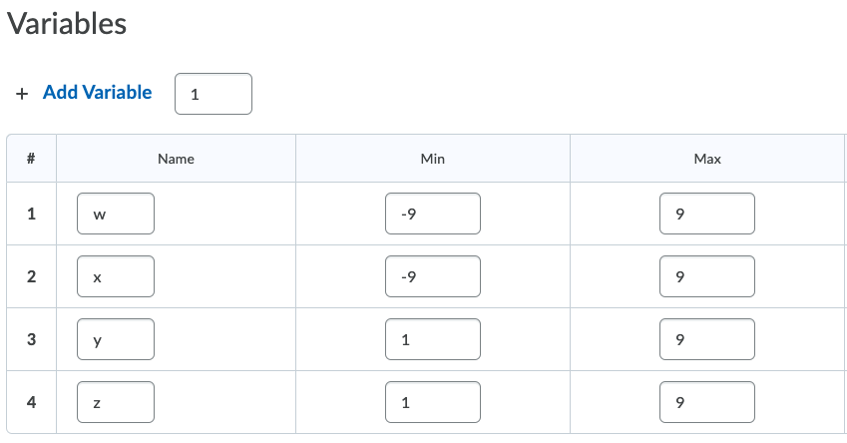

2+ variable
(Med.)
1 Variable:
For the question
f(x) = 3x²+2x-1,
evaluate f(x).
Make sure your variables are in braces.
{w}*{x}^2+{y}*{x}-{z}
Arithmetic Problems in iLearn
Notes:
Y and Z are all positive numbers in my example, so it doesn’t say +-8. You can have a communication with students about those types of problems if you want to include negative numbers in the range.

Slide 12
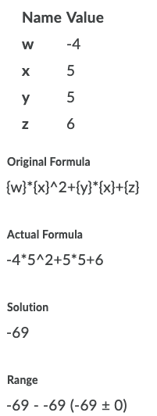
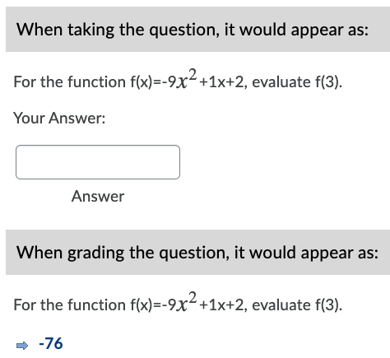
2+ variable
(Med.)
Test:
Preview:
Arithmetic Problems in iLearn

Slide 13
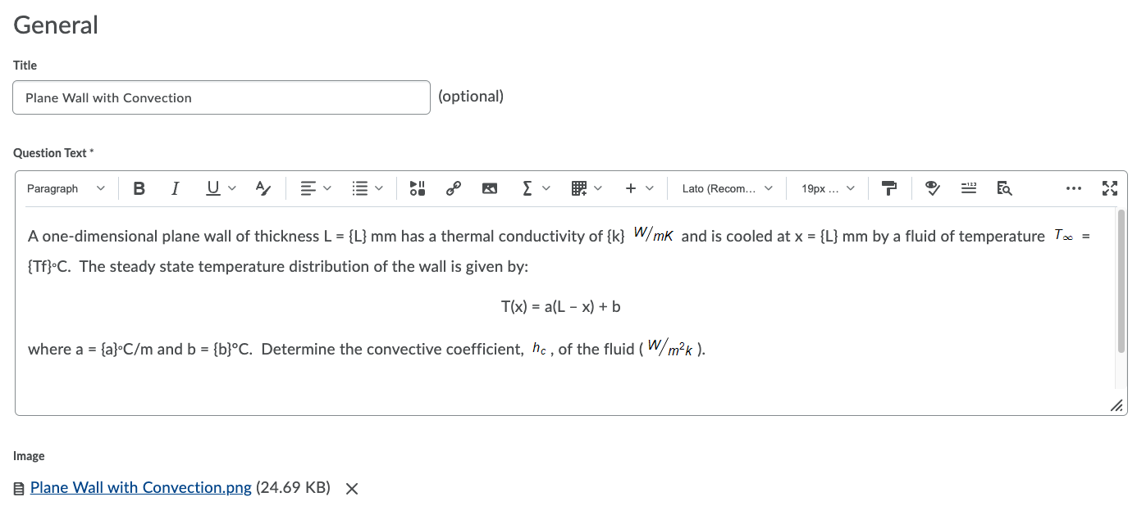
2+ variable
(Hard)
Notes:
Heat Transfer Example
Rich Text Editor
Picture
Do not name the image (alt text) whatever the answer is
You can also attach it or insert it straight into the problem.

Slide 14
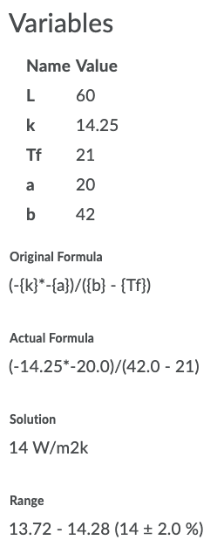
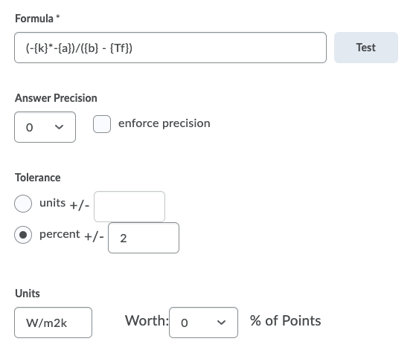
2+ variable
(Hard)
Notes:
Heat Transfer Example
Percent changes the range
Units have to be precise
Case Sensitive and Insensitive Available
Student Ownership- Go back and add points
Answer Precision= Acceptable Decimal
Enforce it to make sure they have that amount of decimals and it is marked as correct/incorrect.

Slide 15
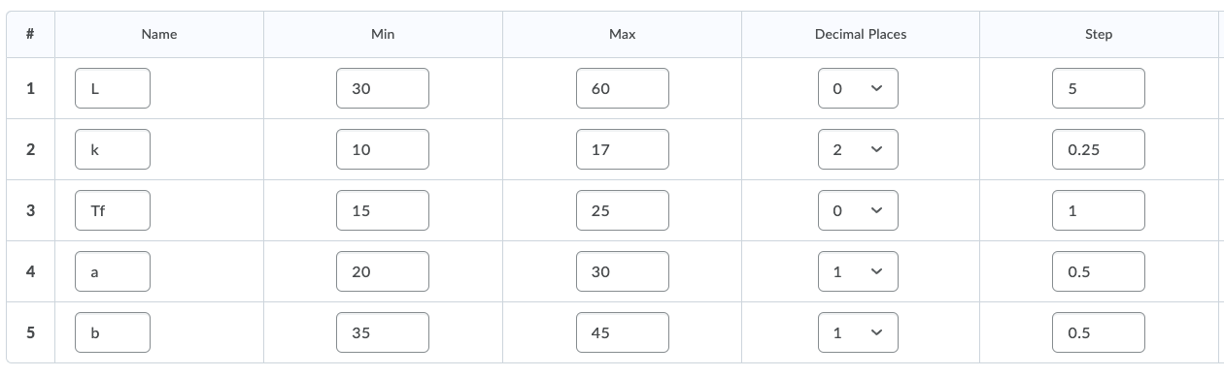
2+ variable
(Hard)
Variables:
Arithmetic Problems in iLearn
Notes:
Heat Transfer Example
Steps and Decimal Places

Slide 16
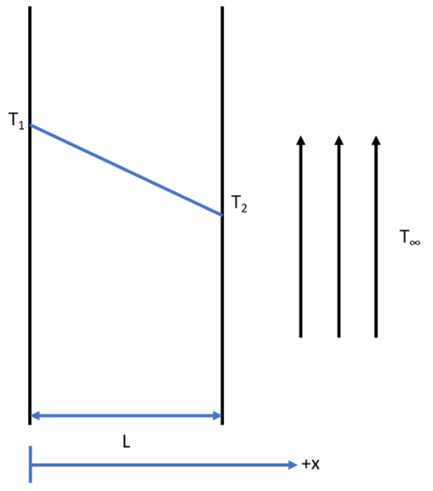
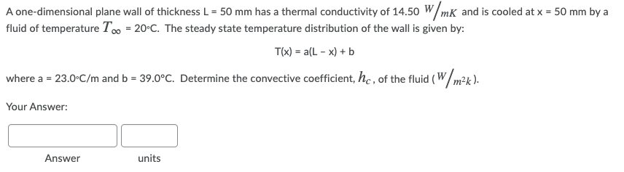
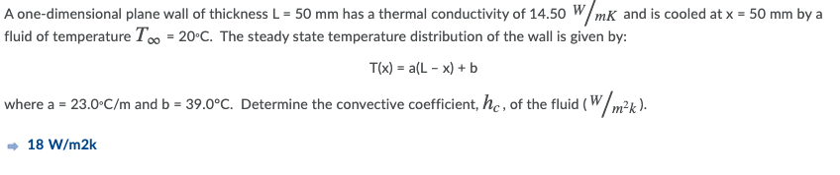
2+ variable
(Hard)
Preview:
Arithmetic Problems in iLearn
Notes:
Heat Transfer Example
Graphical Equations
Practice Problems-
Some other ways to implement this would be to have just a few practice problems that are not tied to a grade available on you iLearn page where they have unlimited tries. Every time, they will get a new problem to practice with with helps with retaining information.

Slide 17
Mathpix.com
2
Mathpix Snips

Slide 18
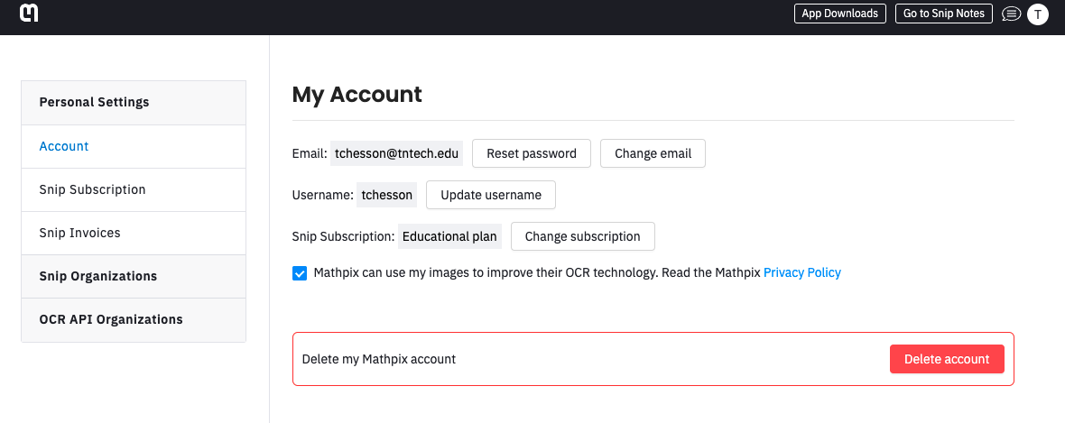



MathPix
Notes:
Not supported by TNTech – for password reset, help, etc., you will need to contact MathPix Support

Slide 19
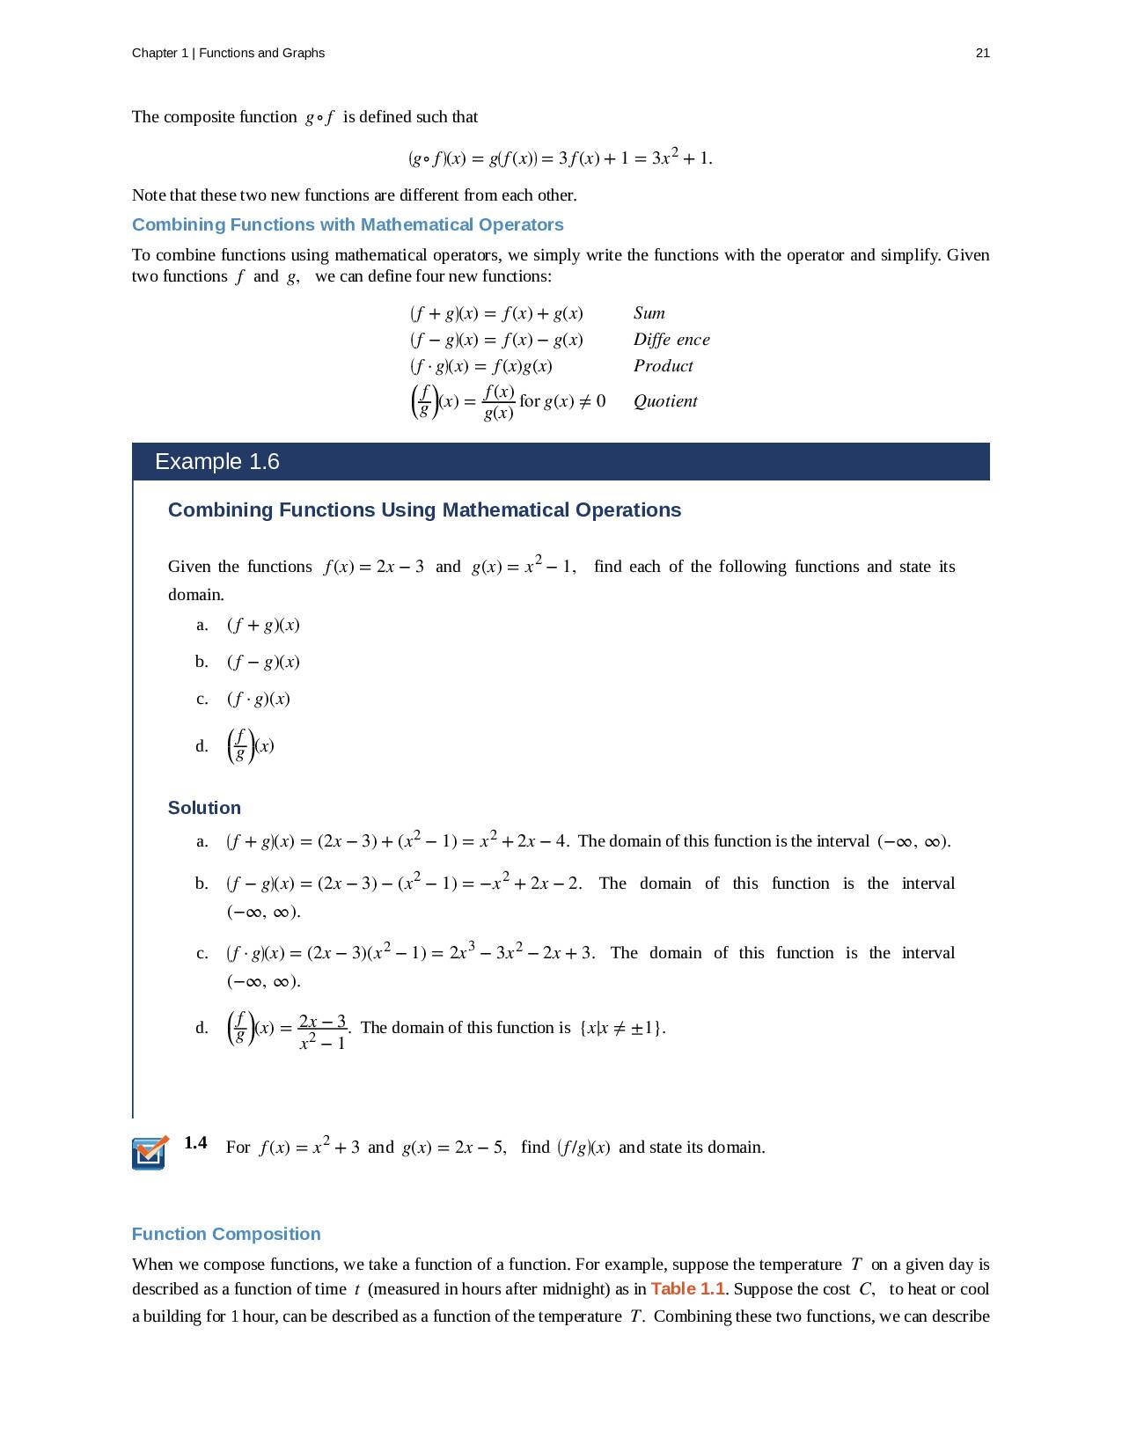
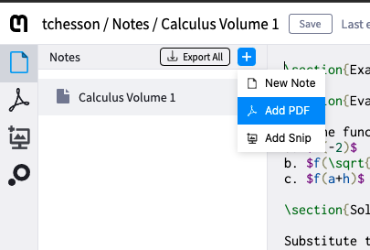
MathPix
Adding PDFs

Slide 20
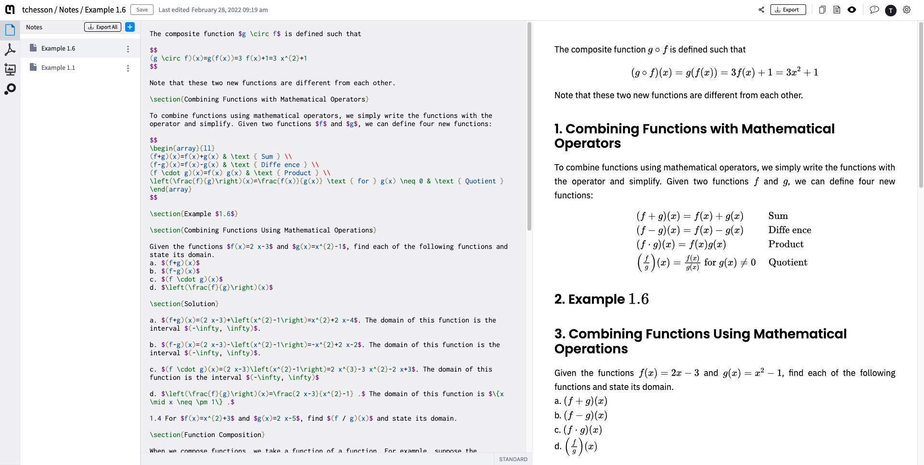
MathPix

Slide 21
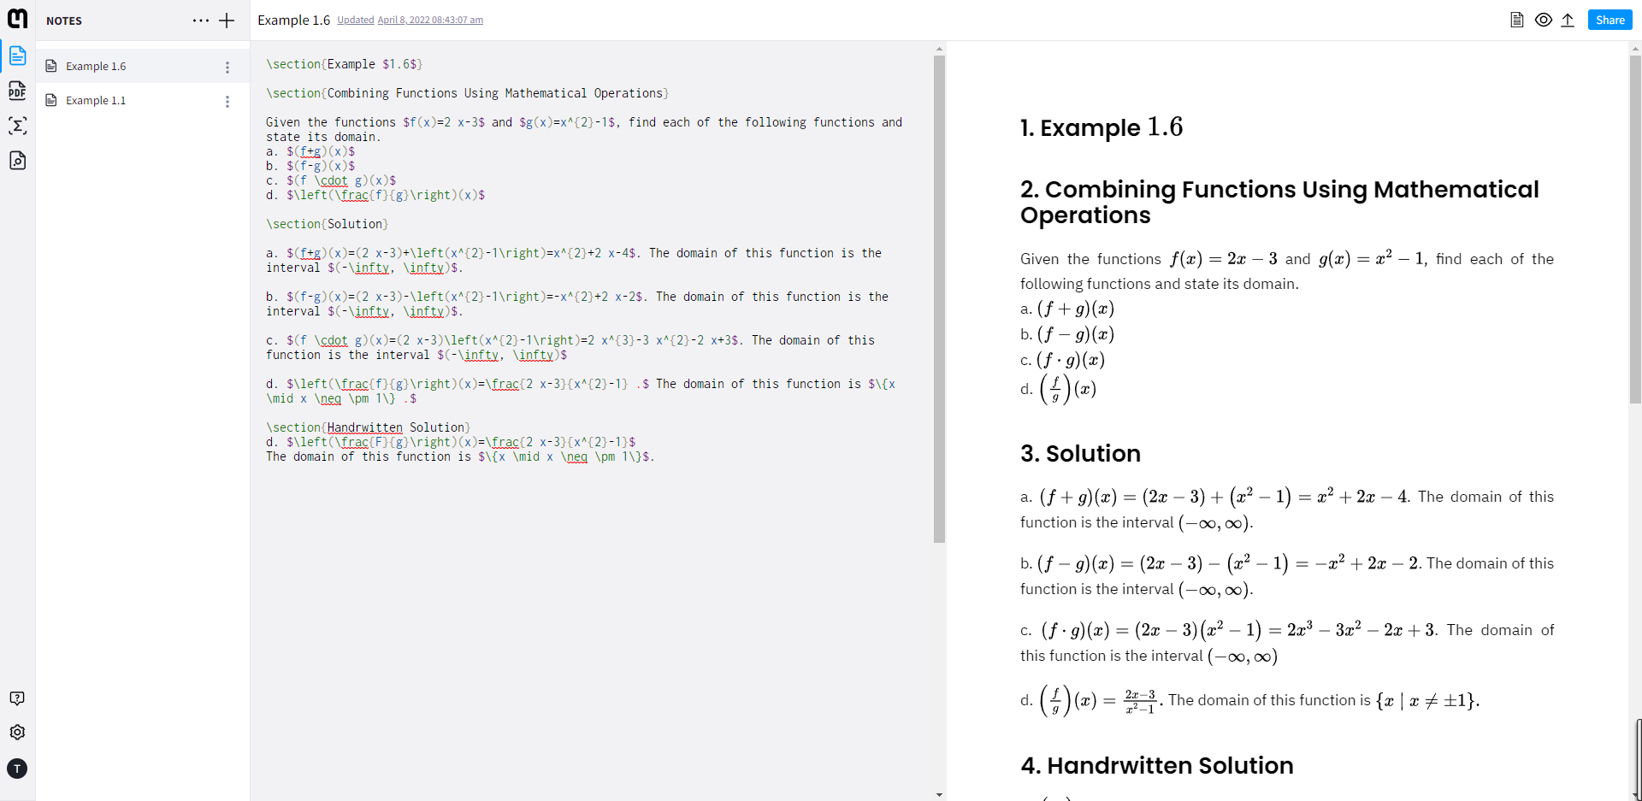
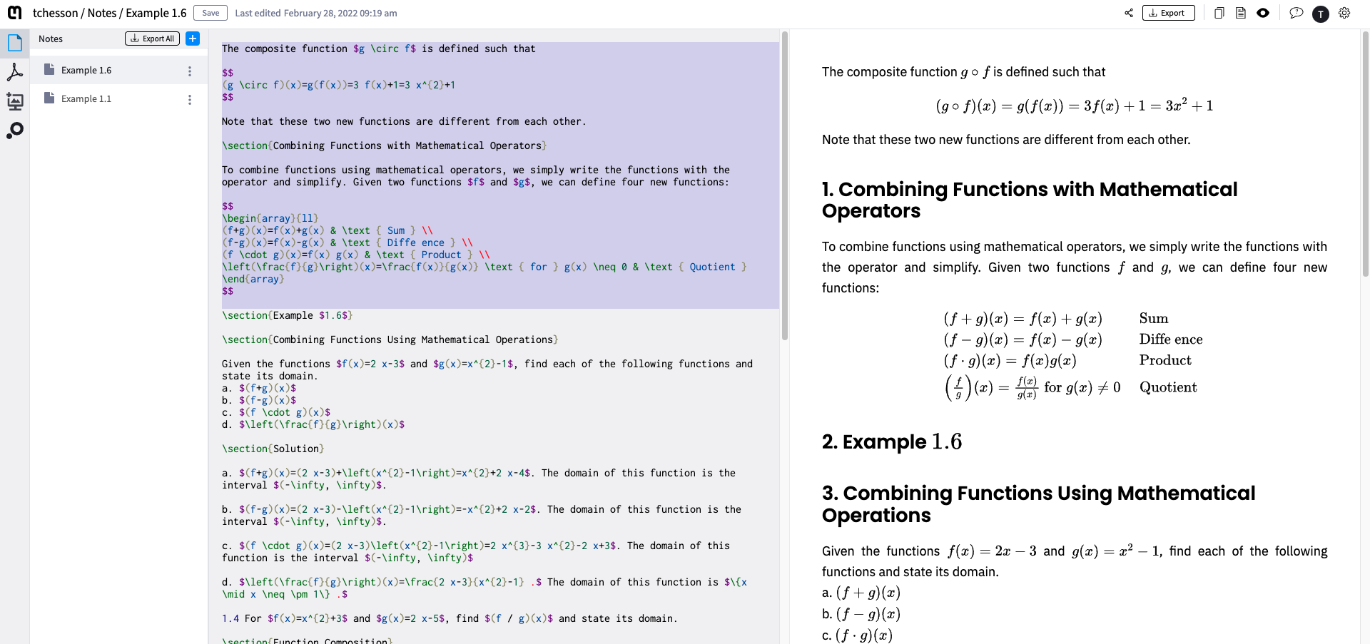
MathPix
Editing Code

Slide 22
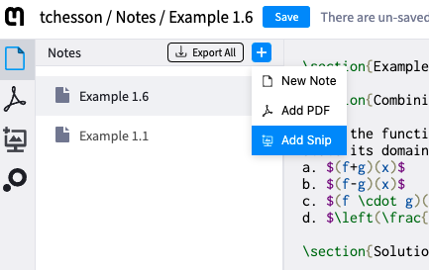
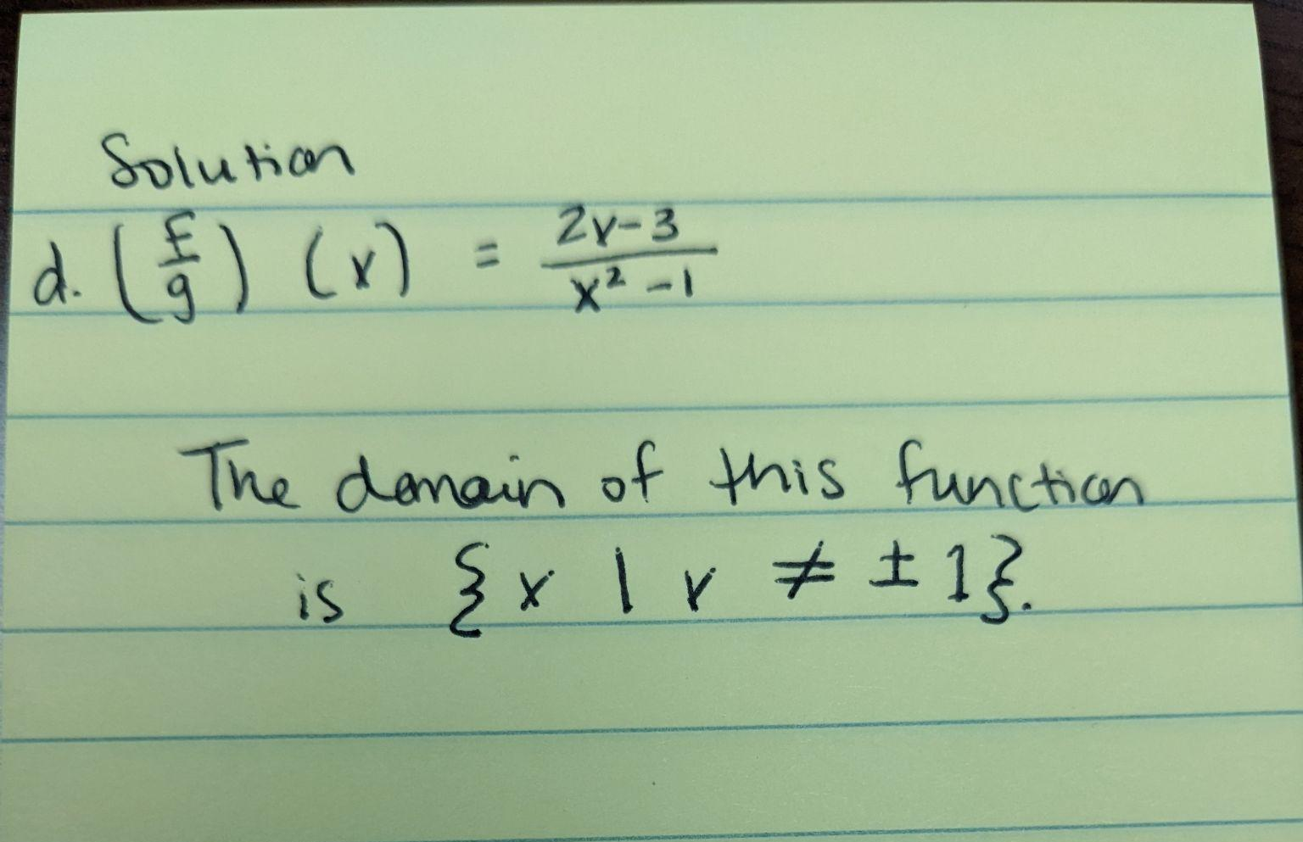
MathPix
Mathpix Snips Accessibility
Adding Snips

Slide 23
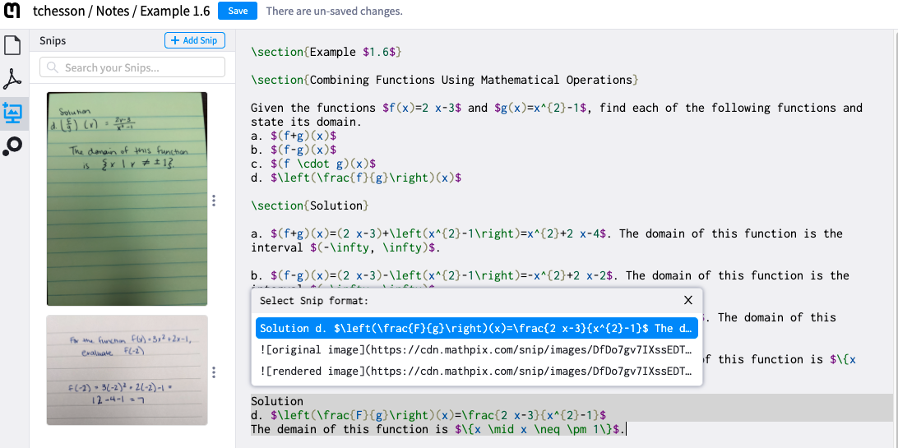
MathPix
Snip Formats

Slide 24
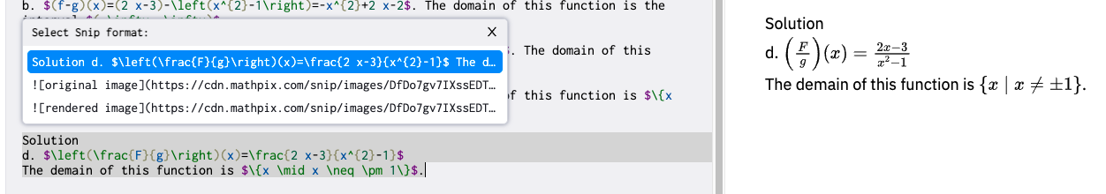
MathPix
Snip Formats
Code
Mathpix Snips Accessibility
Notes:
There are ways to make your pdfs and snips accessible. I have linked to the Mathpix accessibility page.
Able to edit code:
Capital F to lowercase
Demain to domain

Slide 25
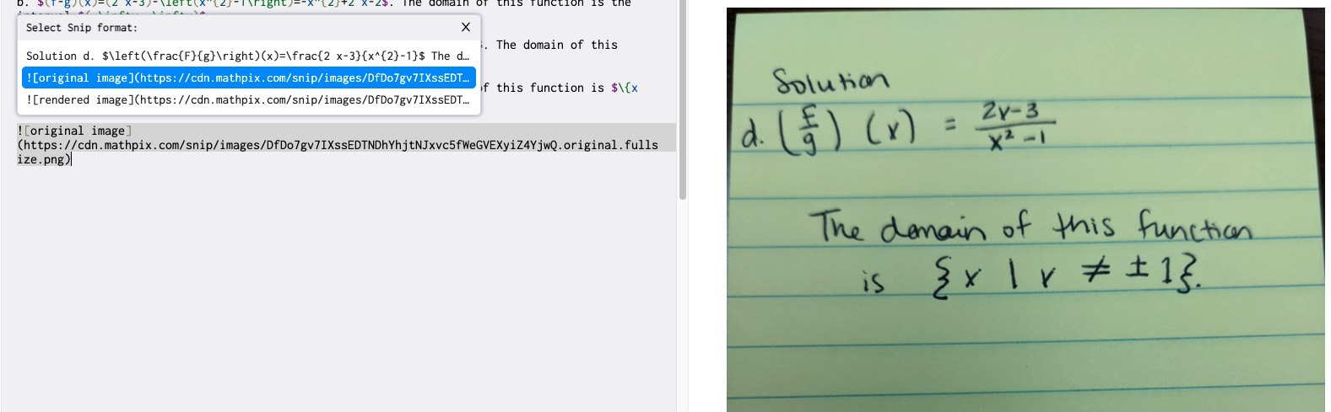
MathPix
Snip Formats
2. Original Image
Mathpix Snips Accessibility
Notes:
There are ways to make your pdfs and snips accessible. I have linked to the Mathpix accessibility page.

Slide 26
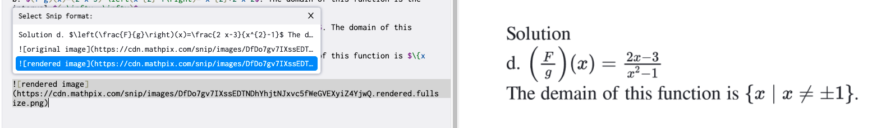
MathPix
Snip Formats
3. Rendered Image
Mathpix Snips Accessibility
Notes:
There are ways to make your pdfs and snips accessible. I have linked to the Mathpix accessibility page.

Slide 27
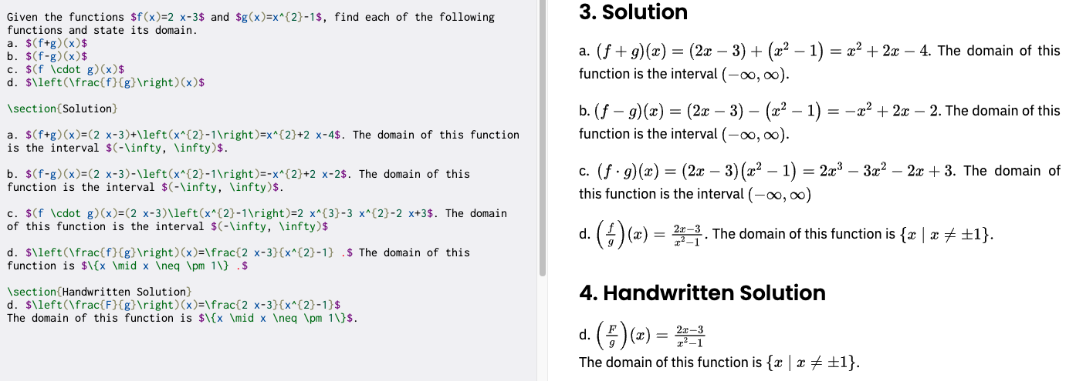
MathPix
Editing Code

Slide 28
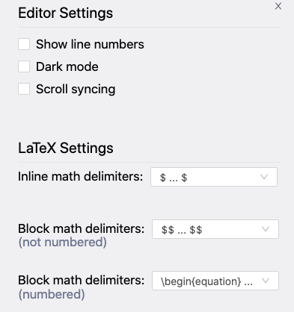
MathPix
Settings:
Syntax Reference
Notes:
Link to Syntax Reference

Slide 29
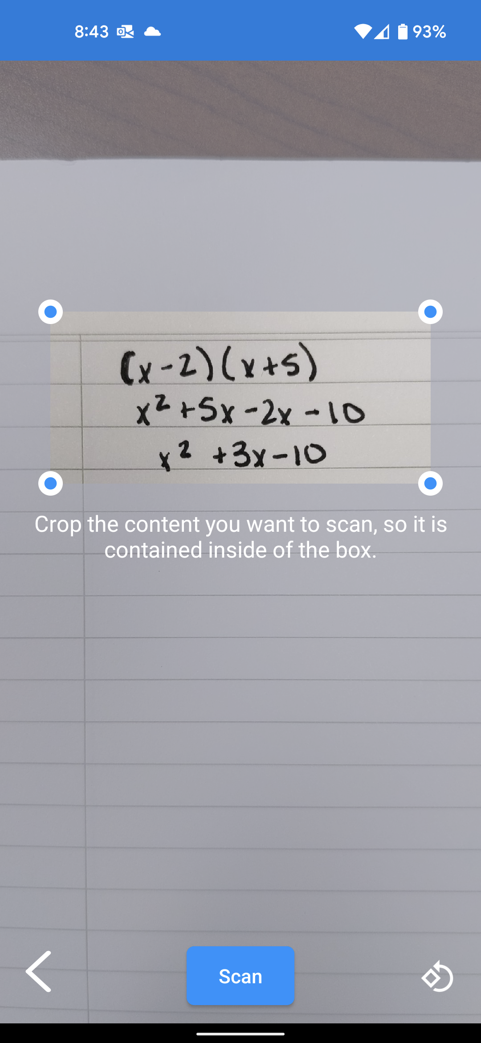
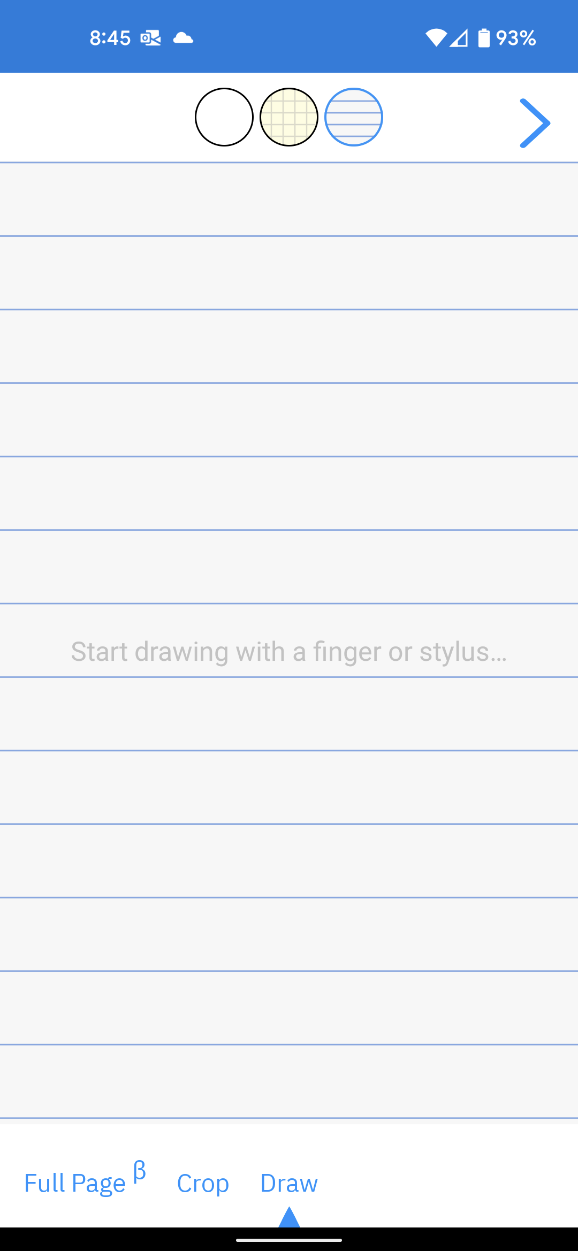
Math
Pix
(App)
Notes:
3 options
Full Page
Auto Crop
Draw on page
Blank page
Graph Paper
Lined Paper

Slide 30
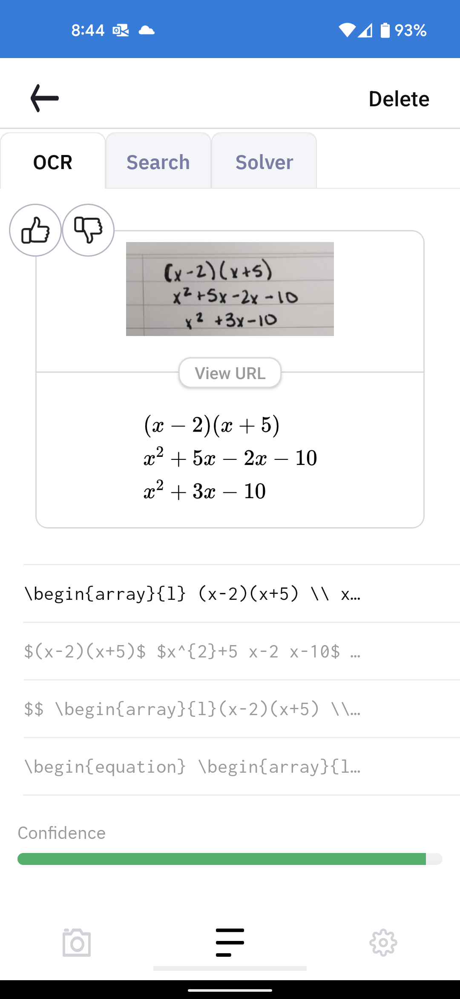
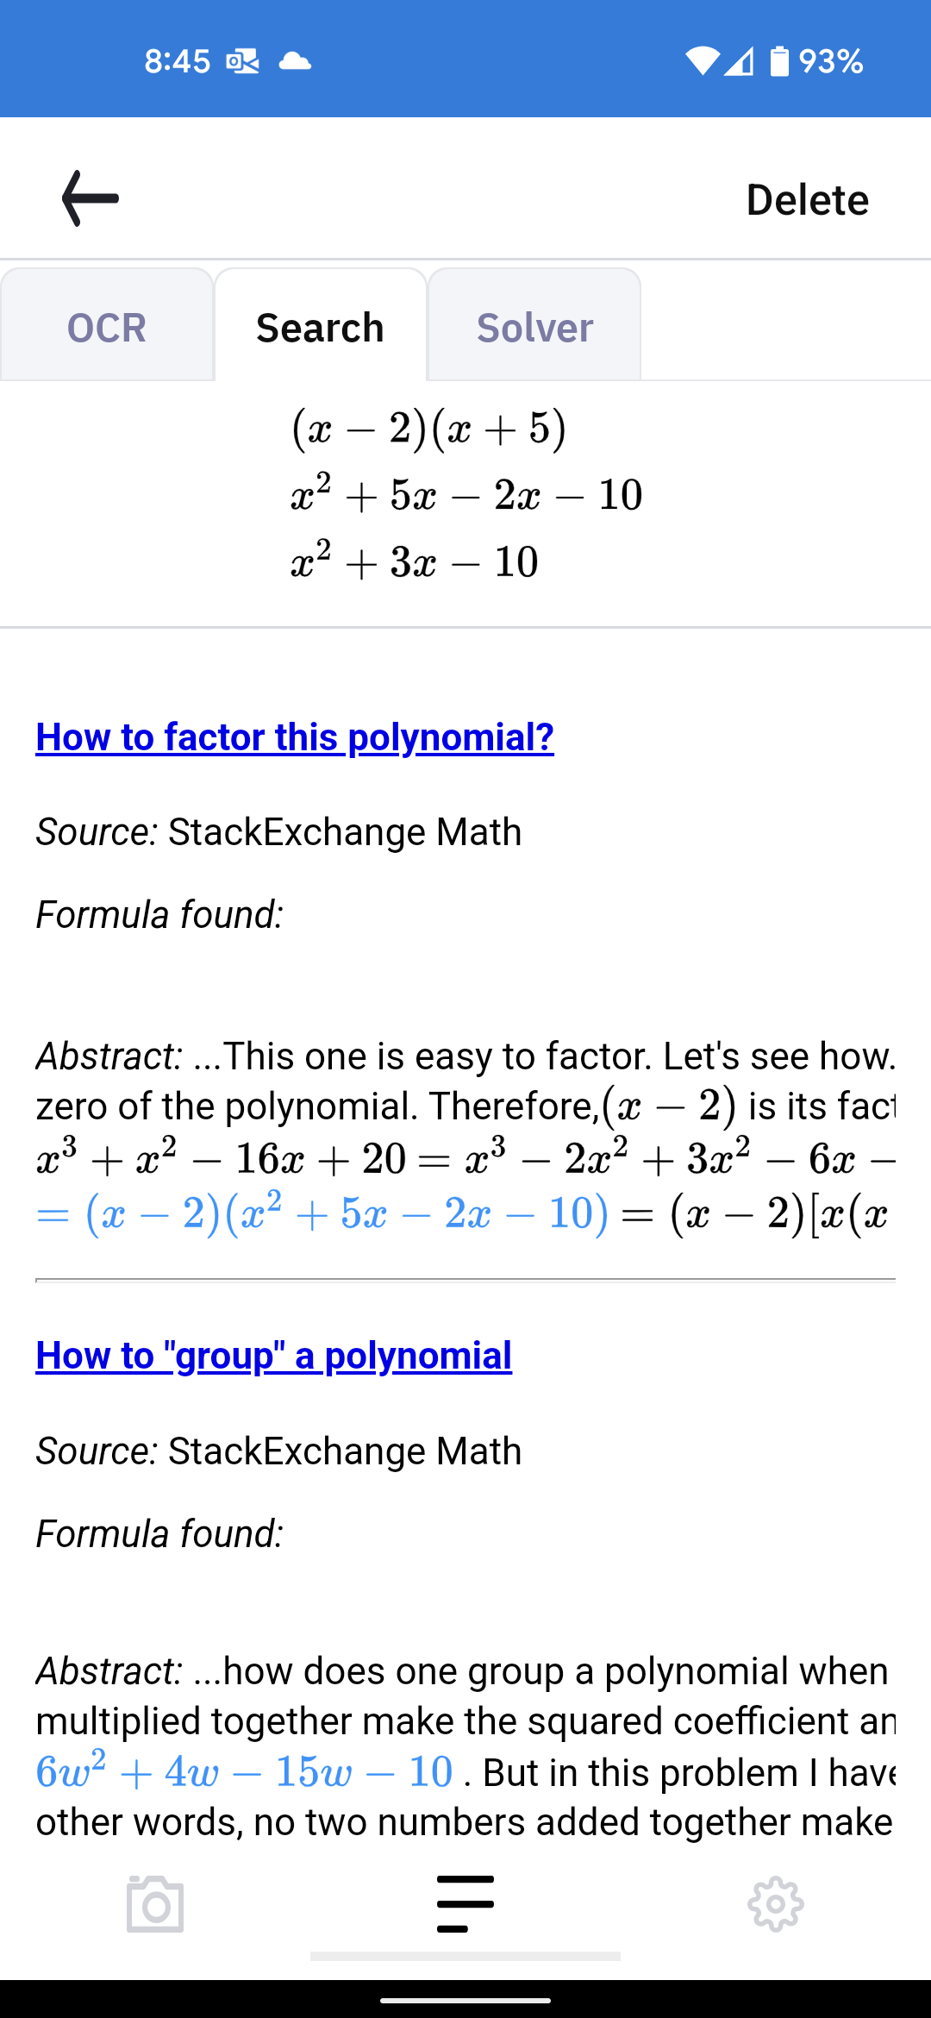
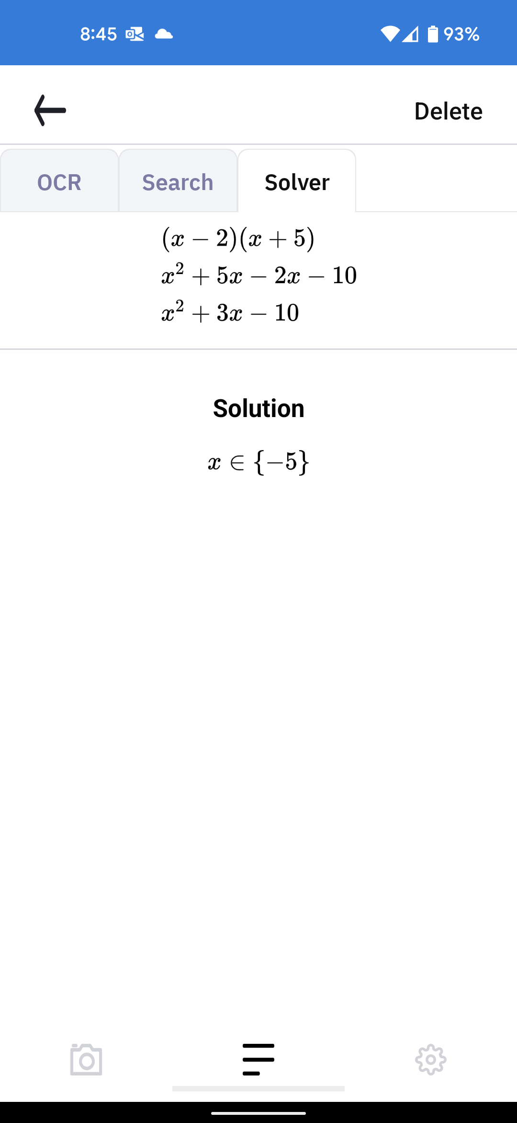
Math
Pix
(App)
Notes:
Also recognizes different languages.
MathpixOCR is a web API for extracting text from images. It works especially well with images containing scientific notation (math, chemistry, physics, …).

Slide 31
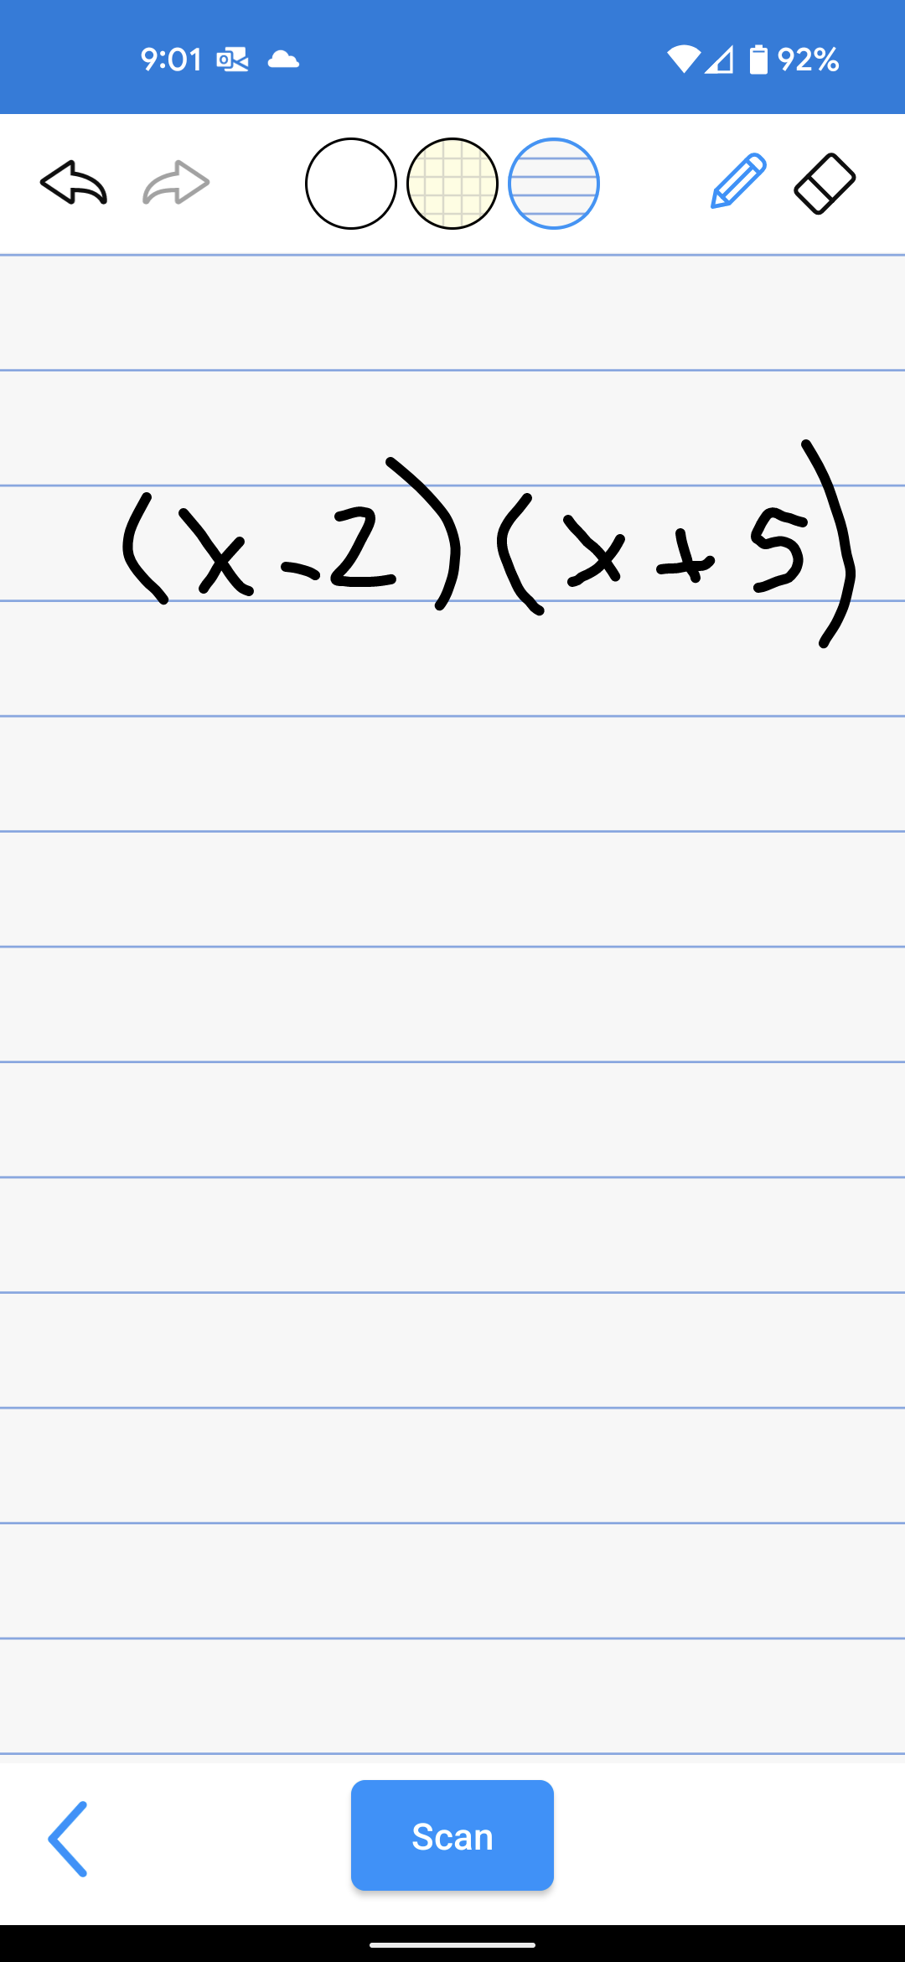
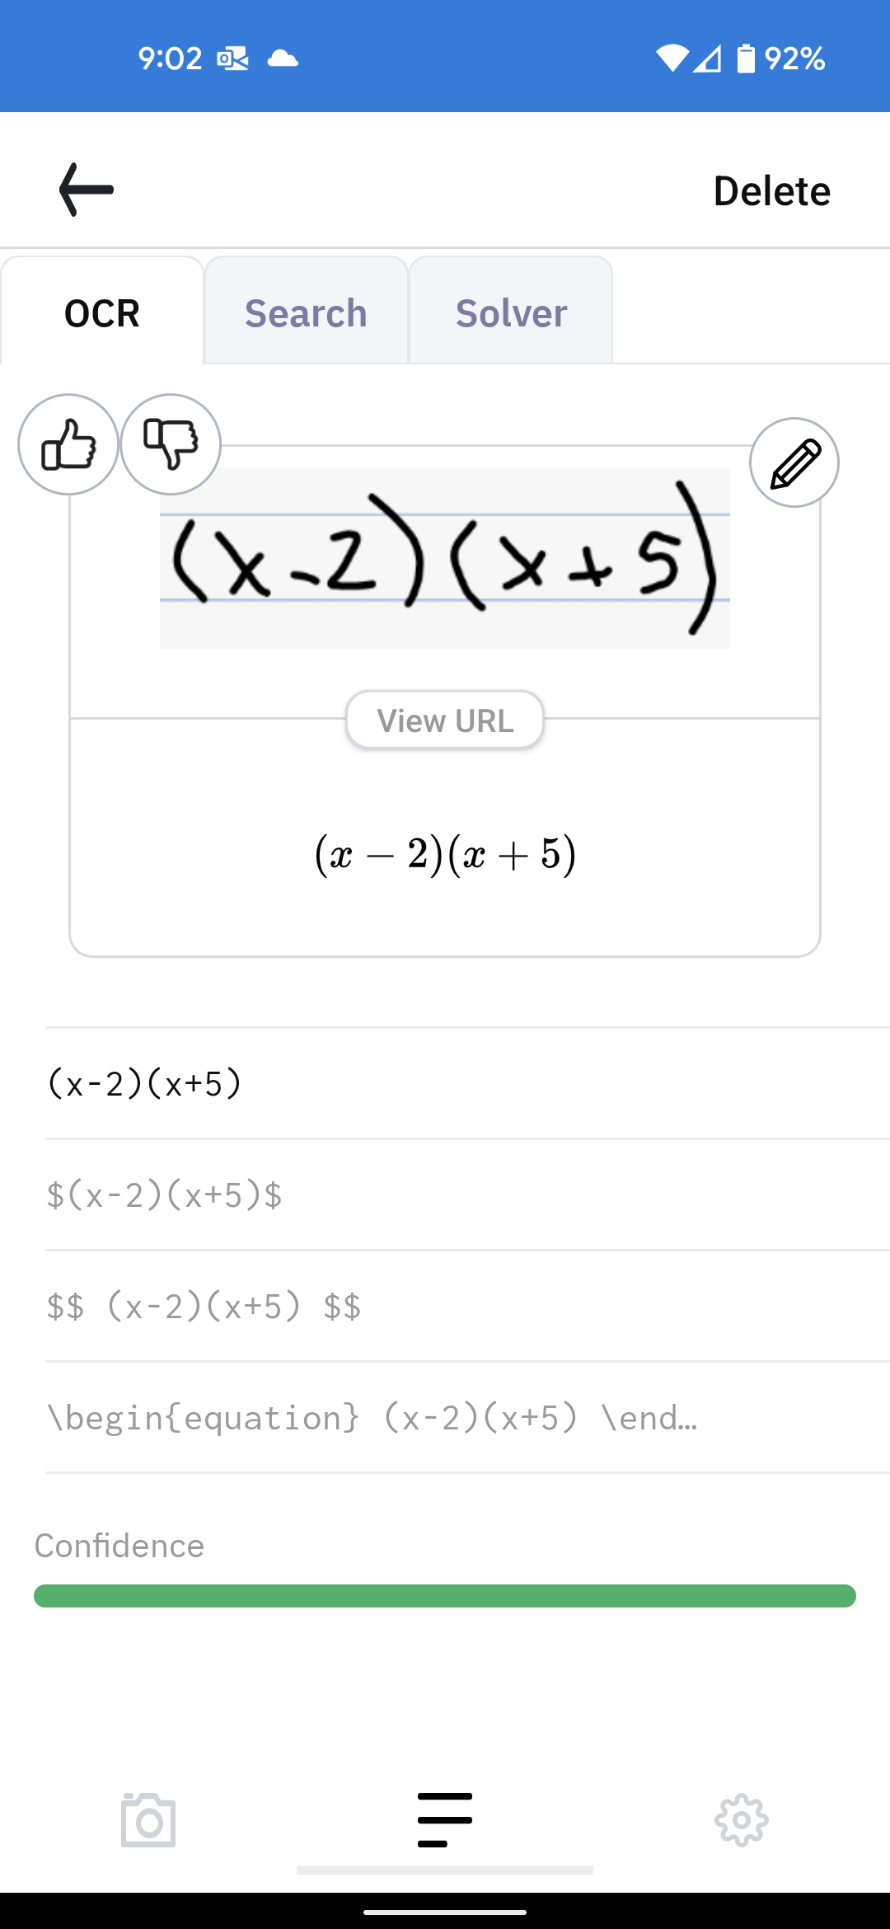
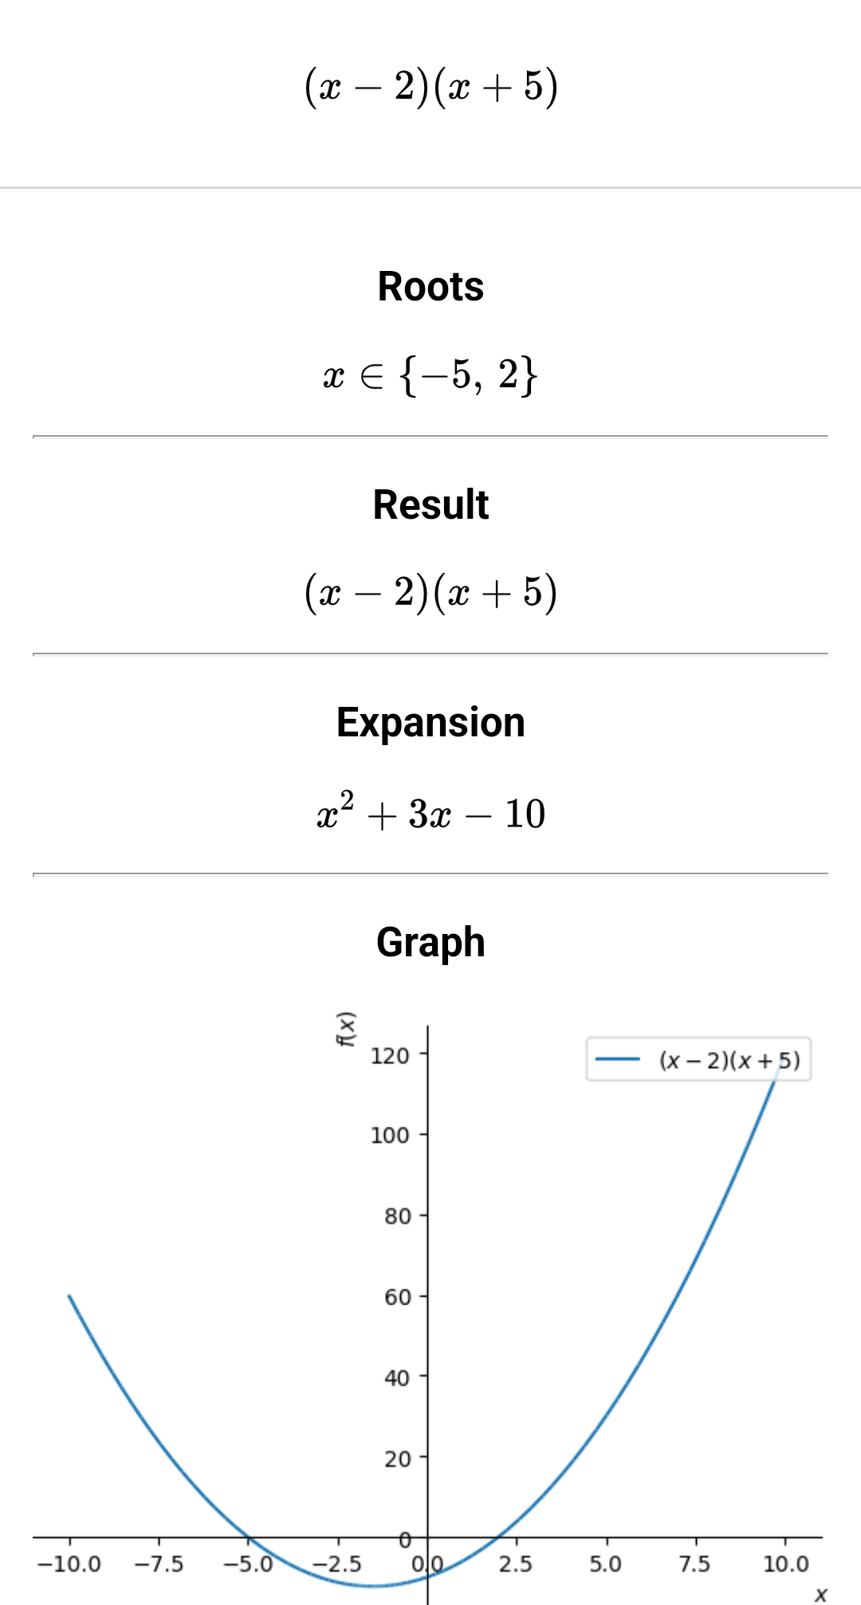
Math
Pix
(App)

Slide 32
Using LaTex in iLearn Quizzes
3

Slide 33
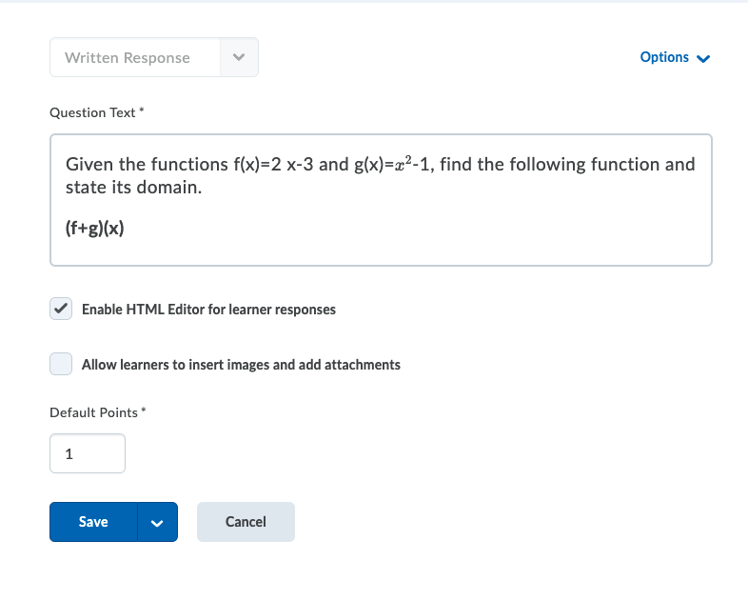
iLearn LaTex
Must enable HTML Editor for LaTex.
Notes:
Can also be short answer – Not arithmetic
Will not be able to have variables like an arithmetic problem.

Slide 34
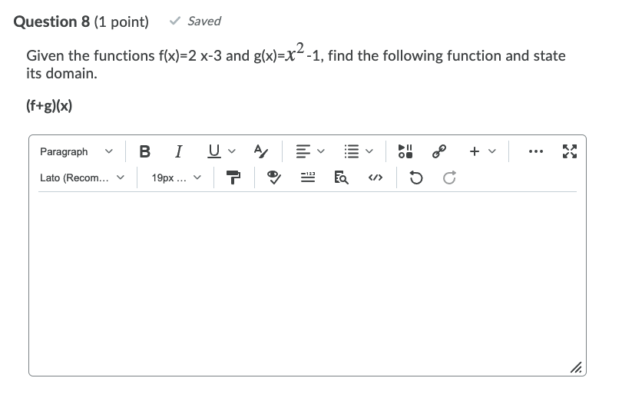
iLearn LaTex
Quiz
Student View
This is a written response- type question.

Slide 35
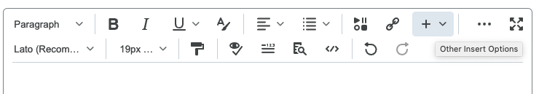


iLearn LaTex
Quiz
Student View
Notes:
Looks a little bit different than the teacher view (+ instead of the E).

Slide 36

iLearn LaTex
Notes:
Preview:
Missing end parentheses after the 1
All of the words are smushed together.
Extra \ and ().

Slide 37


iLearn LaTex
Quiz- Student View
Notes:
Backlash - space

Slide 38

iLearn LaTex
Quiz- Student View
Notes:
Preview updates in real time.

Slide 39

iLearn LaTex
Quiz- Student View
Notes:
If equations are large, students may see this equation box instead of their problem. They can review it by going back to + > Equation > LaTeX. The editing screen will pop up again and they are able to review or change.

Slide 40

iLearn LaTex
Grading
Teacher View
Notes:
The teacher view will be able to see the problem instead of the E with the box around it. Since it is a written response, it does not grade it for you. If you had a short problem, you could add it in short answer, and it would grade it – just make sure students are aware that they will need to review it and come to you if it marked something wrong that they think it right.

Slide 41








Source
Student Resources
Interactive Online Math Tools
Desmos
Math Fortress
Wolfram Alpha
Downloadable Math Apps
Math Ref
iMathematics Pro
MyScript Calculator
Available as App & Online
MathPix Snip
Notes:
Desmos offers a variety of interactive online math tools for college students. Each tool can help students practically work through their math problems. (Graphing Calculator, Scientific Calculator, 4-function Calculator, Geometry Tool)
MathFortress.com offers a variety of math tutorials for college students.
Wolfram|Alpha can help students with their college homework, allowing them to work through diverse topics and mathematical problems.
‎Math Ref This app provides tools such as a unit converter, quadratic solver, and triangle solver to help students with a wide range of math calculations, with a cost of $1.99.
‎iMathematics™ Pro This app provides students with clear explanations of solutions for over 70 math topics by using the Advanced Calculator, the Fraction Approximator, and the Equation Solver. The app costs $2.99.
MyScript Calculator This app allows students to write out math equations by hand and provides a result immediately. Students can transfer their solutions and view their full history later. The app costs $2.99.

Slide 42

Any Questions?
Resources:
Tutorials:
Arithmetic Problems in iLearn
Mathpix.com
Using LaTex in iLearn
Other Resources:
University of Arizona D2L
Mathpix OCR User Guide

