Slide 1
Critical Thinking
Taylor Chesson
Online Instructional Design Specialist

Slide 2
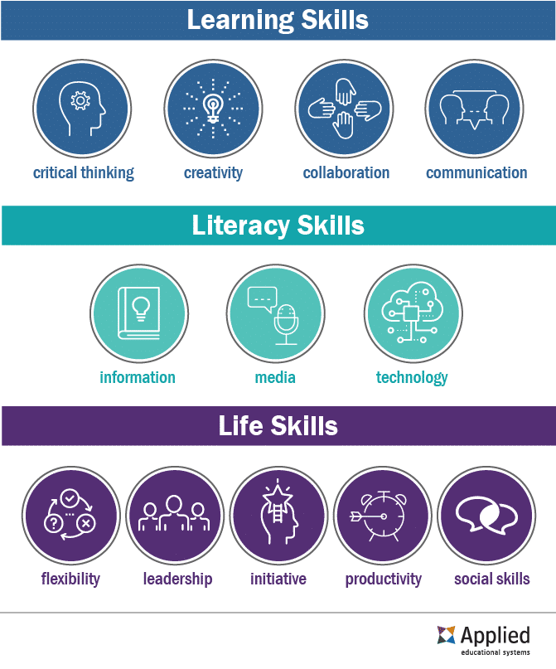
What are 21st Century Skills?
Considered the most important skills in today's workplace.
Provide a foundation for successful learning.
Help ensure student success outside of the classroom.
Real-Scenarios in Life
Future Workplaces
Notes:
How today's students can stay competitive in a changing job market.
Learning skills (4Cs) teaches students about the mental processes required to adapt and improve upon a modern work environment.
Literacy skills (IMT) focuses on how students can discern facts, publishing outlets, and the technology behind them. There’s a strong focus on determining trustworthy sources and factual information to separate it from the misinformation that floods the Internet.
Life skills (FLIPS) look at nonphysical elements of a student’s everyday life. These intangibles focus on both personal and professional qualities.
Source: Stauffer, B. (2022) What are 21st Century Skills? AES. Retrieved 6 May 2022 from https://www.aeseducation.com/blog/what-are-21st-century-skills

Slide 3
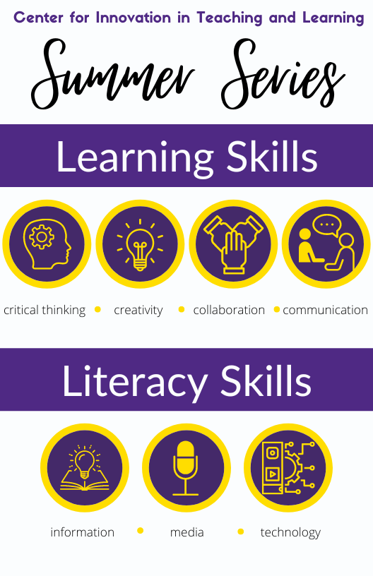
June: Learning Skills - - - - - - - - - -
6/7 – Critical Thinking
6/14 – Creativity
6/21 – Collaboration
6/28 – Communication

Slide 4
Agenda
1
2
3
4
Critical Thinking
Metacognition
In-Context Learning
Inductive & Deductive Reasoning
How does it play a part in your courses and students’ future careers?
What do students need to consider when thinking about their learning?
How does in-context learning supplement comprehension and application?
How do I used various types of reasoning as appropriate to a situation?

Slide 5
What is Critical Thinking?
Critical Thinking is…
the act of analyzing facts to understand a problem or topic thoroughly.
making sure you have good reasons for your beliefs.
learning to evaluate arguments as good and bad.
Notes:
Critical Thinking is about making sure you have good reasons for your beliefs.
When you can distinguish between good and bad reasons for something – you’re exercising your critical thinking skills.
Learning to evaluate arguments as good/bad.
Challenge: We come with beliefs and opinions that may be difficult to change.
Healthy skepticism

Slide 6
Critical Thinking
Willingness to engage in and persist at a complex task
Flexibility and open-mindedness
Willingness to abandon non-productive strategies to self-correct
Verbal reasoning
Argument analysis
Hypothesizing and undertaking a systematic process to check evidence
Estimating likelihood and uncertainty
Decision-making
Notes:
Source: Framework for 21st century learning definitions
https://drive.google.com/file/d/11xmPMltqhDZuuV7vrgBU7LDavSMeUBiM/view

Slide 7
Metacognition
Thinking about your thinking.
Knowing what you know.
Notes:
Metacognition is knowledge, awareness and control of cognitive processes.
Knowledge of contents of memory.
Awareness of when you are using memory.
Control of factors in utilizing contents of memory
It requires being aware of and regulating, or controlling, our thinking processes.
Planning > Evaluating > Monitoring (cyclical)
Metacognitive skills are important because they help individuals understand their learning processes and how they learn effectively. Further, metacognitive skills help people learn information quickly and retain information for their educational or professional development. This is because they understand the methods they need to use to educate themselves and overcome potential learning barriers.

Slide 8
Metacognition
Plan
Monitor
Evaluate
Notes:
Planning: Asks students to question what they want to learn, what existing knowledge they can use to help them learn, what they need to focus on to learn and what time frame they have to achieve comprehension.
Monitoring: Students ask questions relating to how well they're retaining information, whether to slow or quicken the pace at which they learn depending on the subject's difficulty and whether they need to seek additional guidance to help them learn.
Evaluation: Students evaluate their ability to learn during the monitoring phase. They question whether what they learned could help them in other areas, determine weak areas where they need to complete additional work and reflect on what they should've done differently to maximize their learning experience.

Slide 9
Questions to Improve Metacognition
Before
Is this similar to a previous task?
What do I want to achieve?
What should I do first?
During
Am I on the right track?
What can I do differently?
Who can I ask for help?
After
What worked well?
What could I have done better?
Can I apply this to other situations?
Plan
Monitor
Evaluate
Notes:
KWL Chart (Know, Want, Learn)
Source: Tanner, K. (2012). Promoting Student Metacognition. CBE – Life Sciences Education, 11(2), 113-120. DOI: 10.1187/cbe.12-03-0033

Slide 10
Putting Metacognition into Practice
Preassessments
The Muddiest Point
Retrospective Post-assessments
Reflective Journals
Assignments for Explicit Instruction
Notes:
Kimberly Tanner (2012) “Promoting Student Metacognition,”
Preassessments—Encouraging Students to Examine Their Current Thinking: “What do I already know about this topic that could guide my learning?”
The Muddiest Point—Giving Students Practice in Identifying Confusions: “What was most confusing to me about the material explored in class today?”
Retrospective Postassessments—Pushing Students to Recognize Conceptual Change: “Before this course, I thought evolution was… Now I think that evolution is ….” or “How is my thinking changing (or not changing) over time?”
Reflective Journals—Providing a Forum in Which Students Monitor Their Own Thinking: “What about my exam preparation worked well that I should remember to do next time? What did not work so well that I should not do next time or that I should change?”
Source: Tanner, K. (2012). Promoting Student Metacognition. CBE – Life Sciences Education, 11(2), 113-120. DOI: 10.1187/cbe.12-03-0033

Slide 11
Putting Metacognition into Practice
Give Students License to Identify Confusions within the Classroom Culture
Integrating Reflection into Credited Course Work
Metacognitive Modeling by the Instructor for Students
Developing a “Classroom Culture Grounded in Metacognition”
Notes:
Kimberly Tanner (2012) Promoting Student Metacognition
Giving Students License to Identify Confusions within the Classroom Culture: ask students what they find confusing, acknowledge the difficulties
Integrating Reflection into Credited Course Work: integrate short reflection (oral or written) that ask students what they found challenging or what questions arose during an assignment/exam/project
Metacognitive Modeling by the Instructor for Students: model the thinking processes involved in your field and sought in your course by being explicit about “how you start, how you decide what to do first and then next, how you check your work, how you know when you are done” (p. 118)
Source: Tanner, K. (2012). Promoting Student Metacognition. CBE – Life Sciences Education, 11(2), 113-120. DOI: 10.1187/cbe.12-03-0033

Slide 12
Critical Thinking & Metacognition
Critical Thinking can be a form of metacognition.
The metacognitive cycle can by applied to critical thinking processes.
Metacognition and critical thinking share the same basic goals.
What’s the link?
Notes:
Being a critical thinker demands self-examination and an evaluation of our own thoughts and beliefs. Since this requires the examination, analysis, and evaluation of one’s own thinking – critical thinking is a form of metacognition.
The cycle
Plan: What am I actually trying to learn? Where are reliable sources of information?
Monitor: Am I learning? Is this information trustworthy?
Evaluate: What evidence do I have? What are the strengths and weaknesses?
Both are approaches to obtaining knowledge. Both concerned with accurate learning and require exploration through the learning process.
Source: https://www.globalmetacognition.com/post/metacognition-critical-thinking-what-s-the-connection

Slide 13
In-Context Learning
Go where the learning takes place.

Slide 14
Pop Quiz!
You are taking a class at TTU and have an in-class exam next week. Where is the best place to study for a test?
Outside under a tree in peaceful sunshine
In your gray, windowless classroom with a noisy air conditioning system
In a quiet, well-lit library
In a noisy coffee shop
Notes:
Source: Design for How People Learn by Julie Dirksen 2016

Slide 15
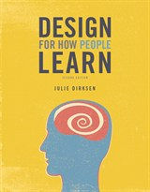
The environment in which you study will become part of your association with the material you are studying.
- Julie Dirksen
Notes:
Why? Because the environment in which you study will become part of your association with the material you are studying.
When possible, you want to encode the information in the same type of environment where you will also be retrieving that information. The same is true for information that needs to be retrieved in a particular context, such as on the job.
Source: Design for How People Learn by Julie Dirksen 2016

Slide 16
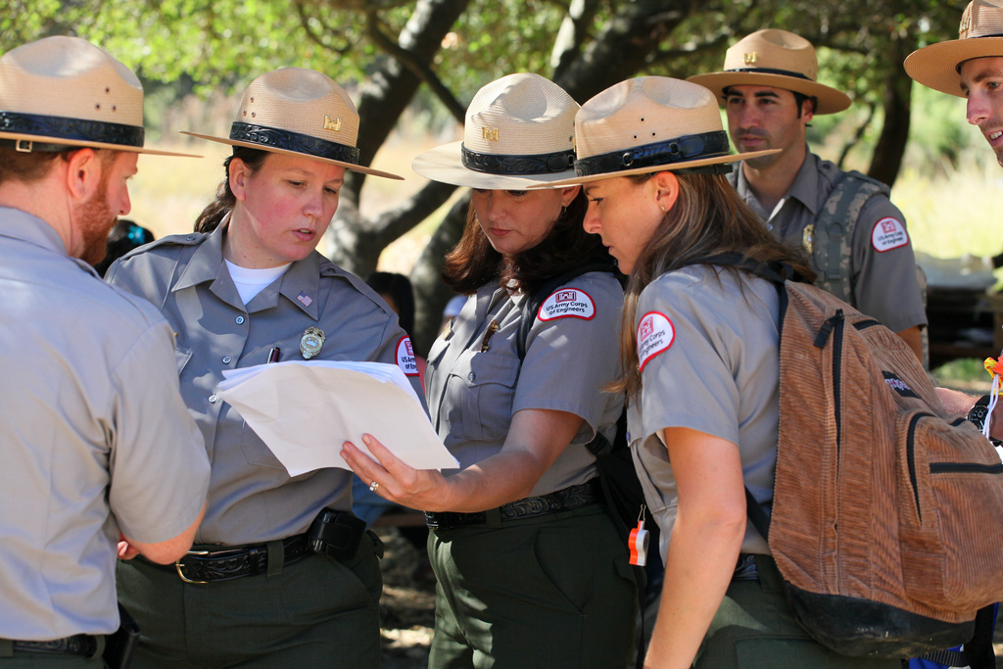
In-Context Learning
Simulations
Gamification
Role-Playing
Residency
Hands-On Activities
Dialogues
Labs
Consider emotional context!
This Photo by Unknown Author is licensed under CC BY
Notes:
Emotional Context: We may be prepared with the knowledge and the protocols but unable to implement them in the unfamiliar emotional context.
Have you ever said to yourself “I knew the right thing to do, but…” The difference between knowing and doing can be a huge gap when the context of encoding and the context of retrieval are significantly different.

Slide 17
Critical Thinking & In-Context Learning
Constructivism
Inquiry
Questioning
Learning Community
Modeling
Authentic Assessment
What’s the link?
Notes:
Constructivism
Students can construct their own knowledge
Must be able to relate knowledge obtained with knowledge they already have
Inquiry
Process of finding something through Observation/Experiment (moving from observation to understanding)
Helps develop critical thinking and practical skills
Questioning
Curiosity encourages thinking skills
Curiosity is stimulated through observation activities = practical skills
Curiosity arises when attention becomes focused on a gap in one’s knowledge (Julie Dirksen p. 143)
Learning Community
Easier to carry out critical and practical skills in groups
Inner-scaffolding (exchange of ideas)
Modeling
Observe thoroughly, not abstract
Reflective modeling leads to self-evaluation
Authentic Assessment
Student cognitive abilities and psychomotor abilities
Source: Contextual Teaching and Learning to Develop Critical Thinking and Practical Skills Detri Kurnia Tari* and Dadan Rosana Yogyakarta State University, Indonesia

Slide 18
Inductive & Deductive Reasoning

Slide 19
Inductive Reasoning
The process of drawing a general conclusion by observing a pattern based on specific scenarios.
“Cause-and-effect reasoning”
Bottom-to-top (specific to general)
Specific Observation: I have an itchy rash on my arm after I hike.
Pattern Recognition: Last summer, I got the same rash on my arm after hiking.
General Conclusion: Something on my hike is causing the rash.
Notes:
Examples: Use inductive reasoning to predict the next two terms in the following sequences.
Caution: It is difficult to know whether or not the conclusions we reach using inductive reasoning are correct. There may be more than one conclusion that fits the observations we made. Hypotheses and conjectures must be held tentatively until we find a way to validate them
Patterns
Conjecture – a conclusion based on incomplete information

Slide 20
Inductive Reasoning Examples
Inductive Reasoning
Pattern
Conjecture
Verify / Modify
Examples:
1, 1, 2, 3, 5, 8, __, __
Based on the survey results, our next CITL presentation will cover _________.
100% of students in the OLCR 1010 online class use their computers to study. Therefore, all TTU students use computers to study.
Notes:
Conjecture – a conclusion based on incomplete information
Students in an online class are much more likely to use computers than the general school population.

Slide 21
Deductive Reasoning
The process of using accepted facts and logical principles to arrive at a specific conclusion.
If A = B and B = C, then A must equal C
Top-to-bottom (general to specific)
Fact: Poison Ivy causes rashes.
Fact: I am allergic to poison ivy.
Fact: Poison Ivy is found on trees.
Conclusion: This rash on my arm after the hike must be from poison ivy.
Notes:
Deductive Reasoning
Caution: The validity of the conclusions that we reach using deductive reasoning depend on the validity of our underlying assumptions. Also, in many situations where deductive reasoning is used, the underlying premises are not always clearly stated.
Truth + Truth = Must be true
Notice how each example of deductive reasoning is more sound (assuming the first two premises are true)?

Slide 22
Deductive Reasoning Examples
Deductive Reasoning
Facts
Definitions
Accepted Properties
Examples:
All noble gases are stable. Helium is a noble gas, so Helium is stable.
All numbers ending in 0 or 5 are divisible by 5. The number 35 ends with a 5, so it must be divisible by 5.
Logical Argument

Slide 23
Critical Thinking & Reasoning
Inference
Recognize Logical Fallacies
Recognize Patterns
Look for inconsistencies and errors in reasoning
Question assumptions
What’s the link?
Notes:
Critical Thinking uses analysis and evidence to make an informed decision. It’s used daily to make decisions and to analyze decisions in science, literature, etc.

Slide 24
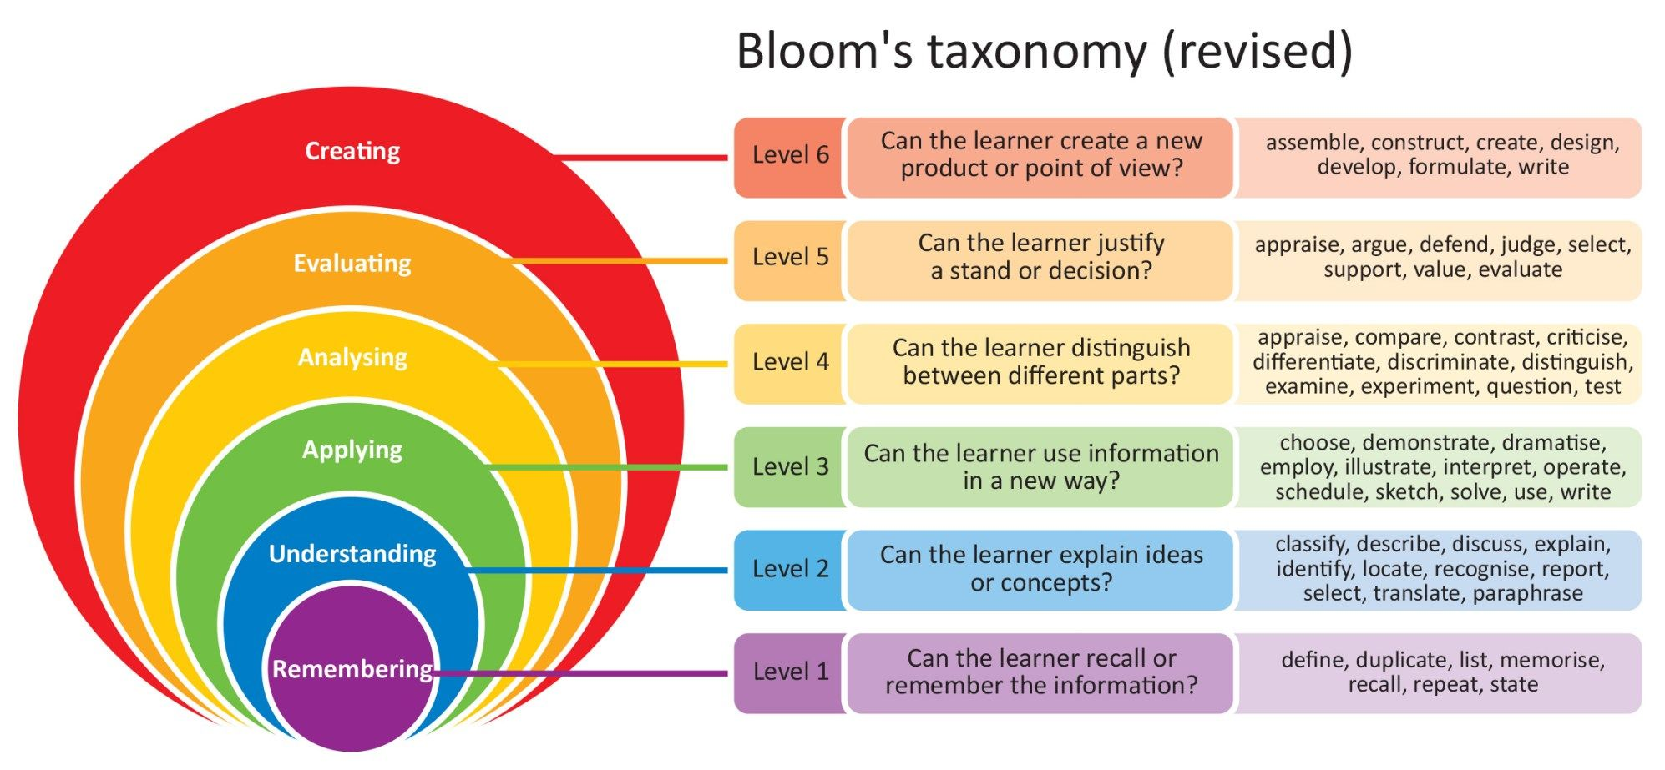
Bloom's Taxonomy
This Photo by Unknown Author is licensed under CC BY-NC-ND
Notes:
Bloom’s Taxonomy and Critical thinking go hand-in-hand. Bloom’s starts with knowledge and slowly pushes students to seek more information and create a hypothesis/analysis.

Slide 25
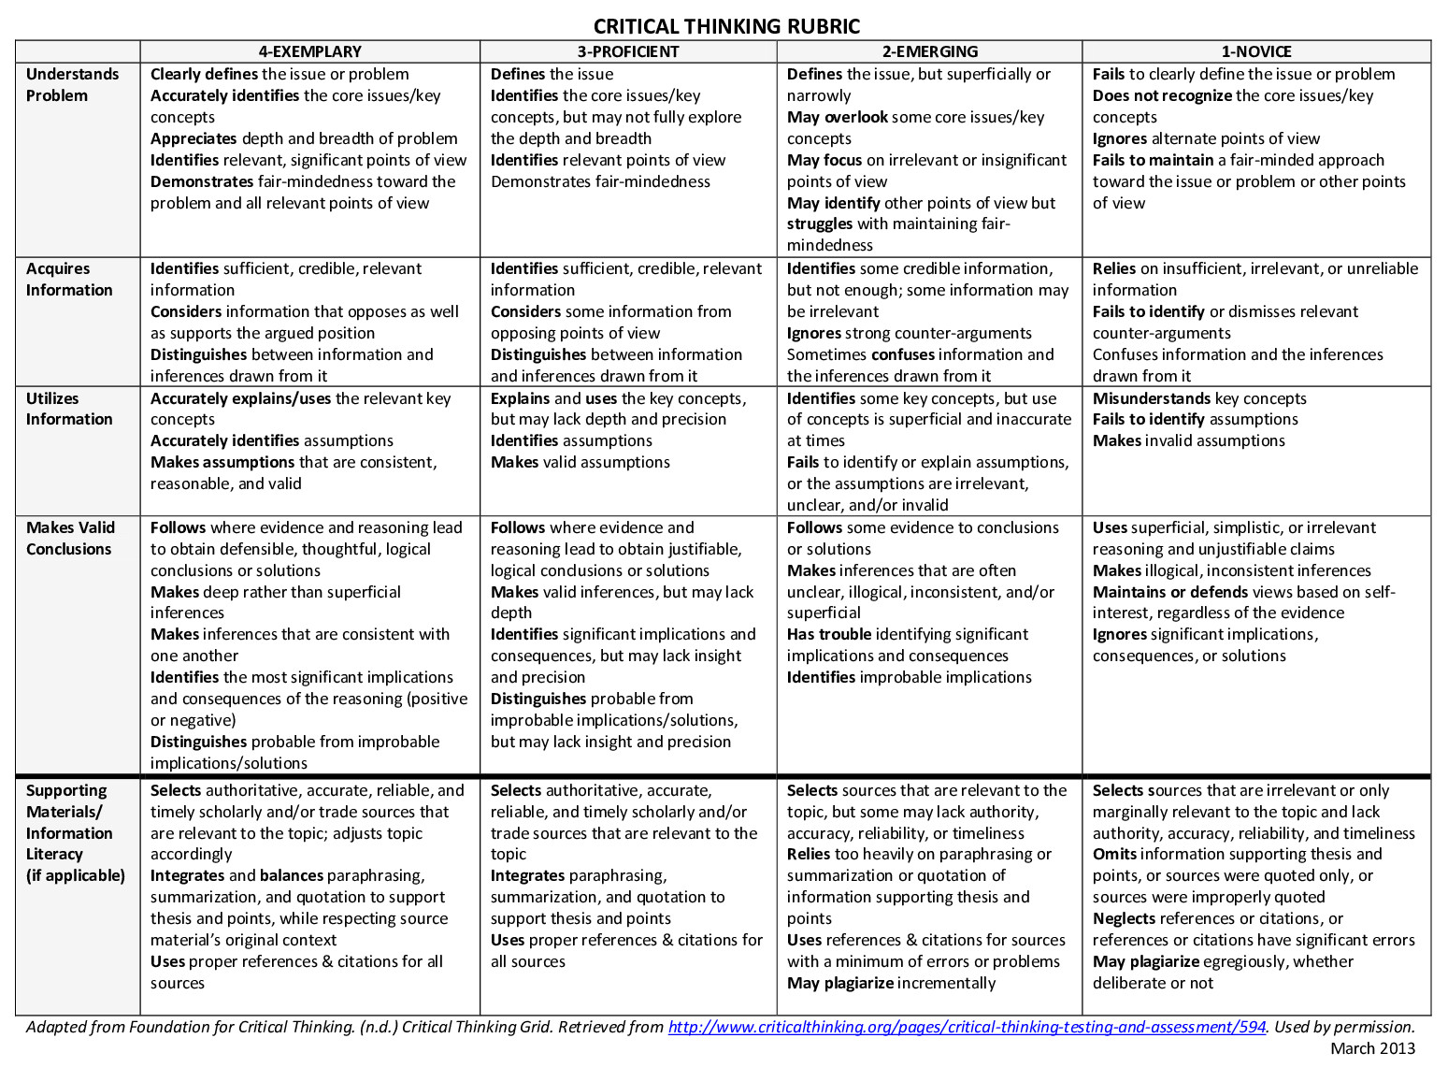
Activities
Think, Pair, Share
Jigsaw
Four Corners
Devil’s Advocate
Socratic Seminar
Notes:
Rubric Source: https://www.isothermal.edu/about/assessment/assets/rubric-think.pdf
Activities Source: FacingHistory.org
According to Human (2008), “A devil’s advocate role is typically played by an individual who provides alternative perspectives and solutions to problems, frequently challenging group assumptions.” Applied to the classroom, playing devil’s advocate means a teacher or student takes the opposing side of the predominant argument. It may not change the students’ minds but using the devil’s advocate approach challenges them to expand their analysis, perspective, and understanding of an issue.

Slide 26
Resources
Critial Thinking Test Check your critical thinking skills with this sample test.
Critical Thinking Rubric Rubric adapted from the Foundation of Critical Thinking.
Indeed Career guide to critical thinking
21st Century Skills Overview of the 21st Century Skills
P21 Framework Framework for 21st Century Learning Definitions
Metacognition More information on metacognition

Slide 27
References
Thank
you!
Dirksen, J. (2016). Design for how people learn (2nd ed.). New Riders.
Keiling, D. (2021). Inductive vs. Deductive Reasoning. Indeed. Retrieved 26 May 2022 from https://www.indeed.com/career-advice/career-development/inductive-vs-deductive-reasoning
Metacognition & Critical Thinking: What's the connection? (2021). Retrieved June 3, 2022, from https://www.globalmetacognition.com/post/metacognition-critical-thinking-what-s-the-connection
Stauffer, B. (2022) What are 21st Century Skills? AES. Retrieved 6 May 2022 from https://www.aeseducation.com/blog/what-are-21st-century-skills
Tari, D. K., & Rosana, D. (2019). Contextual Teaching and Learning to Develop Critical Thinking and Practical Skills. Journal of Physics: Conference Series, 1233(1). DOI:10.1088/1742-6596/1233/1/012102
Tanner, K. (2012). Promoting Student Metacognition. CBE – Life Sciences Education, 11(2), 113-120. DOI: 10.1187/cbe.12-03-0033
Questions, Comments, Concerns?

