Slide 1
Designing Assessments
Heather Rippetoe & Taylor Chesson
CITL Instructional Designers

Slide 2
Agenda:
Key Takeaways:
Types of Assessments
Alignment
Implementing Effective Assessments
Assessment Tools
Students must have multiple opportunities over time to demonstrate competency.
Assessments must be manageable for faculty to provide feedback.

Slide 3
1.
Types of Assessments
Formative and Summative

Slide 4
Formative Assessment Overview
Goal:
Monitor Student Learning
Provide Ongoing Feedback
Instructors improve teaching.
Students improve learning.
Lower Stakes
Quick Check-In
Notes:
Source: https://www.cmu.edu/teaching/assessment/basics/formative-summative.html#:~:text=The%20goal%20of%20formative%20assessment,target%20areas%20that%20need%20work

Slide 5
Formative Assessment Examples
Frequent knowledge checks
Chunking “milestone” tasks
Spreading larger exams into multiple, shorter assessments
Reflection Questions
Repeated-attempt quizzes
Notes:
Source: https://www.cmu.edu/teaching/online/designteach/strategies/lowstakespractice.html

Slide 6
Formative Assessment Tools
iLearn
Quizzes
Discussion Boards
Checklists
Reflection & Knowledge Checks
PollEverywhere
Qualtrics
MS Forms
FlipGrid

Slide 7
Summative Assessments Overview
Carefully aligned with learning goals
Higher stakes/greater percentage of overall course grade
Demonstration of higher degrees of competency

Slide 8
Summative Assessments Examples
"Locally designed" (Suskie, 2009) final exams
Essays
Presentations of information
Observation of student performance/behavior
Final project products
Portfolios

Slide 9
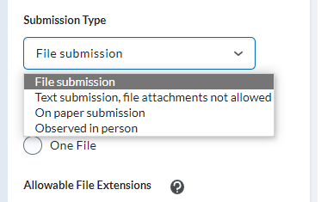
Summative Assessments Tools
iLearn
Assignments

Slide 10
2.
Alignment
Curriculum Mapping &
Backwards Course Design

Slide 11
Backward Design Model How many assessments do I need?
1
2
3
Determine Learning Goals & Objectives
Plan
Assessments
Plan Learning Activities
To Establish
What learners should know & be able to do by the end of the course
Transfer of knowledge to other challenges
That are
Ongoing
High & Low Stakes
Aligned with learning goals/objectives
Of varying types
That
Are minds-on & hands-on
Encourage exploration
Align with learning goals/objectives
And to:
Distinguish “Need to know” and “Nice to Know”
Clarify for students the purpose of the course content
Such as:
Problem or case analysis
Major and minor course projects
Synthesizing information through reflections/discussions
Quizzes & tests
And:
Use textbook as a reference, not a syllabus
(Source)
Notes:
Source: https://www.rochester.edu/college/cetl/assets/img/backward_design_model_april_2020.png

Slide 12
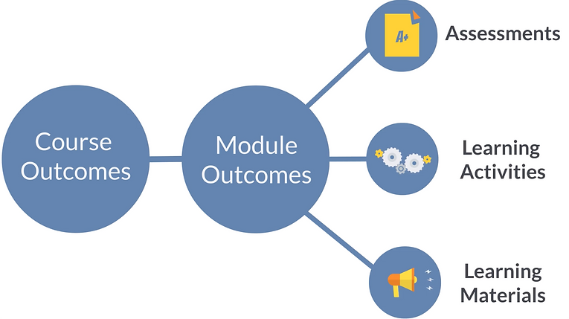
Curriculum Mapping
The Online Course Mapping Guide
Curriculum Map Example
This Photo by Unknown Author is licensed under CC BY-SA-NC

Slide 13
3.
Implementing Effective ASsessments
Student Voice & Good Measures

Slide 14
"For major grades, it's important for me to have smaller parts of the assignment due throughout the semester so I can get feedback as I go."
TTU Student Response

Slide 15
Manageable
Time
Content
Frequent feedback prior to exam
Quizzes
Homework
In-Class Examples
SGID Themes

Slide 16
A really good assessment question…doesn’t look that different from a really good instructional activity.
(Pelligrino, 2015)
Engages the student
Forces them to think and reason
Offers opportunities to show what they know
Provides challenges that shouldn’t be impossible
Allows students to learn something by solving/answering
Demonstrates ability to provide evidence for process
What makes an assessment a good measure of student understanding?
Notes:
Dr. Jim Pelligrino. Learning Sciences Professor. (University of Illinois at Chicago)

Slide 17
4.
Grading Tools
Rubrics, Video Grading, & Types of Feedback

Slide 18
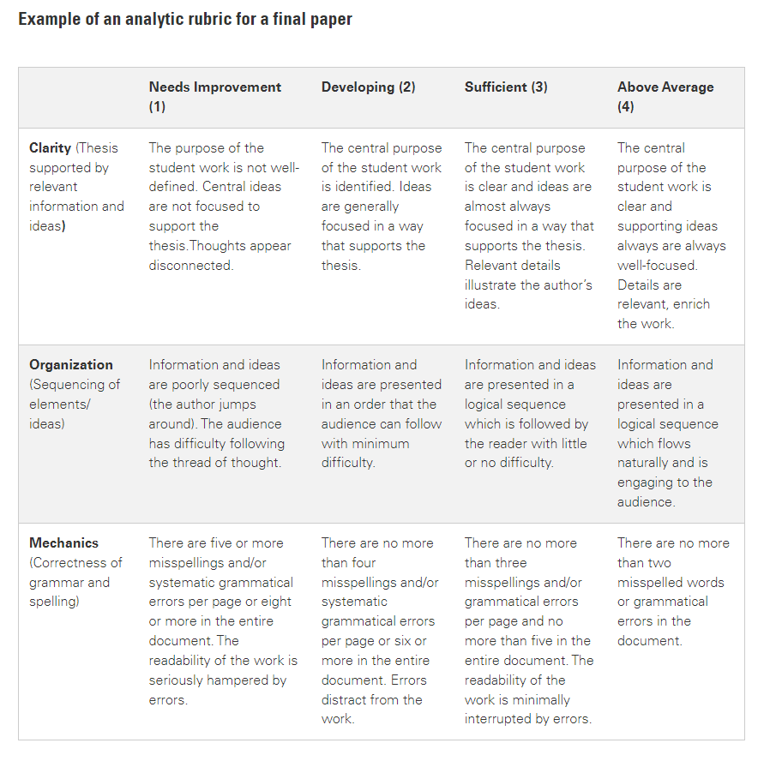
What does a rubric look like?

Slide 19
Rubrics
Benefits for students
Understand expectations
Self-evaluate
Benefits for instructors
Clarify vague, fuzzy goals
Grade items faster
Existing resources
Create an Analytic Rubric [Video]
Create a Holistic Rubric [Video]
Add a Rubric to an Existing Activity [Video]
Create a Weighted Rubric [Video]

Slide 20
Video Grading
Supports instructor-student interaction
Humanizes assessment
A pilot study using a qualitative approach has indicated that students prefer screencast assessment because of its multimodality and its ability to make the instructor’s thought process while grading transparent (Harris & Greer, 2021; Vincellette, 2013)
Can be quicker for the instructor

Slide 21
Feedback
Self-Evaluation vs. Self-Grading
Evaluation: Using judgment to evaluate their own work as well as the process that led them to the final product.
Grading: Marking one’s own work against a set of criteria provided by instructor
Peer-Evaluation
Instructor-Evaluation
(Source)
Notes:
https://cft.vanderbilt.edu/student-assessment-in-teaching-and-learning/

Slide 22
Feedback
Self-Evaluation vs. Self-Grading
Peer-Evaluation
Students assess peer’s work prior to submission have their own work checked by peers.
Allows students to take ownership and work through the process of learning
Watch for biased evaluations! Set up system of evidence-based evaluation
Instructor-Evaluation
(Source)
Notes:
https://cft.vanderbilt.edu/student-assessment-in-teaching-and-learning/

Slide 23
Feedback
Self-Evaluation vs. Self-Grading
Peer-Evaluation
Instructor-Evaluation
Traditional Evaluation
Based on rubric or pre-determined and unbiased grading system
If using the three tiers of evaluation, the instructor should be able to spend less time on corrections.

Slide 24
THANKS!
References
Assess Teaching & Learning. (n.d.). Eberly Center - Carnegie Melon University. Web Address.
Fisher, M. R. (n.d.). Student Assessment in Teaching and Learning. Vanderbilt University. Web Address.
Harris, H.S. & Greer, M. (2021). Using multimedia for instructor presence in purposeful pedagogy-driven online technical writing courses. Journal of Technical Writing and Communication. Web Address.
Hartley, B. & Cha, A. (2022). Mapping Your Course. The Online Course Mapping Guide. Web Address.
Real Learning for Real Life. (2015). What does a good assessment look like in the eyes of a student? [Video]. YouTube. Web Address.
Suskie, L. (2009). Assessing Student Learning: A Common Sense Guide. 2nd ed. Jossey Bass.
Vincelette, E.J. & Bostic, T. (2013). Show & tell: Student and instructor perceptions of screencast assessment. Science Direct. Web Address.
Any questions, comment, or concerns?

