Slide 1
Student-
Centered
Learning
Taylor Chesson
Online Instructional Design Specialist

Slide 2
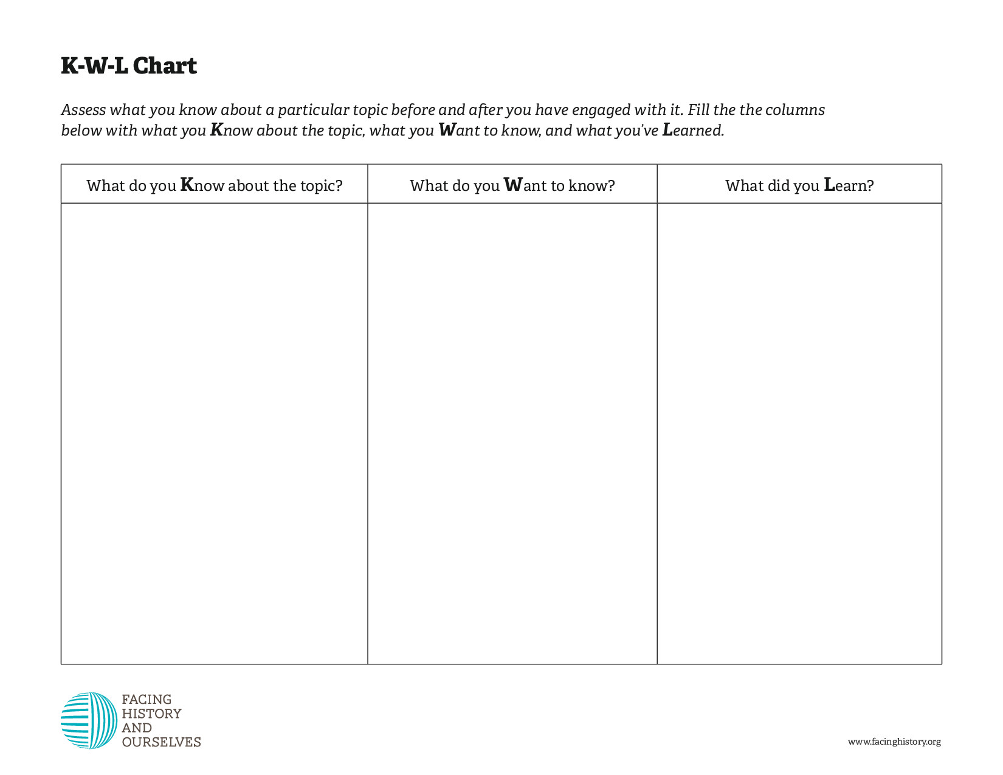
KWL Chart Resources
Facing History
Teaching History
Extra Step
Think, Puzzle, Explore
3-2-1 Bridge
I Used to Think… Now I Think…

Slide 3
Student Centered Learning (SCL) is a teaching method broadly defined as a shift in the focus of activity (or instruction) from the teacher to the student.
All types of courses from Tech-Enhanced (On Ground) to Tech-Flex (Hybrid) to Tech-Direct (Online) can utilize SCL.

Slide 4
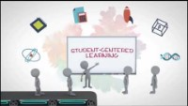

Slide 5

How could this be an example of student centered learning?

Slide 6
Key Characteristics of SCL:
Actively engages students with the learning materials
Encourages students to think, problem-solve, evaluate evidence, analyze arguments, and generate hypotheses
Asks students to reflect on what they are learning
Gives students some control over the learning process
Encourages collaboration

Slide 7
What happens in the typical college classroom?
Who is
Delivering the content?
Leading the discussions?
Previewing & reviewing material?
Offering the examples?
Asking and answering most of the questions?
Calling on the students?
Solving the problems, providing the graphs, and constructing the matrices?
In most classrooms… it’s the teacher.
“When it comes to who’s working the hardest most days, teachers win hands down. Students are there, but too often education is being done unto them.”
(Weimer, 2013)

Slide 8
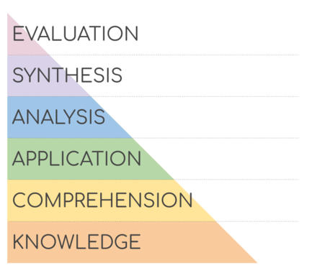
Bloom’s Taxonomy
This Photo by Unknown Author is licensed under CC BY-SA

Slide 9
What happens in the typical college classroom?
Who is
Delivering the content?
Leading the discussions?
Previewing & reviewing material?
Offering the examples?
Asking and answering most of the questions?
Calling on the students?
Solving the problems, providing the graphs, and constructing the matrices?
How can we take 2-3 of these and convert them to being student-centered learning?

Slide 10
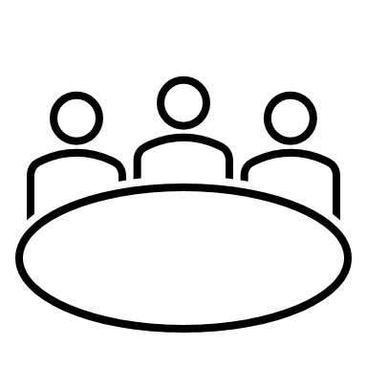
Forms of SCL
Personalized Learning
Project-Based Learning
Differentiated Instruction
Station-Based Classroom
Flipped Classroom
Inquiry-Based Teaching

Slide 11
How do I implement SCL in my classes?
Find out who students are and what they expect
  What they want to learn
  What questions they have
Use a SCL technique that incorporates grouping
  Employ Teams
  Assign Roles
Let students choose some topics
Create Rubrics (or have students create them)
Introduce learning contracts (or team contracts)
Encourage self-assessment

Slide 12

Challenges of SCL:
Still need to maintain course quality and set high expectations for students.
Still need to stick to the syllabus and course plan, but also need to be flexible and allow “wiggle room.”
Need to prepare students to take an active role in the course.
Notes:
What fears do you have?
What’s worked for you?
What barriers do you anticipate?

Slide 13
It’s about Student Learning.
Educator acts as facilitator… encouraging learners to be self-motivated and independent (Bailey & Colley, 2015).
Mode of delivery that lifts engagement.
More rewarding for both students and instructors.

Slide 14
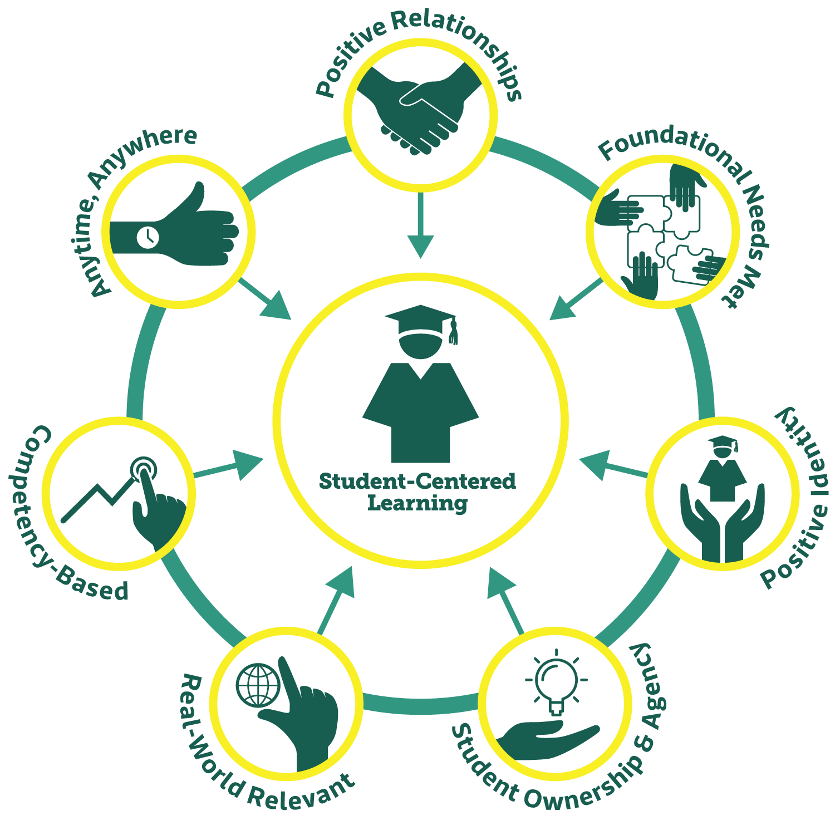
“…in student-centered learning the model shifts from being teacher-centered and standardized to student-centric and individualized”
(Kaput, 2018)
Notes:
Positive Relationships – Students have relationships with adults and peers who care about, believe in, and hold them to high expectations.
Foundational Needs Met – Students biological, physiological, and safety needs are met. (Maslow’s hierarchy of needs)
Positive Identity- Students are fully embraces for who they are and develop a sense of positive identity and belonging.
Student Ownership and Agency – Students have the freedom to exercise choice in pursuing interests, with teachers serving as guides and facilitators.
Real-World Relevant – Students solve real-world problems and learn skills they will use in their own lives.
Competency-Based – Students progress by demonstrating mastery and receive support as needed.
Anytime, Anywhere – Students learn in the community, at internships, on weekends, during extracurriculars, etc.

Slide 15
REFERENCES:
Bailey, G. & Colley, H. (2015). ‘Learner-centered’ assessment policies in further education: putting teachers’ time under pressure. Journal of Vocational Education & Training, 67(2), 153–168. doi:10.1080/13636820.2014.983956
Kaput, K. (2018). Evidence for Student-Centered Learning. Saint Paul, MN: Education Evolving. Web Address.
O'Neill, G. & Mcmahon, T. (2005). Student-centred learning: What does it mean for students and lecturers?. Emerging Issues in the Practice of University Learning and Teaching. AISHE. Web Address.
Valencia College. (n.d.). Student Centered Learning. Canvas Essentials Sandbox. Retrieved June 24, 2022, from Web Address.
Weimer, Maryellen. (2013). Learner-Centered Teaching: Five Key Changes to Practice. (2). Jossey-Bass.
THANK YOU!

