Slide 1
Groups & Teams
Heather Rippetoe
Center for Innovation in Teaching and Learning

Slide 2
“The generic attribute of collaboration is now understood as an essential part of university education” (Ellis & Han, 2021).
Notes:
Remember that collaboration is a 21st century skill, one of the skills that helps students and graduates succeed in the workforce

Slide 3
Collaboration includes:
Collaborating with others
Demonstrating ability to work effectively and respectfully with diverse teams
Exercising flexibility and willingness to be helpful in making necessary compromises to accomplish a common goal
Assuming shared responsibility for collaborative work, and valuing the individual contributions made by each team member
from Battelle's Framework for 21st Century Learning Definitions
Notes:
Source

Slide 4
Collaboration skills may not come naturally to students.

Slide 5
"Our data raise the possibility that perhaps instead of students being lazy or unmotivated, students face barriers such as ...
Anxiety about group work
Low perceived value of peer discussion for their learning
Contending with other students in the group who are dominating."
STEM research by Eddy et al, 2015, qtd in Felten & Lambert, 2020

Slide 6
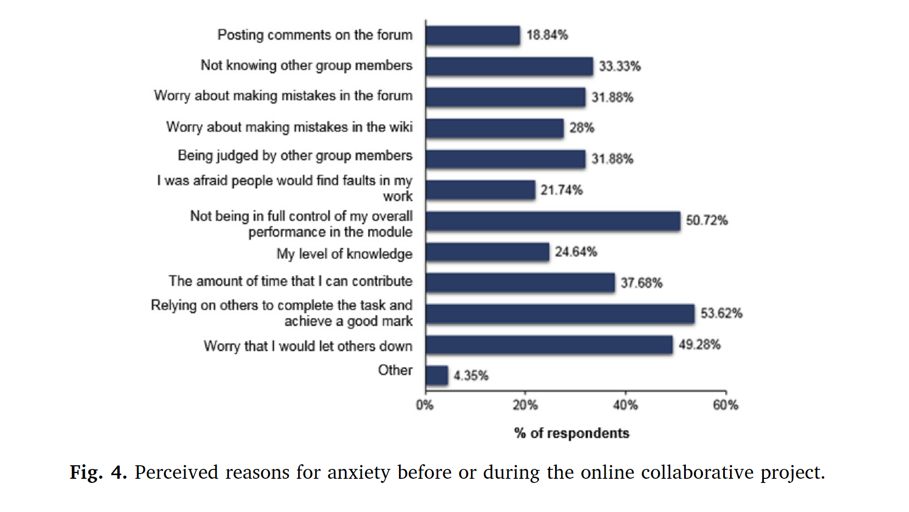
Hilliard, et al, 2020, p. 7

Slide 7
Collaboration as a continuum
Think-Pair-Share & Breakouts
Shorter-term projects
Longer-term group projects
Students practice sharing with one other person or small group during a class session. In class or virtual class.
Unit or module project producing a product (group narrated ppt presentation, group essay). In and out of class; synchronous and asynchronous.
Semester-long process producing a product (community intervention plan, prototype).

Slide 8
Think-Pair-Share & Breakouts
Include a "collaboration" or "group work" statement in your syllabus detailing:
What collaboration might look like
The importance of collaboration to student success
Establish group work norms & expectations as a class
"Norms that engender a supportive learning environment include acting and interacting responsibly, treating others with respect and concern, and fostering a learning orientation" (Everson & Poole & the IRIS Center, 2003, p. 2).
Think-Pair-Share is a gentle start
Establish & begin working in groups early in the semester
Offer a “solo group” option

Slide 9
Shorter-term Projects
Unit or module project producing a product (group narrated ppt presentation, group essay, group model or prototype).
In and out of class; synchronous and asynchronous.
When designing shorter & longer-term projects, look for ways to facilitate "collaborative learning" and not just "cooperative learning"

Slide 10
Longer-term Projects
Similar to preparing for shorter-term projects, except:
Provide/encourage a teamwork contract
Group Work Evaluation Form: "Everyone loves each other, then differences start to appear, then the surveys start getting honest"
Provide prompts for reflection: what did you learn about being on a team?

Slide 11
What are some examples of collaboration at Tennessee Tech?

Slide 12
Panel Participants
Dr. Pedro Arce
University Distinguished Faculty Fellow
Professor of Chemical Engineering & Past Department Chair
Department of Chemical Engineering
Dr. Andy Pardue
Lecturer
Mechanical Engineering
Dr. Sally Pardue
Associate Professor
Mechanical Engineering

Slide 13
What are some ways we can support students in groups/teams?

Slide 14
Hilliard, et al., 2020, p. 10
More guidance and support could have been provided in the following areas:
advice on best practices for online group work (i.e. from tutors or past students)
information on using additional communication tools
help with encouraging engagement and participation of group members
changes in the assessment marking [grading], predominantly the group mark [grade] element
One survey respondent wrote: ‘I think the [university] could have pushed at the start to get everyone involved rather than just leaving it to the group’.
The marking [grading] criteria were not clear and further clarification of these would have helped reduce anxiety.

Slide 15
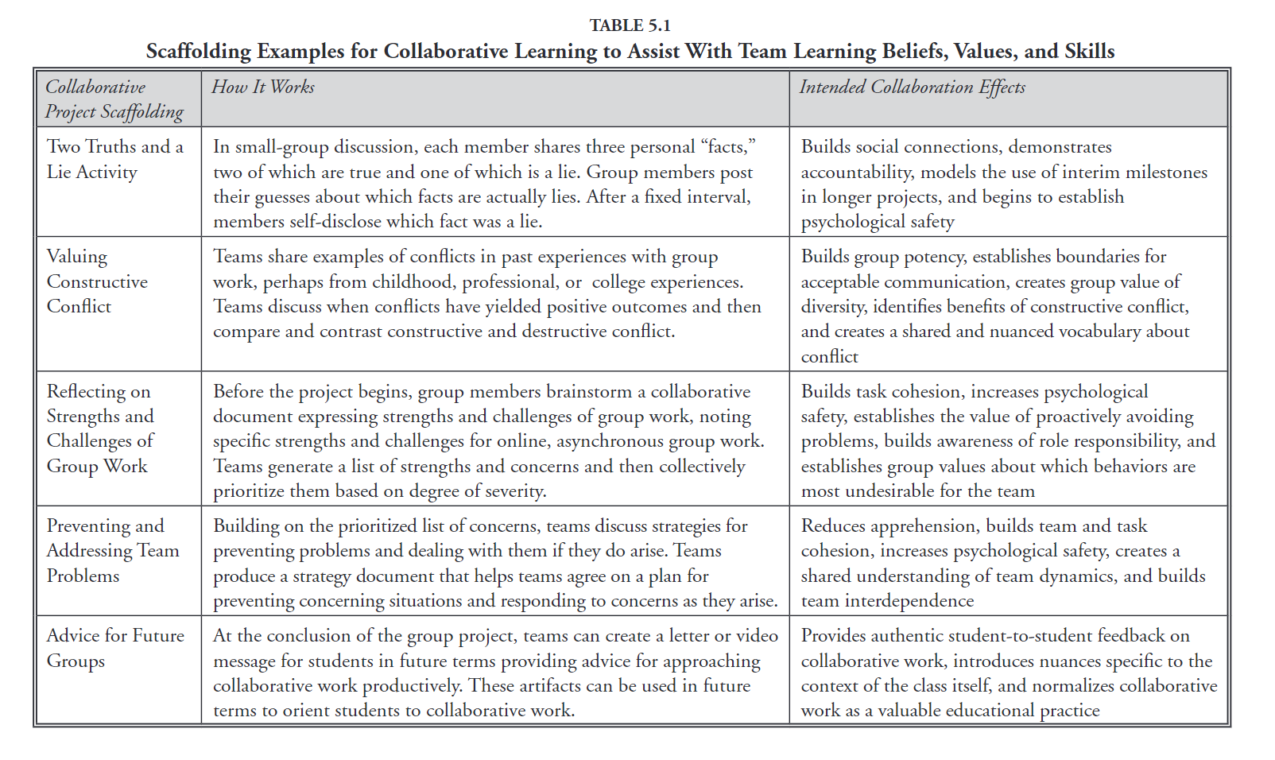
Robertson & Riggs, 2018, p. 75

Slide 16
Evaluating Collaborative Projects
With a subtitle

Slide 17
Evaluation considerations
For longer term projects, include multiple submission & grading checkpoints.
Solo grade only?
Group grade only?
Some combination of the two?
Include a reflection piece

Slide 18
Thank you!
What ideas and questions do you have?

Slide 19
References
Battelle for Kids. (2019). Framework for 21st Century Learning Definitions. P21_Framework_DefinitionsBFK.pdf (battelleforkids.org)
Ellis, R. & Han, F. (2021). Assessing university student collaboration in new ways. Assessment & Evaluation in Higher Education. (46)4, 509-524. https://doi.org/10.1080/02602938.2020.1788504
Evertson, C., Poole, I., & the IRIS Center. (2003). Establishing classroom norms and expectations. http://iris.peabody.vanderbilt.edu/wp-content/uploads/ pdf_case_studies/ics_norms.pdf
Felten & Lambert (2020). Relationship-rich education. https://search-ebscohost-com.ezproxy.tntech.edu/login.aspx?direct=true&db=nlebk&AN=2446122&site=ehost-live&ebv=EB&ppid=pp_80

Slide 20
References, continued
Fjelkner-Pihl. (2022). “Ok—I Need Help from Somewhere”: ‘The Educational Value of Multiplex Student Relationships in a Commuter College.’ Innovative Higher Education. “Ok—I Need Help from Somewhere”: ‘The Educational Value of Multiplex Student Relationships in a Commuter College’ | SpringerLink.
Hilliard, J., Kear, K, Donelan, H., & Heaney, C. (2020). Students’ experiences of anxiety in an assessed, online, collaborative project. Computers & Education. https://doi.org/10.1016/j.compedu.2019.103675
Robertson, R.J. & Riggs, S. (2018). Collaborative Assignments and Projects. High–Impact Practices in Online Education: Research & Best Practices. Linder & Hayes, Eds. Stylus. https://search-ebscohost-com.ezproxy.tntech.edu/login.aspx?direct=true&db=nlebk&AN=1918610&site=ehost-live&ebv=EB&ppid=pp_71

Slide 21
Credits
Special thanks to all the people who made and released these awesome resources for free:
Presentation template by SlidesCarnival
Photographs by Pexels

