Slide 1
OPTIMIZING INSTRUCTOR FEEDBACK
Go to POLLEV.com/rippetoe

Slide 2
Notes:
Poll Title: Do not modify the notes in this section to avoid tampering with the Poll Everywhere activity. More info at polleverywhere.com/support Join instructions https://www.polleverywhere.com/join_instructions

Slide 3
TOPICS
Feedback and feedforward
Student feedback literacy
Design strategies
Audio & video feedback

Slide 4
FEEDBACK AND FEEDFORWARD
What are the most recent uses of these terms?

Slide 5
Notes:
Poll Title: Do not modify the notes in this section to avoid tampering with the Poll Everywhere activity. More info at polleverywhere.com/support Feedback is the single most powerful influence on student success. https://www.polleverywhere.com/multiple_choice_polls/ZGSwmcWJxv7HHvOFLVM6F?state=opened&flow=Default&onscreen=persist

Slide 6
Instructor
Student
Notes:
There are two participants in the feedback process: the person providing the feedback, which can be a professor (or a tutor, or a peer, which we’ll talk about in a minute), and the person receiving the feedback, which in our context is going to be a student.

Slide 7
It can be an emotional business
Notes:
Like assessment, feedback is an emotional business.
As shown in this image, it can cause discomfort for both the sender (typically the educator) and the recipient.
Is the sender’s job over once they have sent the information?

Slide 8
Even the feedback sandwich can feel harsh
Notes:
Feedback can be emotional for both parties; hence the perceived need for the “feedback sandwich”. This “sandwich”, as depicted here in the slide, is similar to the “sugar-coated pill” in its function – disguising the “negative” feedback, or making it more palatable.
Learners see through the ritual of the feedback sandwich – disregard the positive “bread” and jump straight to the “meat”.

Slide 9
The problem with feedback
Learners complain that they do not get enough feedback
Both parties describe it as confronting
Both parties agree that it is very important
Educators resent that although they put considerable time into generating feedback, learners take little notice of it
Educators typically think their feedback is more useful than their learners think
Feedback is typically ‘telling’ and diagnostic in flavour, often lacking strategies for improvement, and often lacking opportunities for further task attempts
Ende 1995; Hattie 2009; Boud & Molloy 2013; Johnson & Molloy 2017
Notes:
This section highlights the problems with feedback, and justifies why we need to think about feedback from another point of view (if we want to generate feedback that makes a difference).
For point six, “diagnostic in flavour” means that, while deficits or strengths in performance are pointed out, strategies for improvement are not provided.

Slide 10
From assessment of learning to assessment for learning

Slide 11
From transmission-centered to learner-centered feedback

Slide 12
Learner-centered feedback offers:
Useful, actional advice to facilitate improvement
Clear opportunities to use this advice in the future
Develops learner’s skills in seeking and using feedback independently over the course of their degree and beyond
Ryan et al., 2021, p. 897

Slide 13
One definition of effective feedback
“Feedback is a process
in which learners make sense of information
about their performance
and use it
to enhance the quality of their work or learning strategies.”
feedbackforlearning.org
Notes:
The Australia (feedbackforlearning.org) project team’s definition of feedback - devised throughout the project.

Slide 14
This is not feedback
“I left feedback on their final essays, which they never collected”
feedbackforlearning.org

Slide 15
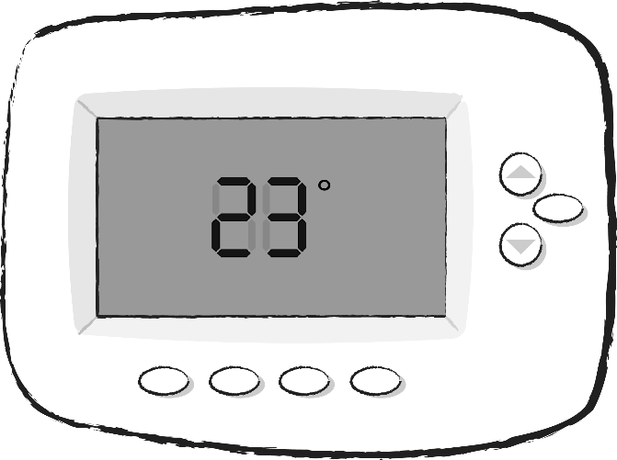
72º
feedbackforlearning.org
Notes:
The understanding of feedback is that feedback is not the input feedback is the process. So in the room there's a thermostat, it's got sensors that are giving it information about the temperature of the room. That thermostat’s job is to keep the temperature at a certain level. The thermostat is told it's too cold, the thermostat then sends a request to a heat pump to heat up the room. The thermostat is monitoring and trying to track any change, and when it sees the change, it sends another signal saying turn the heat pump off
In the places that we've taken the word feedback from there is this sort of long-standing understanding that feedback is a process where inputs lead to change and feedback is not just the input.

Slide 16
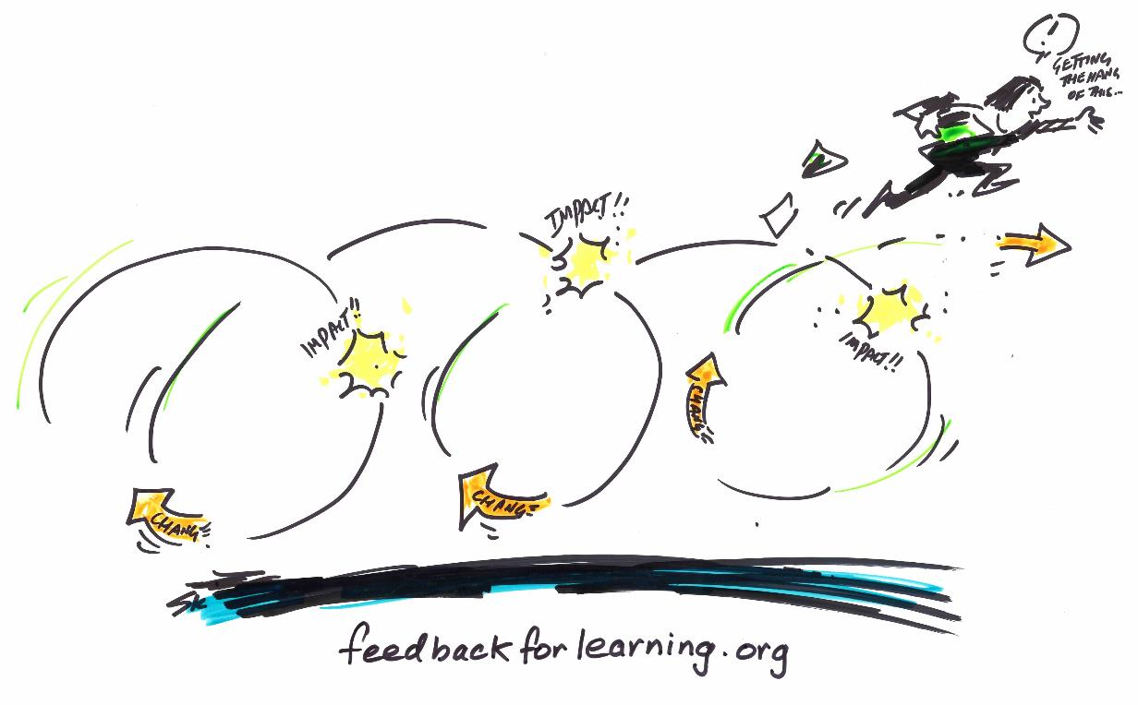
This is feedback
Notes:
So feedback is more akin to this sort of thing than it is to the stack of uncollected essays. Here we've got something that involves a lot of loops, it's iterative, these impacts, there's change and there's a student in charge of the whole thing who's engaged in many cycles getting better and leaping off to the next thing.

Slide 17
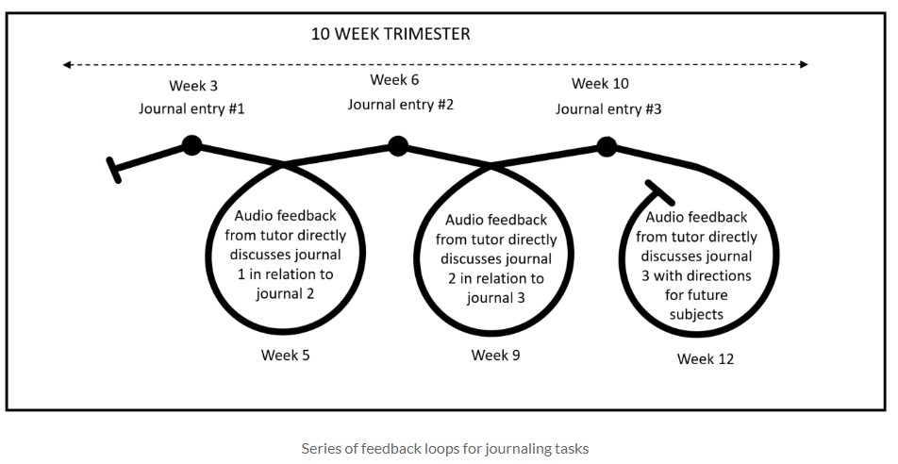
Case study 2 – Personalised feedback at scale – Feedback for Learning

Slide 18
LEARNER-CENTERED FEEDBACK CHARACTERISTICS
Considers affect
Makes comments usable
Strengthens relationships
Encourages dialogue
Promotes learner independence
Ryan et al., 2021
Notes:
CONSIDERS AFFECT: Positively framed feedback = enhanced learner self-efficacy and motivation. Negatively framed comments may reduce self-esteem and lead to disengagement
MAKES COMMENTS USABLE: Use language that is targeted at the right level, easy for learners to understand, and avoids complex academic terms
STRENGTHENS RELATIONSHIPS: Use the student’s name and consider including a brief relational comment to display recognition and value of the individual learner behind the piece of work
ENCOURAGES DIALOGUE: Dialogue may help learners regulate their understandings and clarify any potential misunderstanding about their work with a knowledgeable expert, which, again, can be someone other than the teacher
PROMOTES LEARNER INDEPENDENCE: Phrase feedback comments as suggestions or questions rather than statements

Slide 19
Summary of messages from the literature
Feedback can be powerful
Feedback is rarely powerful
Feedback is not an INPUT but rather a PROCESS, so a focus on feedback design is needed
Feedback needs to be judged in terms of OUTCOMES
Notes:
Point four – quality of feedback is judged on learner outcomes (this is the test of quality).

Slide 20
What is “feedforward”?
A concept seen in both business and education
Feedback specifying what to do in future performances

Slide 21
Feedback vs. Feedforward via @inner_drive
Feedback | Feedforward
Emphasis on the past | Emphasis on the future
Critiques previous work | Suggestions on what to do next time
Describes what has happened | Ideas on how to improve
Focused on what did and didn’t go well | Focuses on how you can develop and progress
Person giving the feedback does most of the work | Person receiving the feedback does most of the work
Highlight errors | Asks, “What would you do differently next time?”
Can lead to people feeling judged | Emphasis is on the task, not the person

Slide 22
Feedforward at its best:
Concentrated on the receiver
Focused on the future
Centered around potential
-- Joe Hirsch

Slide 24
STUDENT FEEDBACK LITERACY

Slide 25
Notes:
Poll Title: Do not modify the notes in this section to avoid tampering with the Poll Everywhere activity. More info at polleverywhere.com/support Students' ability to effectively engage with and utilize feedback processes needs more attention. https://www.polleverywhere.com/multiple_choice_polls/XdD0SWid7Sb3TijeAogsi?state=opened&flow=Default&onscreen=persist

Slide 26
Student Feedback Literacy
How students understand and can utilize feedback for their own learning
Carless & Boud (2018)
Notes:
Shift from what teachers do to initiate feedback to what students do and how they might be more actively involved (Molloy et al., 2020)

Slide 27
Take an active role to seek information
Make sense of that information
Undertake subsequent tasks to enable translation of newly constructed knowledge into practice
STUDENTS’ ROLE IN THE FEEDBACK PROCESS

Slide 28
KEY FEATURES OF STUDENT FEEDBACK LITERACY
Appreciating feedback
Making judgments
Managing affect
Taking action

Slide 29
Feedback An example
Orientation to standards of work & purpose of feedback
Activity 1
Learner judges work
Learner asks for specific feedback
Others judge work
Compare judgements
Plan for improved work
Activity 2
Notes:
Run through the key elements of Feedback Mark 2 (using laser pointer).
The learner has the tough job of “comparing judgements” (their own evaluative judgement with the opinions of others) – and then needs to come up with a plan for improved work.
As in Feedback Mark 1, there needs to be a second activity set up for learners so that the feedback can have an effect.

Slide 30
DESIGN STRATEGIES

Slide 31
Notes:
Poll Title: Do not modify the notes in this section to avoid tampering with the Poll Everywhere activity. More info at polleverywhere.com/support Teachers can design for effective feedback. https://www.polleverywhere.com/multiple_choice_polls/OEEVGc6bvnV4YVzaKhBbi?state=opened&flow=Default&onscreen=persist

Slide 32
DESIGN STRATEGIES
Segment assignments so they build on feedback
Discuss/present your own experiences with feedback
Ask students what kind of feedback they would like
Have students develop a plan for responding to and utilizing feedback
Notes:
Describe your own experiences of receiving and working with feedback. Solicit students’ experiences and concepts of feedback. What they experience in college may be different from secondary school. Elbow’s three readers example.
This can include doing group evaluations of exemplary work and having students review their own work based on a rubric. This can also include both your feedback as well as feedback from tutors, writing center personnel, and peers.

Slide 33
LOOKING FOR EFFECT
It’s ok to start small
“Identify one teacher comment and explain one reaction to the comment.”
Notes:
In this kind of feedback, students have opportunities to incorporate new strategies into practice AND educators are able to monitor the effect of their comments (to calibrate their own feedback practices).
One premise of the task design is that Activity 2 must be somehow related to Activity 1.

Slide 34
ITERATIVE TASK DESIGN
Activity 3
Activity 2
Activity 1
Overlap of learning outcomes
Degree of task
challenge
Overlap of learning outcomes
Time
Molloy & Boud 2013
Notes:
The x axis is time, and the y axis represents degree of task challenge.
You can see the overlapping of learning outcomes, which means that students have a chance to improve elements of work that were commented upon in the earlier task.

Slide 35
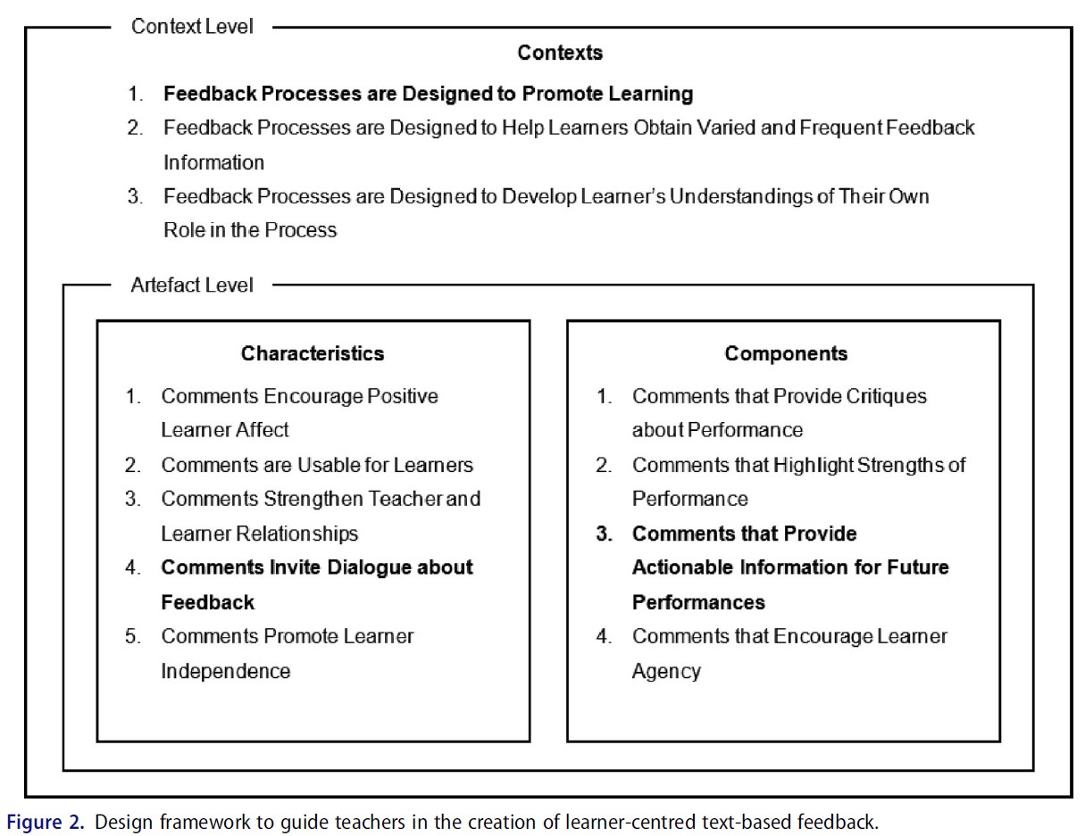
THREE THINGS TO DO FIRST
Ryan et al., 2021
Notes:
Based on the evidence presented within this paper, teachers who are motivated to move toward learner-centred feedback design, but who need to limit additional labour, may do well to focus their energies on the three design attributes that aligned with all four learner-centred conceptualisations of feedback:
designing feedback processes to promote learning (Context #1),
ensuring that comments invite dialogue (Characteristic #4) and
providing comments that include actionable information (Component #3).

Slide 36
AUDIO & VIDEO FEEDBACK

Slide 37
Notes:
Poll Title: Do not modify the notes in this section to avoid tampering with the Poll Everywhere activity. More info at polleverywhere.com/support I have tried or am using audio or video feedback. https://www.polleverywhere.com/multiple_choice_polls/S4lYr4KdrrZsnrQf1KEwv?state=opened&flow=Default&onscreen=persist

Slide 38
“I like the audio feedback. It kind of forces me to write out everything I need to work on for my next assignment. So, I’m kind of forced to sit and listen to it all, when sometimes you can just kind of skim through written feedback and throw it away.”
Student quoted in Molloy et al., 2020

Slide 39
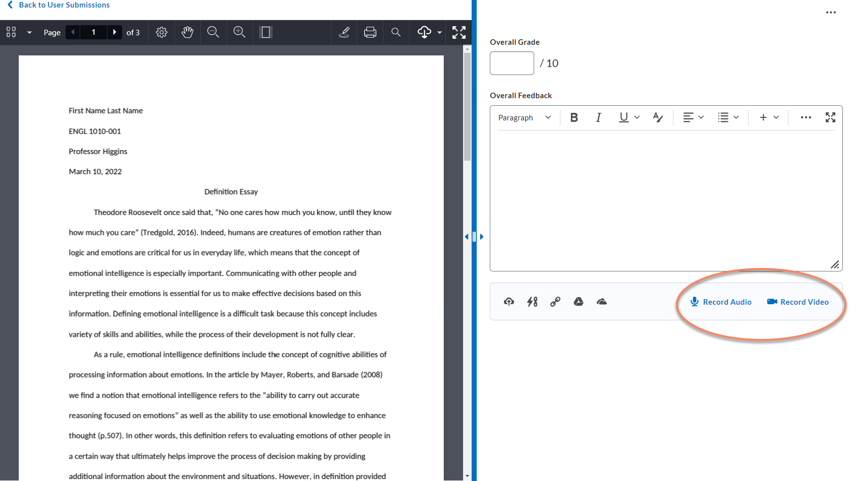

Slide 41
AUDIO & VIDEO FEEDBACK
Most student’s approve
But be aware that …
‘Personalized’, ‘supportive’ and ‘motivating’
May help build educator-learner relationships, with learners considering educators more ‘approachable’ after listening to audio feedback
Some studies report that learners find listening to audio feedback stressful, and that hearing their educator’s voice may amplify critical comments
Gould & Day, 2013; Voelkel & Mello, 2014

Slide 42
ONE FINAL RESOURCE

Slide 43
Notes:
Poll Title: Do not modify the notes in this section to avoid tampering with the Poll Everywhere activity. More info at polleverywhere.com/support What's one key takeaway from today's session? https://www.polleverywhere.com/free_text_polls/eSZTfKBn09l9etZlyDN81

Slide 44
THANK YOU!
THOUGHTS? QUESTIONS?

Slide 45
References
Bowman, J.D. (2020). Getting students to engage with feedback. How to Get Students to Use Feedback | Edutopia
Feedback for Learning: Closing the assessment loop. (n.d.) https://feedbackforlearning.org/
Gould, J. & Day, P. (2013). Hearing you loud and clear: learner perspectives of audio feedback in higher education. Assessment & Evaluation in Higher Education, 38(5), 554-566. doi:10.1080/02602938.2012.660131
Ryan, T. Henderson, M. Ryan, K., & Kennedy, G. (2021). Designing learner-centred text-based feedback: a rapid review and qualitative synthesis. Assessment and Evaluation in Higher Education. 46(6), 894-912. https://doi.org/10.1080/02602938.2020.1828819
Voelkel, S. & Mello, L. V. (2014). Audio
feedback – better feedback? Bioscience
Education, 22(1), 16-30.
doi:10.11120/beej.2014.00022

Slide 46
CREDITS.
Presentation Template: SlidesMania
Sample Images: Unsplash
Fonts used in this presentation: Roboto

