Slide 1
Feedback from Students: Midsemester Evaluations
Taylor Chesson – Instructional Designer

Slide 2
What?
Feedback from students is a low-stakes way of obtaining formative feedback from your students at a point in the semester when any adjustment you make can benefit your current students.
(“Mid-Semester Evaluations”)

Slide 3
When?
To Administer:
After the first big unit
Mid-Semester Evaluations
To Act:
Immediately
Next Semester
Next Course Revision

Slide 4
Why (for students)?
Positively affect student motivation
Lead to increased student engagement in class
Reduce the time it takes to learn a concept or skill
Enhance critical thinking abilities
Build metacognitive skills
Increase student responsibility for their own learning
(Pedersen, 2020)

Slide 5
Why (for teachers)?
Make sure teaching is connected to learning
Assess own instructional approach when teaching a course
Discover the impact of instructional changes from the previous semester
Demonstrate care and commitment to students' success
Avoid surprises in their end-of-semester course evaluations
(“Mid-Semester Feedback”)

Slide 6
How?
Exit Tickets
Reflection Surveys
Stop, Start, Continue
Course Structure Surveys
Self-Assessments
Critical Incident Questionnaire (Brookfield)
50 CATs
(Angelo & Cross)
(Pedersen, 2020)

Slide 7
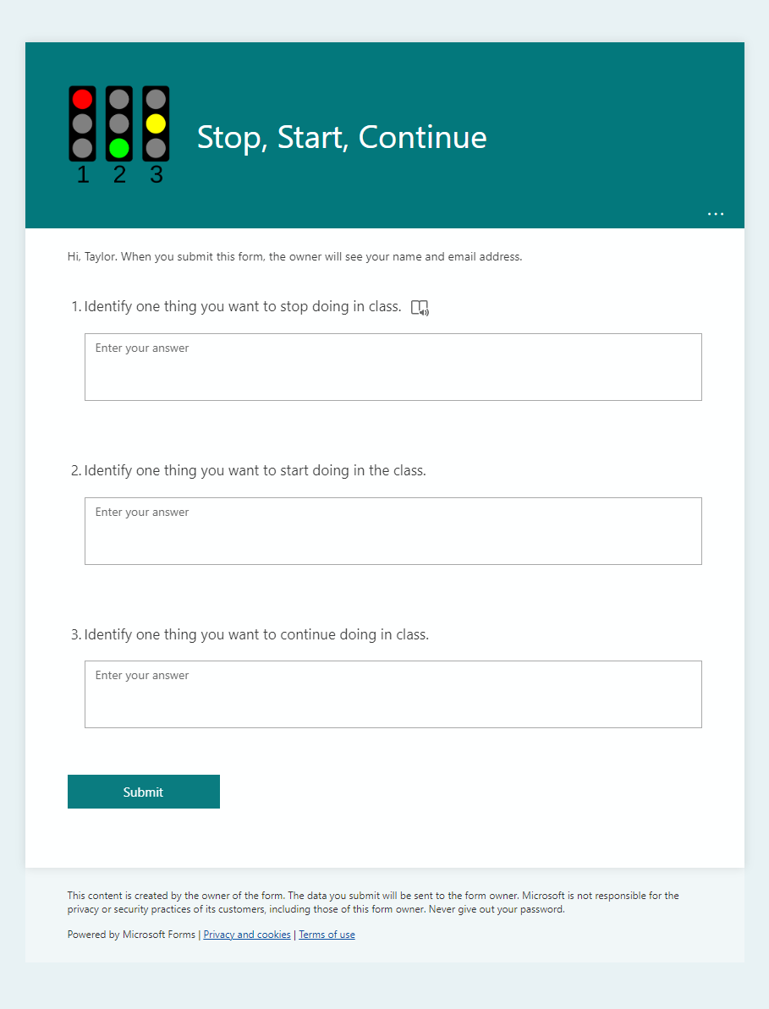
How? Polling
MS Forms
Qualtrics
Poll Everywhere
Survey Tool in iLearn
Notes:
Example of Start, Stop, Continue

Slide 8
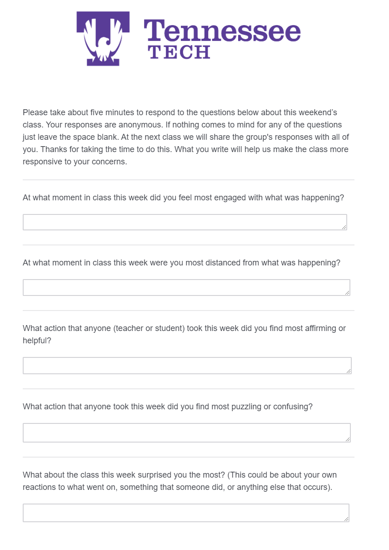
How? Polling
MS Forms
Qualtrics
Poll Everywhere
Survey Tool in iLearn
Notes:
Example of Brookfield’s Critical Incident Questionnaire

Slide 9
How? Polling
MS Forms
Qualtrics
Poll Everywhere
Survey Tool in iLearn
Notes:
Session on Poll Everywhere (8.30)
https://www.tntech.edu/citl/programs/engagement.php
Example of Exit Ticket

Slide 10
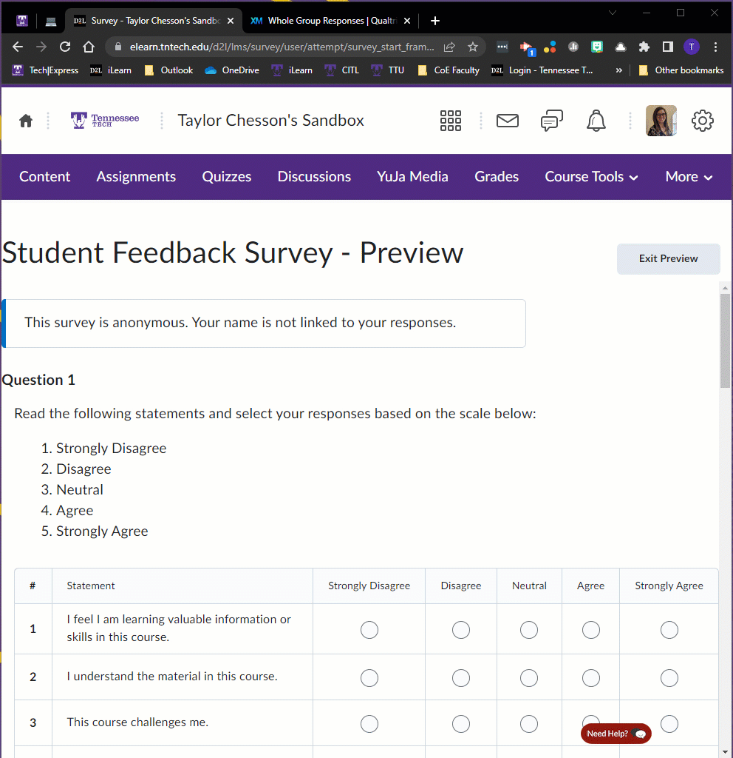
How? Polling
MS Forms
Qualtrics
Poll Everywhere
Survey Tool in iLearn

Slide 11
How? Discussion Board
FAQ
Suggestion Box
CyberCafe

Slide 12
How? Small Group Instructional Diagnostic (SGID)
CITL SGID Page

Slide 13
Small Group Instructional Diagnostic (SGID)
Mid-term course evaluation
Outside Facilitator (CITL)
Conducts a discussion with students
Provides feedback to an instructor
Students
Answer questions individually
Break into groups and reach a consensus
Faculty
Leaves classroom to ensure student anonymity
Has in-class discussion about SGID results
Receives feedback of areas students agree/disagree
Notes:
Simple and straightforward method of mid-term course evaluation
Uses an outside facilitator to conduct a discussion with students and to provide feedback to an instructor.
Faculty member is not in the classroom when the SGID occurs.
Facilitator takes students through a series of questions about the course, individually and in small groups, where the small group members must reach consensus on their answers.
This process can give the faculty member a good idea of areas where there is a lot of student agreement and/or where the class is divided.
After a SGID is done, the faculty member should have a conversation with students about the results of the SGID.

Slide 14
SGIDs can…
Help strengthen communication between faculty and students.
Offer an opportunity to make mid-semester course adjustments.
Assist in the development of ideas for strengthening a course.

Slide 15
Perceptions of Student Learning
Faculty felt midcourse evaluations improved student learning.
Interview: 90%
Survey: 59% (only 11% did not)
Student Reponses:
71% felt their learning would increase because their faculty conducted an evaluation.
45% said they would rate their professors more highly at the end of the semester because they had conducted a midcourse evaluation.
(McGowan & Osguthorpe, 2011. p. 168)
Notes:
In a study done at BYU regarding mid-course evaluations.

Slide 16
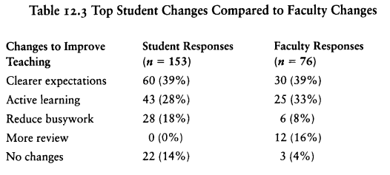
Actions to Improve Student Learning
(McGowan & Osguthorpe, 2011. p. 169)

Slide 17
SGIDs:
Should only take 20-25 minutes of your class time
Confidential
Not tied to assessments/evaluations

Slide 18
SGID Procedure
Bookings
Pre-Meeting
During
Reports
Post-Meeting

Slide 19
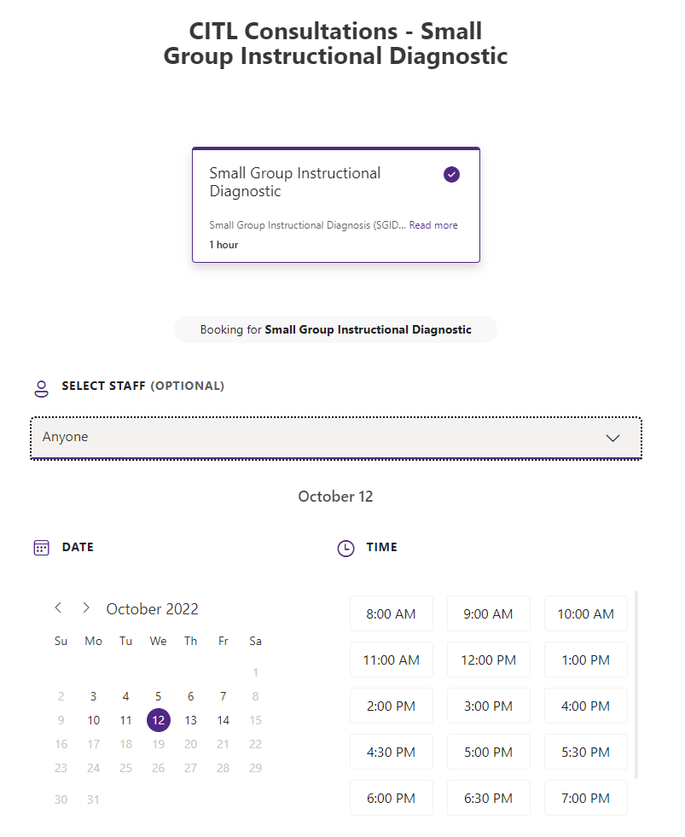
Bookings
CITL SGID Bookings Page
September 26 - October 14
Included:
Class Information
Preferred Time
Additional Information
Notes:
Course Name and Section
Date and Time Class Meets
Number of Students Enrolled in the class
Where does your class meet?
Additional Information (optional)

Slide 20
Pre-Meeting
Purpose: Opportunity for the facilitator to find out whether there are issues that the faculty member would like the facilitator to be attentive to during the process.
Discuss SGID Process
Show Instructor survey questions
See if any questions need to be changed
Confirm meeting time

Slide 21
Survey Questions
Briefly describe at least three things you like about the course–the characteristics that you believe support your learning.
Briefly describe at least three things you dislike about the course–the characteristics that you believe hinder your learning.
What suggestions can you offer that would enhance your learning?
What can you (students) do to improve your learning?

Slide 22
During SGID
Students will receive an email from the CITL with a survey link the day of the SGID.
Students will answer individually. All responses will be anonymous.
Students will split into groups of 3-4, and they will reach a consensus of one answer for each question.
One person from the team will resubmit the survey with group results.

Slide 23
After SGID
Students will receive a second email from the CITL with a new survey link.
The survey takes the group responses and allows students to agree, disagree, or remain neutral for each response.
Students have 24 hours to complete the second survey.

Slide 24
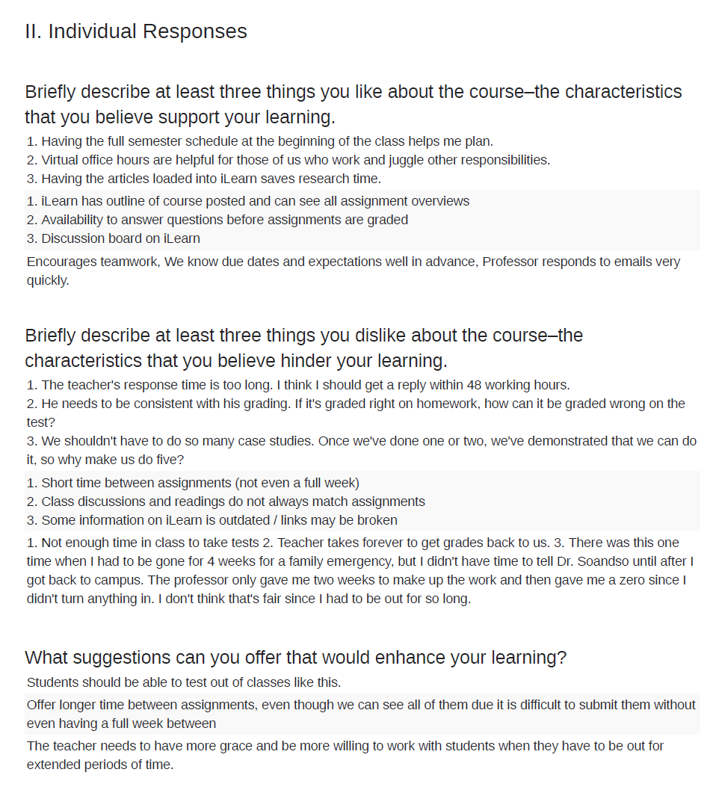
Individual Report
Example

Slide 25
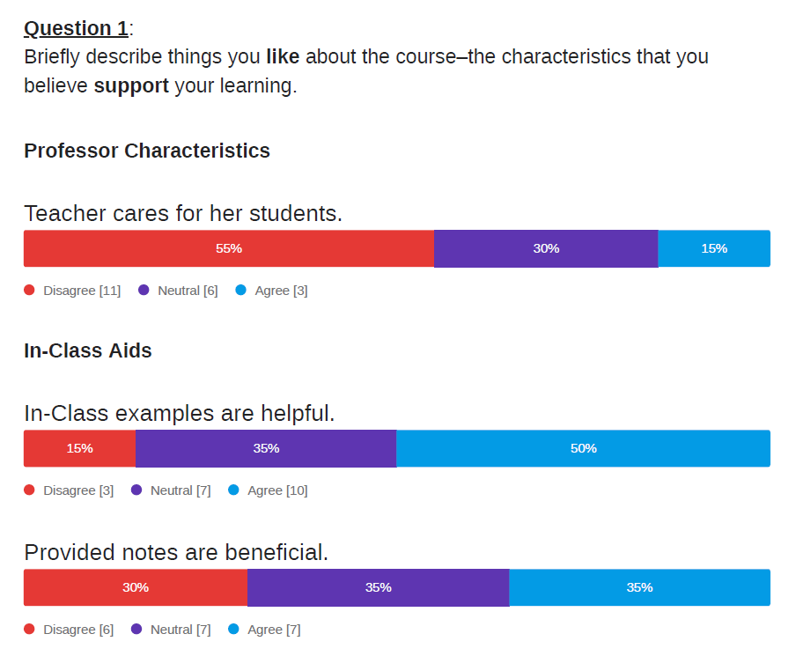
Whole Group Report
Example

Slide 26
Faculty Engagement with Student Feedback
2%
Did not discuss with students
5%
Discussed with students and made no changes
9%
Discussed with students and made changes
* Percentage of improvement in rating scores
(McGowan & Osguthorpe, 2011. p. 169)

Slide 27
The nature of the comments that you get back through the SGID is the information we want as instructors from the IDEA. We read all the comments we get at the end of the semester and hope for "the pearl" amongst all of that for something that we can actually do to improve […] The nature of the comments [from SGID] was much richer, more reflective, and more actionable.
Dr. S. Pardue (College of Engineering)

Slide 28
Post-Meeting
CITL Facilitator will gather data and generate a report within 48 hours.
Facilitator and Instructor can meet again to discuss feedback.
Instructor takes results back to class and discusses with students.

Slide 29
References
THANK YOU
McGowan, W. R., & Osguthorpe, R. T. (2011). Student and faculty perceptions of effects of midcourse evaluations. To Improve the Academy, 29 (1), 160-172. doi:10.1002/j.2334-4822.2011.tb00629.x
“Mid-semester evaluations.” (n.d.). Center for Innovative Teaching and Learning at Indiana University. Retrieved 14 Sept. 2022 at Web Address.
“Mid-semester feedback.” (n.d.). Center for Teaching & Learning at UT Austin. Retrieved 14 Sept. 2022 at Web Address.
Pendersen, J. (2020). Why you should use a mid-semester evaluation. iTeachU at UAF eCampus. Retrieved 14 Sept. 2022 at Web Address.

