Slide 1
Breakout Rooms for student engagement
Virtual options for group activities

Slide 2
A little review of engagement
The Student Engagement Series, so far:
The Primacy/Recency Effect, When Learning Takes Place
Increase Student Engagement by Leveraging the Learning Management System
Improve Student Engagement with Less Technology
Breakout Rooms for Student Engagement

Slide 3
Session topics
Benefits of Group Work
Platform Options for Breakout Rooms
Strategies & Activities for Groups
Some Things to Keep in Mind

Slide 4
Benefits of group work
Exposes students to a variety of perspectives
Helps students improve their negotiating skills
Students learn to teach others
Boosts critical thinking skills, active learning and independent thinking
Engages students in proactive collaboration
Improves social skills
Provides a deeper understanding of the material
Increases student engagement

Slide 5
Options for breakout rooms
Virtual meeting platforms

Slide 6
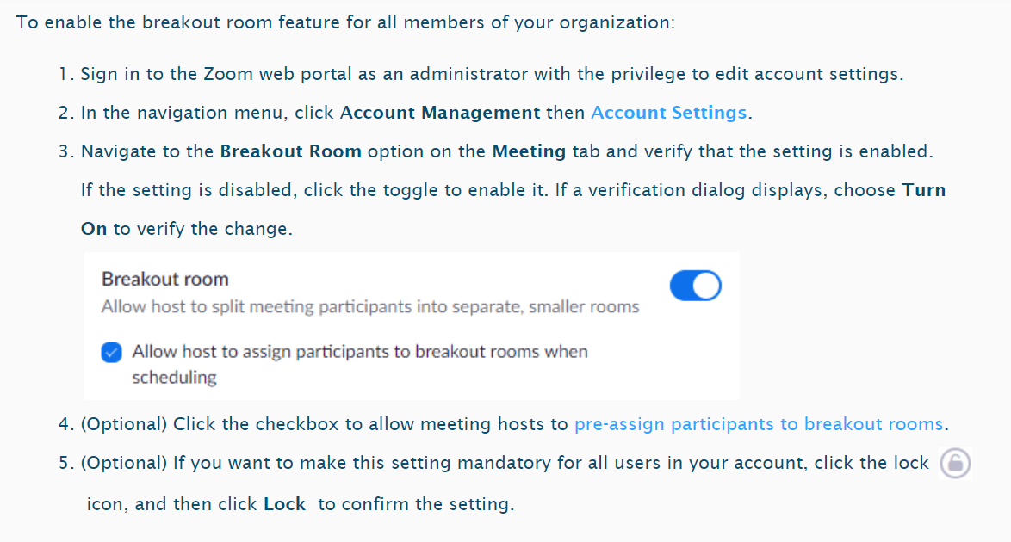
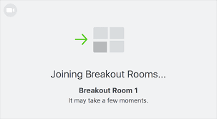
Zoom breakout rooms
Notes:
Accounts at Tech are limited
40min time limit for non-pro accounts
Zoom campus/pro account for campus until May

Slide 7
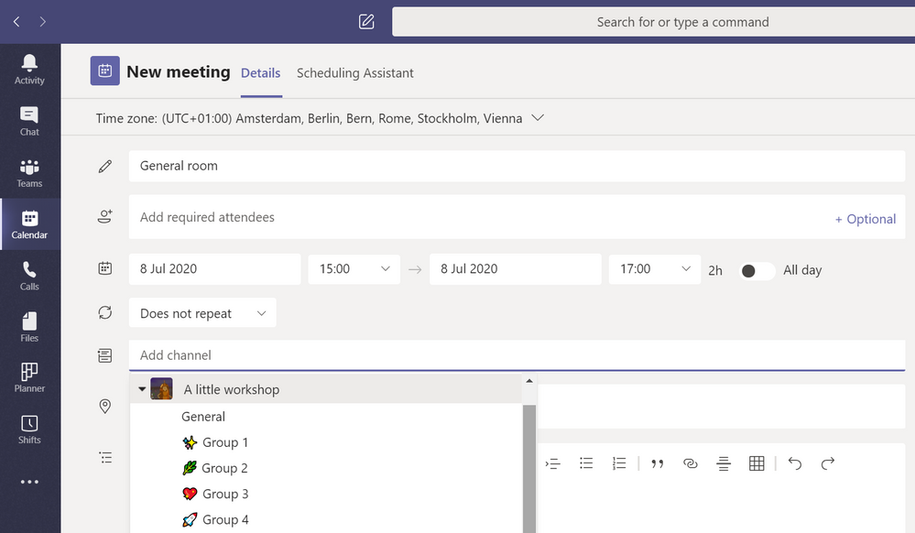
Ms Teams
Notes:
Have to create separate channels to act as rooms
Then create separate meetings for each channel
Tough to manage and a lot of work on the front end
MS Teams has breakout room feature on the way

Slide 8
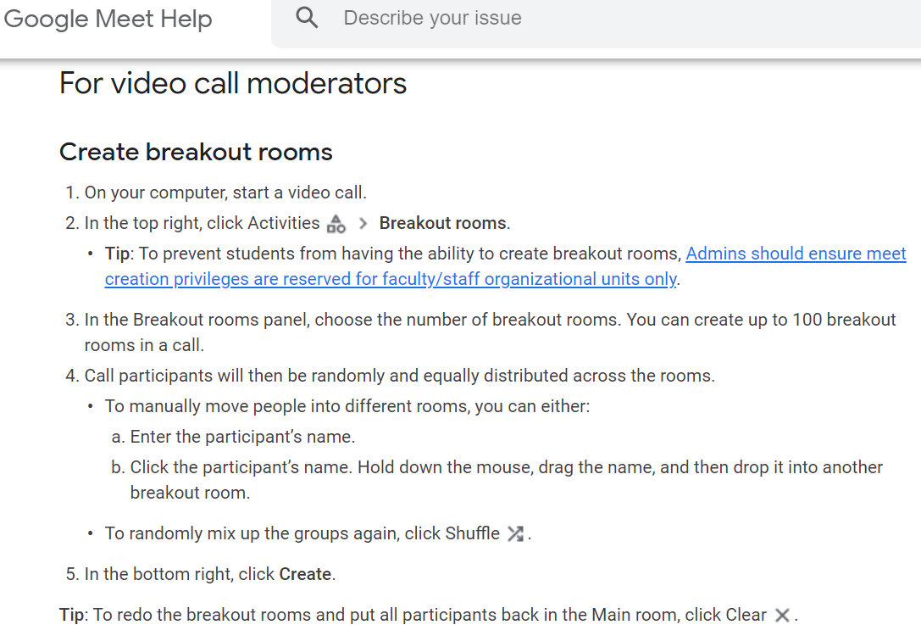
Google meet
Notes:
Free for up to 100 meeting participants
Time limit up to 1 hour

Slide 9
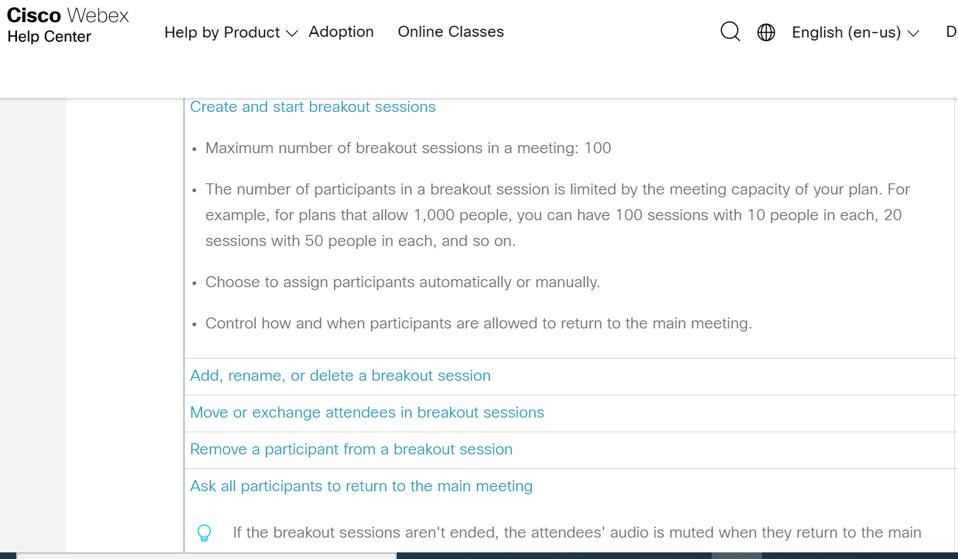
webex
Notes:
No time limitations known
Number of participants depends on plan

Slide 10
Breakout plan
Some suggestions for group activities

Slide 11
Round robin
Pose an open-ended question to all students
Give them some time to think independently
Create breakout rooms of 3 to 8 members and instruct students to allow each person in the group to briefly share their response to the question.
Have a designated reporter for each group share their discussion with the entire class
This activity allows every student in your course to share. Be explicit about how much you want students to share (one word, one sentence, or for one minute).

Slide 12
Jigsaw
Identify a learning module that can be broken into parts (example: students need to read four different research papers about the same or a similar topic).
Form small groups and have each group focus on one of the parts (e.g., each group reads one of the four papers). This can be completed asynchronously.
During class, allow the groups to discuss their part with the goal of being able to explain it to other classmates.
Reform the groups so that each new group has one member that focused on a different part. Each group member now explains their part to the new group.
Provide the new groups with a problem to solve that requires the integration of the different parts.
Note: Make sure to only use this model for material that sensibly breaks into complementary or dependent parts. Otherwise, students may find little motivation to learn the other parts from their classmates.

Slide 13
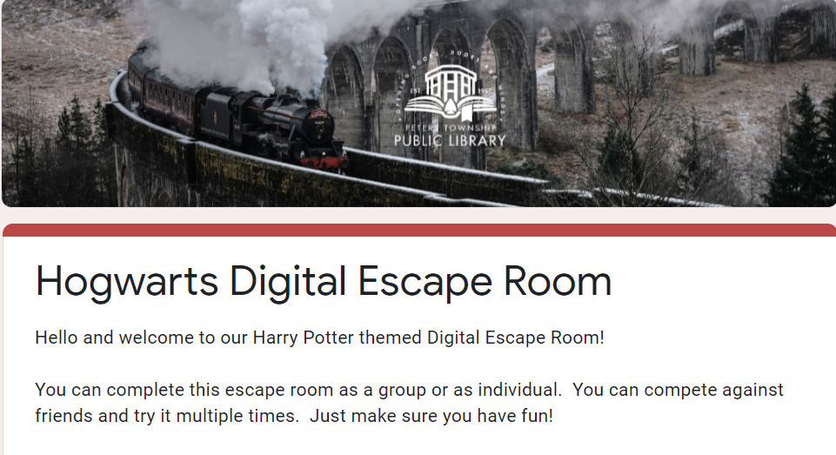
Escape rooms
https://docs.google.com/forms/d/e/1FAIpQLSflNxNM0jzbZJjUqOcXkwhGTfii4CM_CA3kCxImbY8c3AABEA/viewform
Notes:
Created in Google Forms
Fun way to present questions and challenges to students

Slide 14
Two-stage “exam”
Students complete an exam (or exam-like questions) individually, keep a copy of their responses, and submit another copy to the instructor. This can be completed asynchronously, think flipped classroom.
Students are put into small groups, complete the same or similar exam, and submit their answers together.
It is not necessary that these “exams” be graded or worth a significant portion of a student’s grade. This could be used simply as a learning activity.
If you do decide to grade this activity, it is recommended that the individual portion count for 85-90% of the grade and the group portion count for the rest, if the student’s individual score is higher than their group score, their grade will be based solely on their individual score.

Slide 15
Create a game or trivia
Create a Kahoot or Quizizz (or any other virtual gaming platform) that is tied to a learning objective.
Divide the class into breakout rooms and allow them to compete in the game in small groups.
The smaller the group the more likely each student will have a chance to answer and participate.

Slide 16
Think-Pair-Share
Propose a question and allow students to think independently for some time.
Create breakout rooms with two students in each room and ask the students to discuss in pairs.
Help students to decide who speaks first and who will be the reporter using an equitable prompt such as selecting the person: whose first name is closest to the end of the alphabet, whose birthday is coming up the soonest, whose hometown is closest to campus, etc.
Close breakout rooms and ask all or some reporters to share what they discussed in their pair.

Slide 17
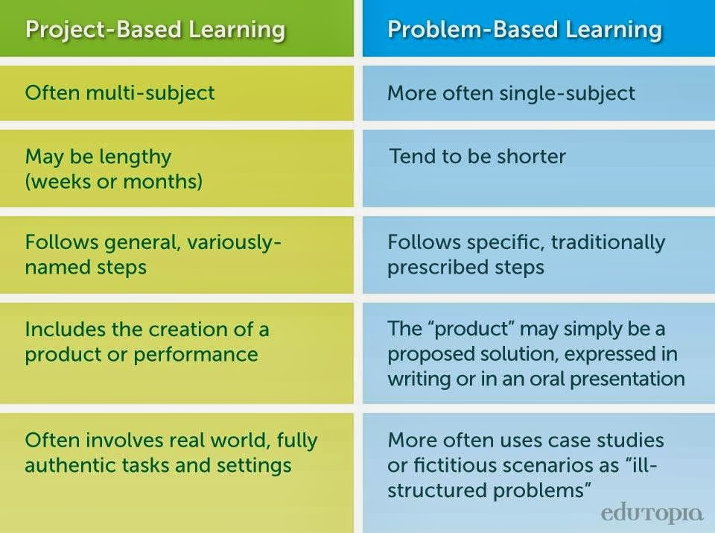
Project based learning
Separate the class into teams and assign each team a project.
Allow the students to work together in their teams while managing their progress.
This could be used as a single class option or a longer term project that spans over several class meetings.

Slide 18
Keep in mind
Some best practices to consider

Slide 19
practices to consider
Have a plan. Don’t attempt to do a breakout activity without some idea of how you want it structured and what outcome you would like to achieve.
Share instructions for the breakout activity where students can see them. Use a shared document or post within the group activity, if possible
Assign a clear task for students to accomplish, such as brainstorming, coming to a position on a set of questions, etc.
Assign roles to students. Assigning roles will help students start the conversation and support equitable participation. (reporter, speaker, scribe…)
Teach students to share their screens and use other room features. Make sure your students are comfortable using the platform before you attempt a breakout session.

Slide 20
Questions or comments?
Thank You!

