Slide 1


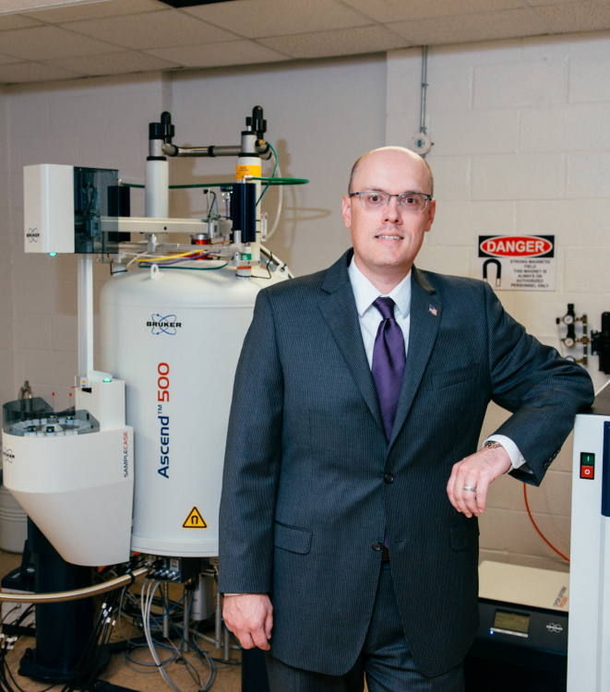

Best Practices in Proposal Development
Research 101 Workshop:

Slide 2

Research 101 Workshop
Best Practices in Proposal Development
Notes:
External funding is extremely competitive and while funding rates differ depending on funding agency and funding program, they are typically in the 20 – 25% range. The good news is that there are things you can do to increase the competitiveness of your proposals and we are going to talk through those “best practices” today.

Slide 3
Topics to be Covered
Know the funder and understand the process
Understand the importance of the solicitation
Develop a realistic timeline
Talk to the program officer
Take advantage of available resources
Don’t just write a proposal, craft it!
Identify key aspects of budget development
Understand the significance of budget justification
OoR staff PreAward contacts

Slide 4





Life Cycle of a Sponsored Project
Develop Proposal
Submit Proposal
Put together competitive proposal that meets all applicable guidelines.
Submit proposal in a timely manner through the required method.
Identify Funding Source
Manage Award
Utilize SPIN, Grants.gov, and other resources.
If funded, the project should be implemented according to award documents and complying with all applicable guidelines.
Project Idea
Completed
Award Close-out
Ensure that all required reports are completed and applicable closing procedures are followed.

Slide 5
Getting to know the funder
At a basic level, you need to understand:
  What are the funding priorities of the agency?
  Who/what do they fund?
  What process (e.g. ad hoc review, panel review, etc.) is used to evaluate proposals?
A good way to learn about an agency is to serve on a review panel.
Look for information about who/what have previously been funded under specific programs (may be on agency website)

Slide 6
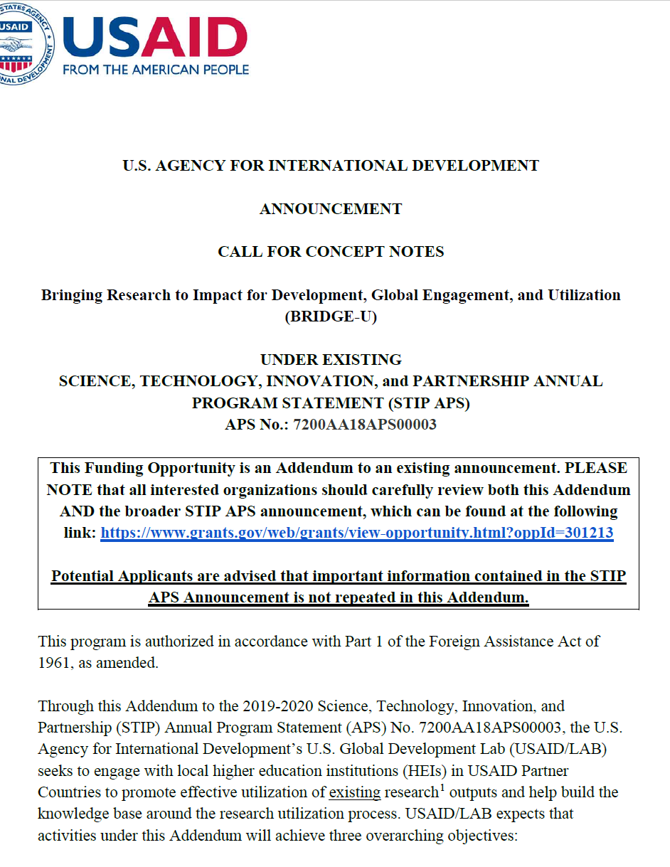
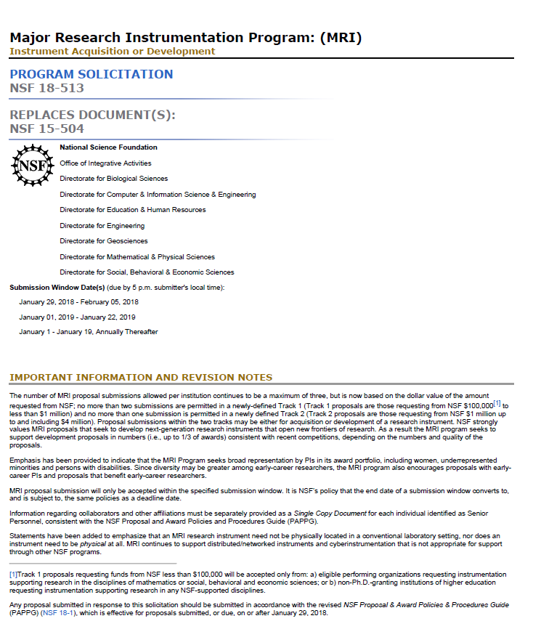
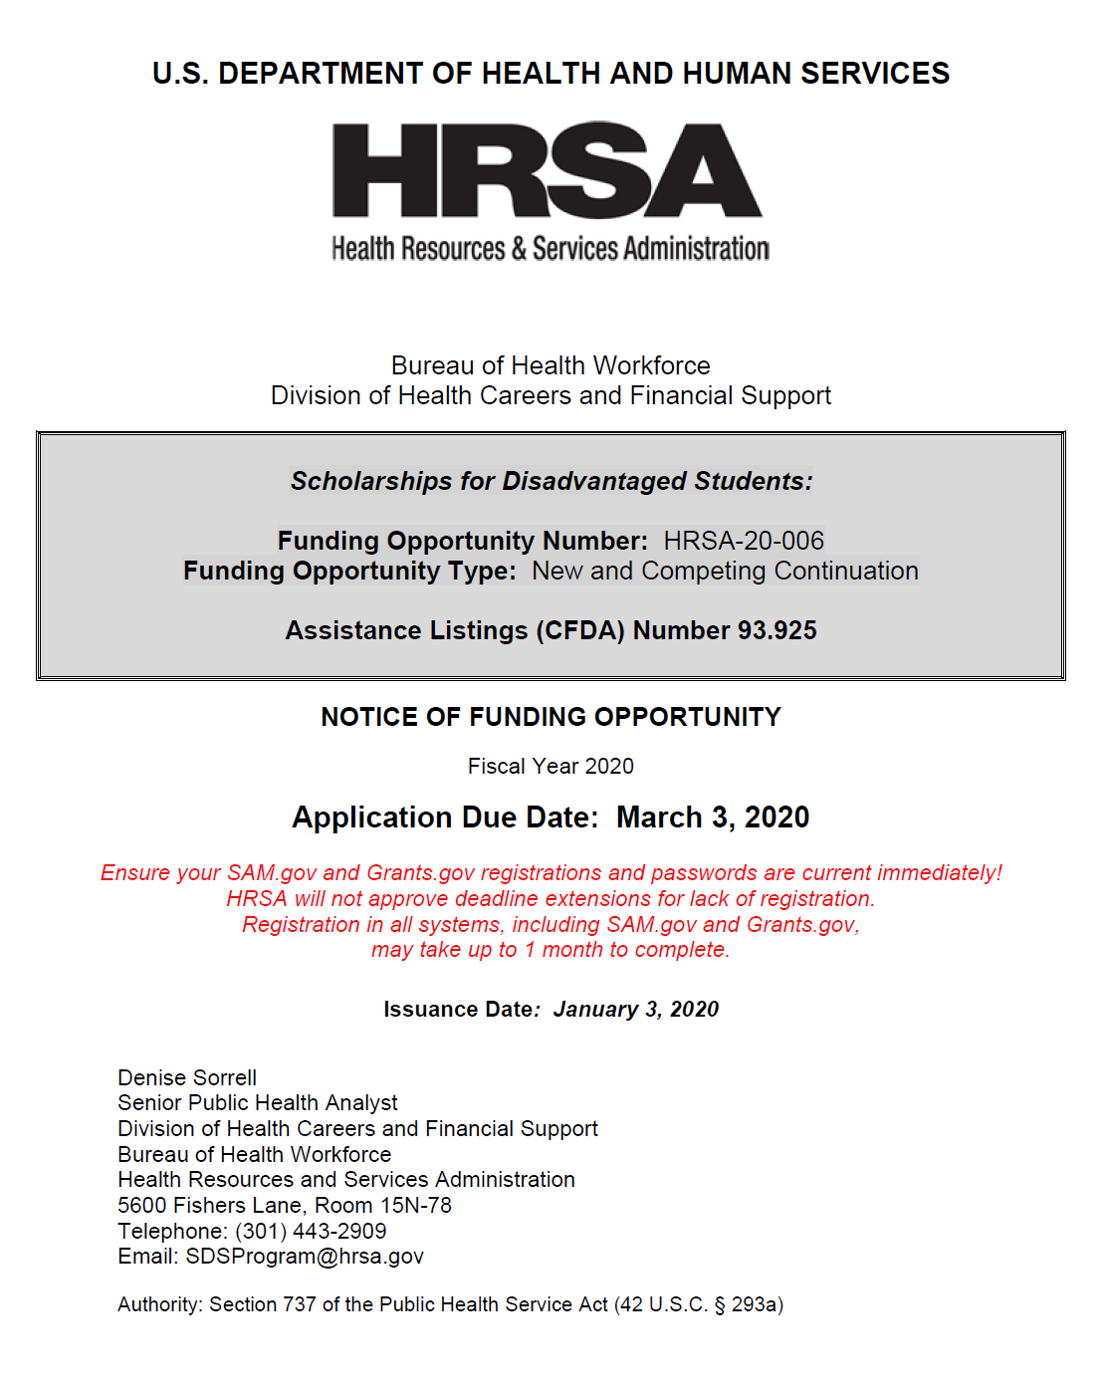
Solicitation/RFP/FOA/NOFA/RFA

Slide 7
Importance of Solicitation
Provides insight about a specific funding opportunity
Read carefully and make sure you (and any collaborators) understand the expectations
Determine the funding priorities and how your project aligns
Review eligibility requirements, deadline information, and how project should be submitted.

Slide 8
Importance of Solicitation Con’t
Determine required documents: project description, biosketches, current and pending support, etc.
Review budget guidelines – what costs are allowable?, are there any costs that are required?
Develop a project description/narrative template based on the requirements in the solicitation
Understand what review criteria will be used

Slide 9
Develop a realistic timeline
Use proposal deadline as an endpoint and work backward to schedule tasks
Allow time for multiple drafts of project description/narrative
Allow time for colleagues (and Office of Research staff) to critique and proofread your draft
If timeline isn’t realistic, consider postponing submission to allow time to develop competitive proposal

Slide 10
Contact the Program Officer
Ideally this contact should take place several months before the proposal deadline.
It should happen only after you have carefully read through the entire solicitation (more than once)
This contact is to determine if your project idea is a good “fit” for their program
Start with an email along with a one pager of your project idea.

Slide 11
Resources Available
Research Development and Grant Writing News – monthly newsletter
Faculty Research Directory – useful in forming project team
Expertise in Department and College
Expertise in the Office of Research
Expertise in the Centers
New Faculty Guide to Competing for Research Funding

Slide 12
Research Toolkit
A research toolkit is available on the Office of Research website.
The toolkit includes samples and templates for common proposal components, as well as information on the core facilities available at Tennessee Tech.
This page is a work in progress, so please let us know if you think of something to be added.
https://www.tntech.edu/research/resources/research-toolkit.php

Slide 13
Crafting your narrative
Carefully outline your narrative – base page approximations on review criteria
A common mistake is to spend too much time/space on laying out the problem.
The bulk of the narrative should be focused on what you plan to do and how you plan to do it.
Be sure to include information on the research team and their qualifications.

Slide 14
Key Aspects of Budget Development
Review RFP for budget restrictions and other key budget details.
The budget comes from the statement of work- costs to achieve the activities listed.
When preparing a budget, consider both direct and indirect costs.
Ask for help if you aren’t sure!

Slide 15
Budget Justification
Critically important –grant funding is a competitive situation – so go the extra mile!
The justification is a written explanation of the items requested in the budget.
Explain why items are essential in relation to the aims and methodology of the project as well as meeting the goals of the proposal.
The more detail the better!

Slide 16
Common Budget Mistakes
Salaries: only TTU personnel are listed in this category and their compensation must be tied to their institutional base salary.
General Overhead Supplies: not allowed.
Cost-share: cannot be voluntary.
Indirect Costs Rate: this is non-negotiable. The institutions federal rate is to be used unless otherwise specified by the agency.

Slide 17

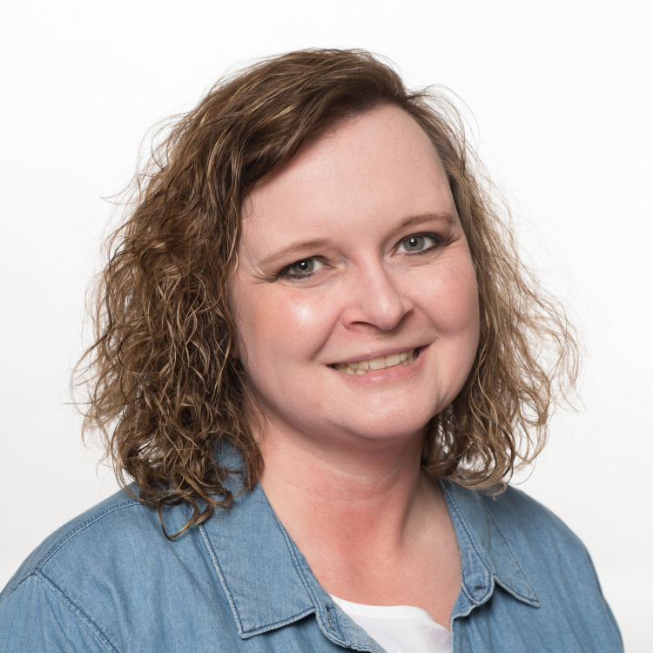
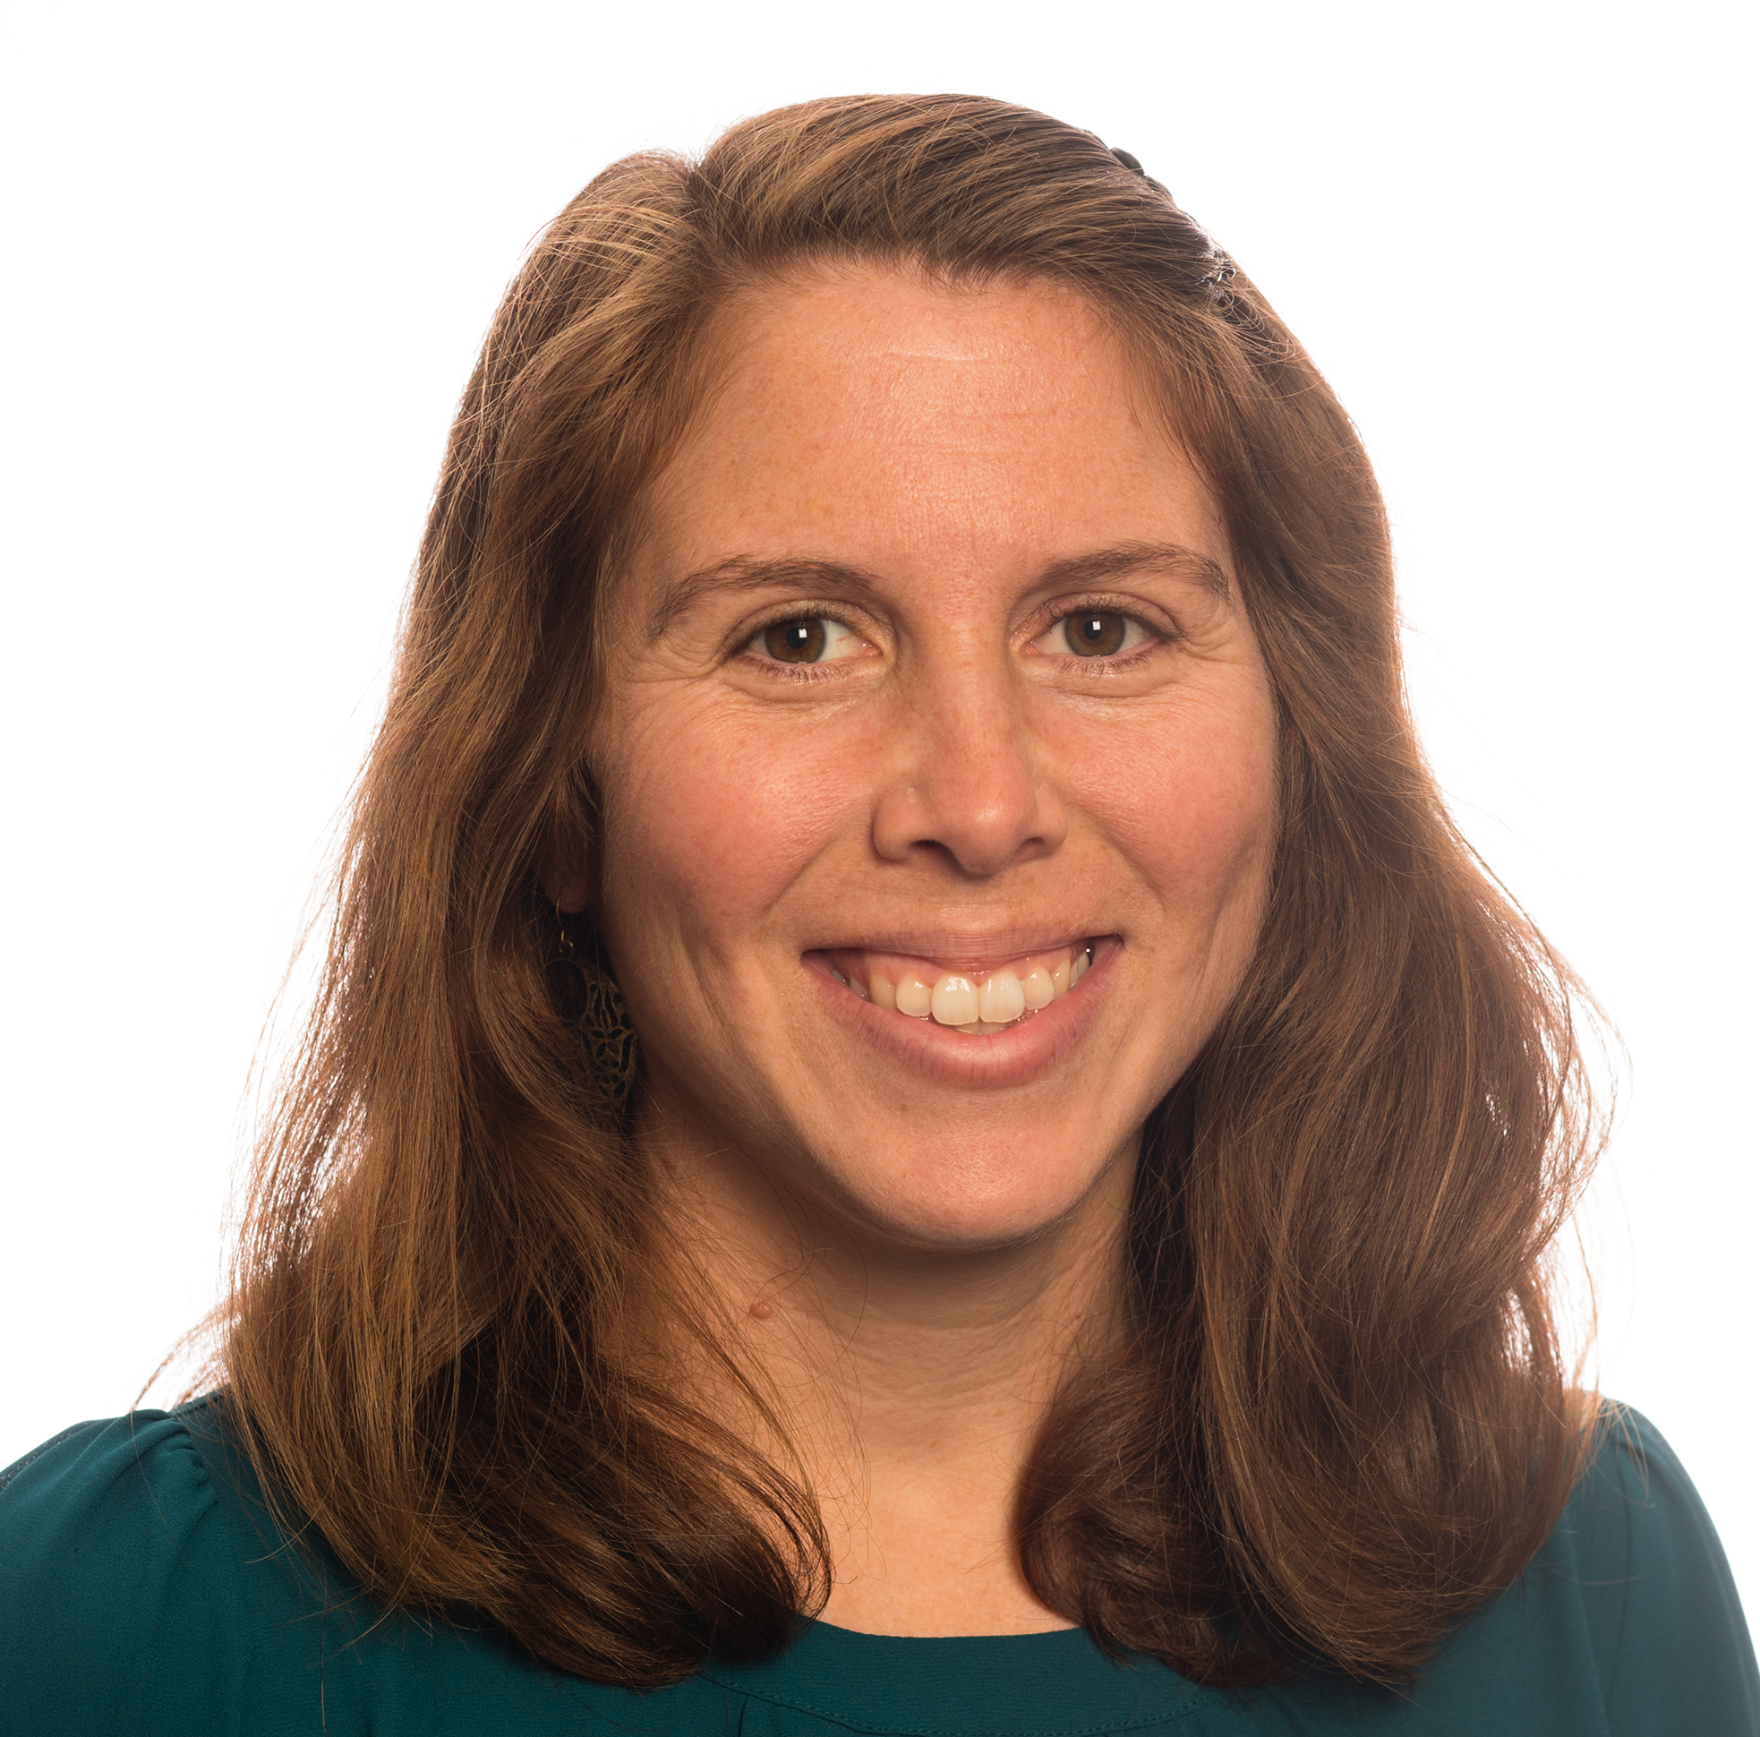
OoR Pre-Award Contacts
Amanda Gallop, Financial Analyst
Assists with budget development
Reviews proposal budgets
Amy Hill, Editor
Provides editorial and graphics support
Assists with application forms
Submits proposal
Jamie Murdock, Grant Development Manager
Serves as the primary point of contact faculty seeking external funding
Assists with review of solicitation/proposal planning and application forms
Reviews proposals against sponsor requirements/review criteria

Slide 18

Upcoming Research 101 Workshops
Questions
Subrecipient Monitoring
  February 4, 2021
Post-Award Management
  February 25, 2021
Responsible Conduct of Research
  March 11, 2021

