Slide 1


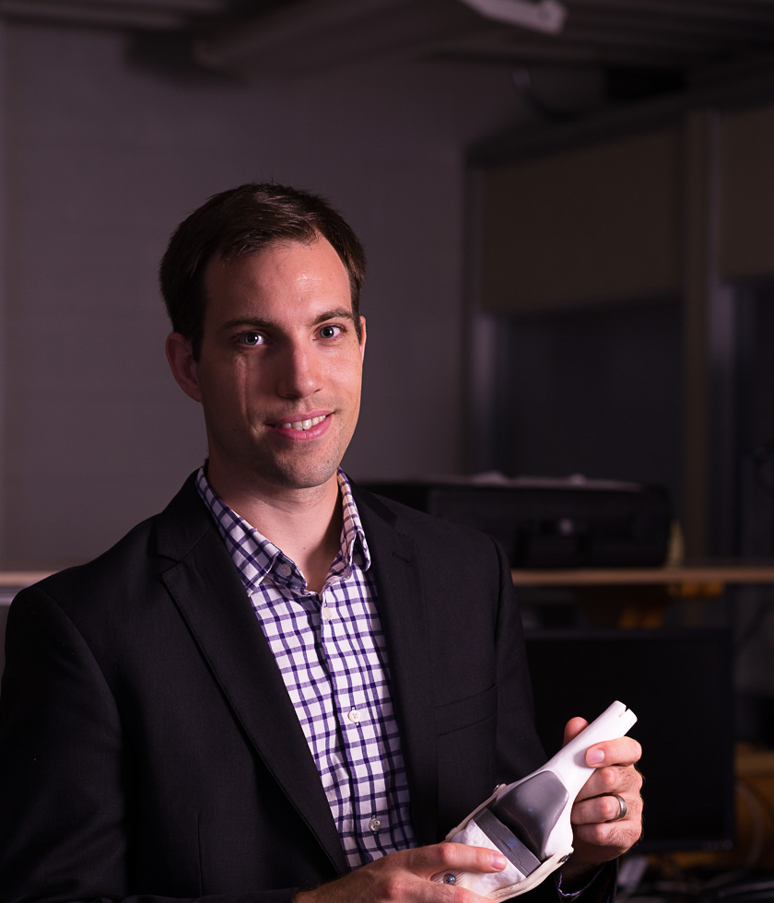
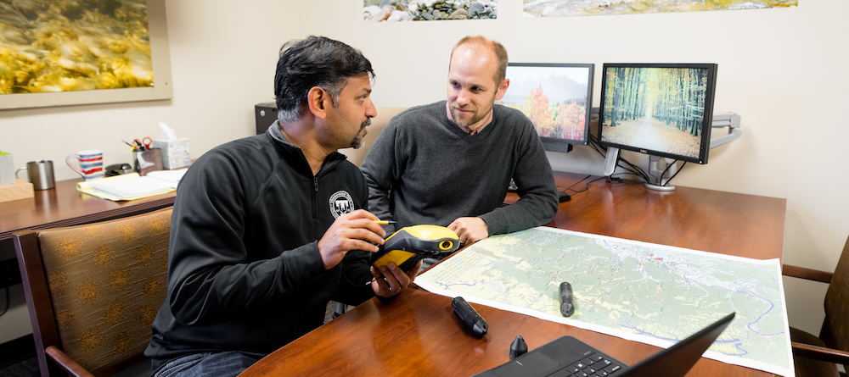
Sponsored Projects Overview
Research 101 Workshop:

Slide 2

Research 101 Workshop
Sponsored Projects Overview
September 17, 2020

Slide 3
Topics to be Covered
Definition of sponsored research/external funding
Role of the Office of Research (OoR) and Office of Grant Accounting (GA)
Internal process and required paperwork
Overview of roles and responsibilities in proposal development and grant management process
Overview of training requirements
Resources available on website/Sharepoint
Staff contacts and communication strategies

Slide 4
What is a Sponsored Project?
  Sponsored programs are projects and/or activities conducted by members of the faculty or, in some instances staff members or students, that are supported wholly or in part by external restricted funds awarded to the University.
  Externally funded activities in which a formal written agreement, i.e., a grant, contract, or cooperative agreement, is entered into by the University and the sponsor.

Slide 5
Office of Research/Grant Accounting
Tennessee Tech University (TTU) receives awards for research, training, public service and technical assistance from extramural funding sources, including federal, state and local governments and private organizations.
The policies and procedures governing research and sponsored programs are diverse and complex. Our goal is to assist faculty, staff, and students in preparing proposals, conducting research activities, and utilizing external funding in compliance with relevant government laws and regulations, and TTU policies and procedures.
Dr. Otuonye is the university official authorized to sign/submit all proposals and most contracts (awards).

Slide 6





Life Cycle of a Sponsored Project
Develop Proposal
Submit Proposal
Put together competitive proposal that meets all applicable guidelines.
Submit proposal in a timely manner through the required method.
Identify Funding Source
Manage Award
Utilize SPIN, Grants.gov, and other resources.
If funded, the project should be implemented according to award documents and complying with all applicable guidelines.
Project Idea
Completed
Award Close-out
Ensure that all required reports are completed and applicable closing procedures are followed.

Slide 7
Internal Process
Notice of Intent to Submit Proposal Form: Completed 30+ days before deadline. Provides information such as preliminary title, PI and other TTU personnel involved, funding program, deadline, and type of assistance needed.
Subrecipient/Contractor Checklist and Subrecipient Commitment form (if applicable): required for collaborative proposals involving subrecipients or contractors/vendors.
Proposal Endorsement Form (PEF): includes budget and personnel information, match requirements, identifies potential compliance issues, etc. Must be signed by PI, Co-PIs and applicable chairs and deans.
Award Activation Form (AAF): Completed if project is funded. Contains similar information to PEF and details in what budget categories the award will be spent.

Slide 8
Key Roles and Responsibilities
The Principal Investigator (PI) has the primary responsibility for the scientific, technical and fiscal leadership of the project, as well as intermittent progress reports.
The Dean and Department Chair approve that PI is qualified to serve and approve any cost share commitments. Department Chair also approves any release time and ensures release occurs.
The OoR assists PI in preparing proposals and implementing awards that are compliant with relevant government laws and regulations, and TTU policies and procedures.
The Project Bookkeeper assists the PI with budget monitoring to ensure expenditures are authorized and within approved budget. The Bookkeeper also develops and maintains documentation and records in accordance with records management procedures.
Grant Accounting collaborates with bookkeeper to ensure appropriate fiscal management and prepares and submits all invoices and financial reports to the agency as articulated in the award documents.
See OoR website for a more complete list of roles and responsibilities: https://www.tntech.edu/research/researchcompliance/roles-and-responsibilities.php

Slide 9
OoR Pre-Award Services
  Assist in identifying appropriate and relevant funding opportunities
  Promote and support collaborative, transdisciplinary research and scholarly activities
  Conduct proposal development workshops
  Assist with proposal and budget development
  Assist in the determination of subrecipient or contractor
  Provide editorial and graphic support on proposals
  Review proposals to ensure sponsor’s requirements are addressed
  Coordinate the submission of proposals to external sponsors using online portals

Slide 10
OoR Post-Award Services
  Process all awards from external sponsors
  Negotiate and execute sponsored agreements
  Conduct initial risk assessment for any subrecipient
  Initiate Project Kickoff Meeting to discuss award details, roles and responsibilities, university and sponsor requirements (including reporting) and closeout procedures.
  Ensure administrative compliance with TTU, state, sponsor, and federal regulations
  Coordinate with GA to respond to audit and bookkeeping-assistance requests and to provide training
  Assist faculty in all matters regarding intellectual property protection and commercialization.

Slide 11
GA Post-Award Services
  Provide oversight for sponsored projects accounting at Tech
  Submit invoicing and financial reporting to the sponsor
  Ensure fiscal compliance with TTU, state, sponsor, and federal regulations
  Monitor all matching accounts and requirements, both 3rd party and internal
  Conduct the draw down of funds and reconcile the draw down to expenses.
  Prepare, disseminate and collect effort reporting certifications on a semester basis
  Coordinate with OoR to respond to audit and bookkeeping-assistance requests and to provide training

Slide 12
Required Training
TTU subscribes to the Collaborative Institutional Training Initiative (CITI) to provide training in the Responsible Conduct of Research, Animal Subjects, Human Subjects, and Export Controls.
All personnel on funded grants are required to complete training in the Responsible Conduct of Research (RCR).
Additional training modules are required for individuals dealing with human subjects, animal subjects, and export controls.

Slide 13
OoR website: tntech.edu/research
Contains:
All internal forms and agreements
Essential information (e.g. congressional district, EIN, DUNS)
Proposal development resources including toolkit and SharePoint site (e.g. New Faculty Guide to Competing for Research Funding)
Faculty research directory
Policies and procedures
ORED supported committee information

Slide 14
Communication
Staff contact information
  Office of Research
    tntech.edu/research/aboutus – contains a list of OoR staff phone numbers and email addresses
  Grant Accounting
    tntech.edu/businessoffice/grant-acc – contains a list of GA staff phone numbers and email addresses
OoR newsletter, Tech Times, faculty listserv, emails to chairs/deans
GA monthly bookkeeper meetings, Teams Group for Bookkeepers, emails.

Slide 15
Upcoming Research 101 Workshops
Identify Funding
  October 22, 2020
Best Practices in Proposal Development
  November 5, 2020
Subrecipient Monitoring
  February 4, 2021
Post-Award Management
  February 25, 2021
Responsible Conduct of Research
  March 11, 2021

