Slide 1
Course Evaluations
They’re not just for the end of the semester..

Slide 2
We’re All In a New Space
Many have been thrust into the world of online learning
Instructors and learners are communicating differently
Face to face sometimes isn’t an option
We miss something there

Slide 3
Use Evaluations to Improve
Find out what students are thinking
Get the feedback you’re not getting in live stream
Don’t wait for the end of the course

Slide 4
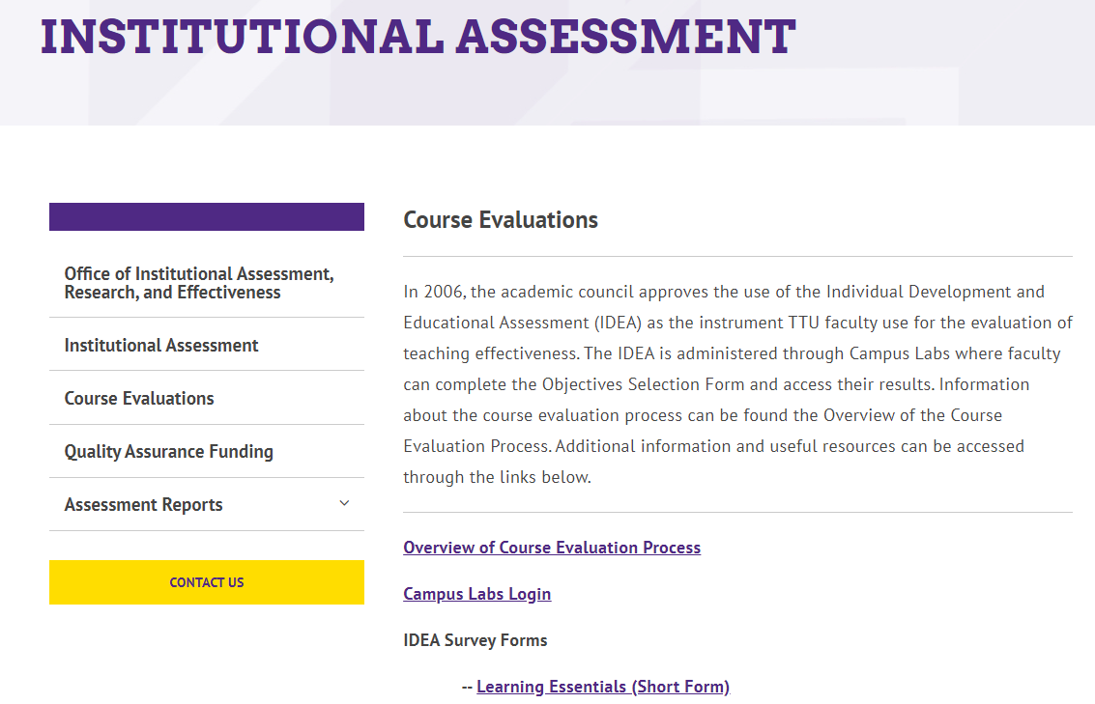
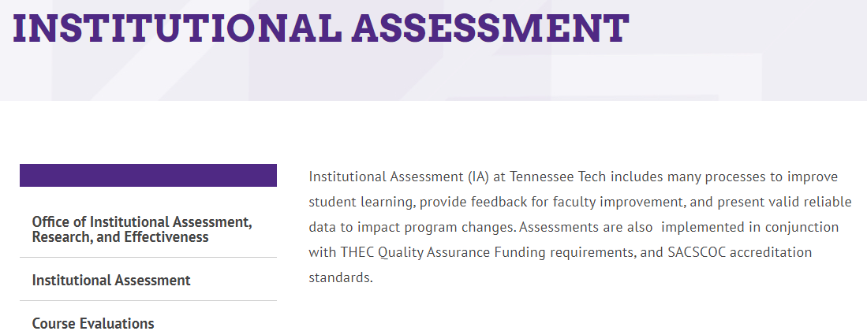
Course Feedback
Not instructor feedback
Resist the urge for personal improvement

Slide 5
Course Feedback
Course evaluations should be about;
Course Structure
Interface
Design
Alignment

Slide 6
Formative Evaluations
Completed any number of ways
Usually at designated points
After each module is complete
After each exam
At midterm
Any other time you deem necessary
It’s about improvement

Slide 7
Why Formative Evaluations
Get the information from the student while it is fresh in their mind
You can use the opportunity to ensure students understand expectations long before the end of the course
Keep a pulse on effectiveness of lessons

Slide 8
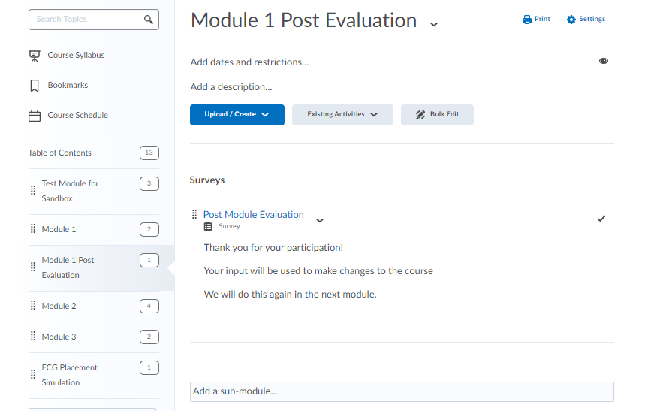
Example Formative Evaluation

Slide 9
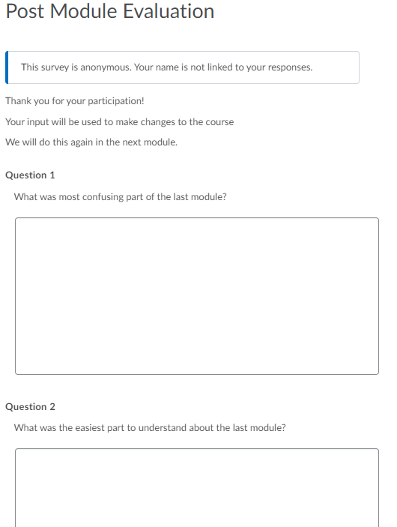
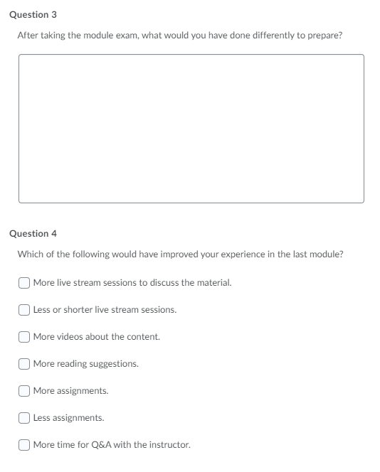
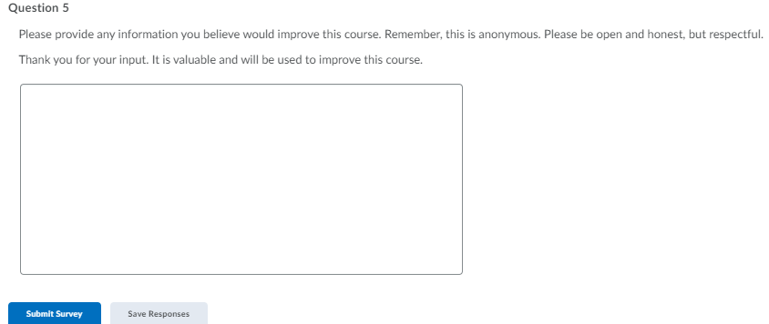
Example Formative Evaluation

Slide 10
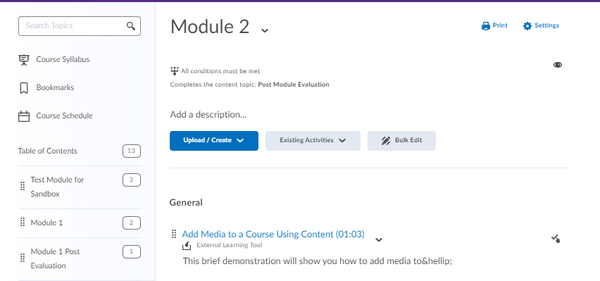
Example Formative Evaluation

Slide 11
Use the Feedback
Develop a plan of action
Set intentions
Use feedback for mid course changes to modality
Plan to change the way you do business based on the formative evaluations
Use feedback collectively for the next section of the course

Slide 12
Use the Feedback
Be prepared to modify your intentions
Never know what you’ll learn in a good evaluation
Could need to make immediate changes, even if not your original intention

Slide 13
Formal Course Review
The SUNY Online Course Quality Review Rubric - OSCQR
To help campuses ensure that their online courses are learner centered and well designed, a team of SUNY staff and campus stakeholders has designed the OSCQR rubric, a customizable and flexible tool for online course quality review.
The OSCQR rubric specifically targets online course design. The OSCQR rubric is unique and differs from other online course quality rubrics in several ways. It is not restricted to mature online courses. The rubric can be used formatively with new online faculty to help guide, inform, and influence the design of their new online courses

Slide 14
OSCQR Course Design Review

Slide 15
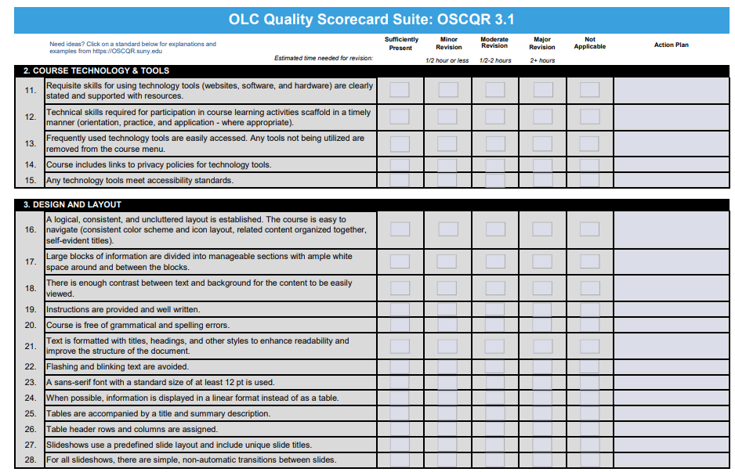
OSCQR Course Design Review

Slide 16
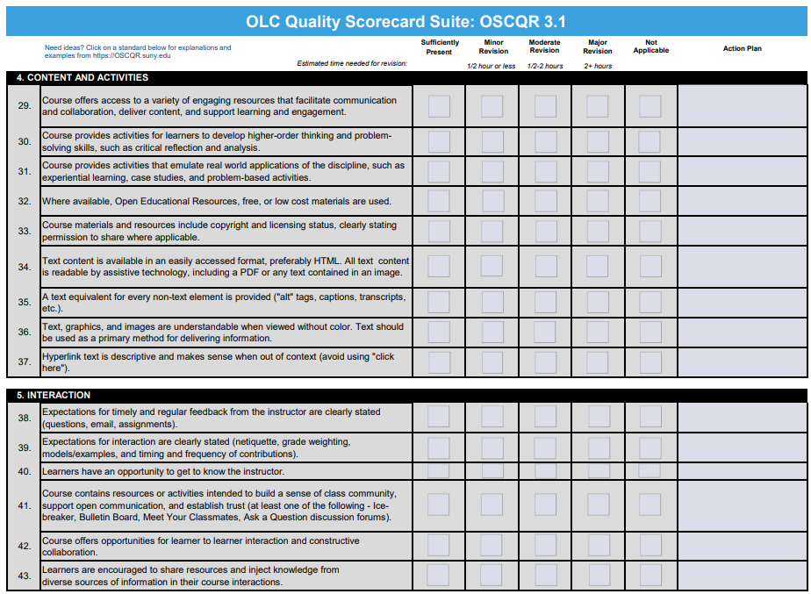
OSCQR Course Design Review

Slide 17
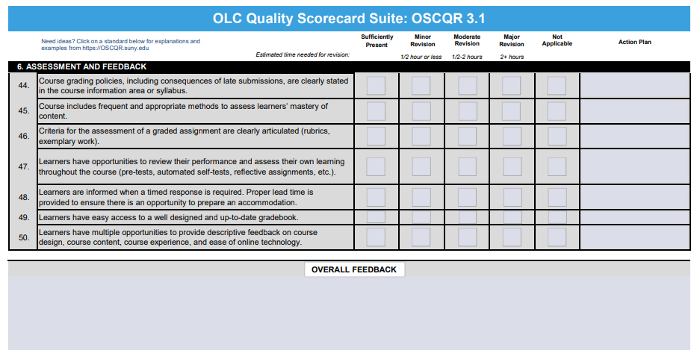
OSCQR Course Design Review

Slide 18
OSCQR Course Design Review

Slide 19
OSCQR Course Design Review
Rubric

Slide 20
Thank you!

