Slide 1
Engagement Opportunities Outside iLearn
Student Engagement Series

Slide 2
Student Engagement Series
The Primary/Recency Effect, When Learning Takes Place
Increase Student Engagement by Leveraging the Learning Management System (iLearn)
Improve Student Engagement with Less Technology
Zoom Breakout Rooms for Engaging Students
Gamification of Learning
Engagement Opportunities Outside iLearn

Slide 3
Engagement Outside of iLearn
Any type of engagement outside of the LMS
Social media
Various live stream and live meeting outlets
Software, websites or tools used for learning and communication

Slide 4
Some of the Tools

Slide 5
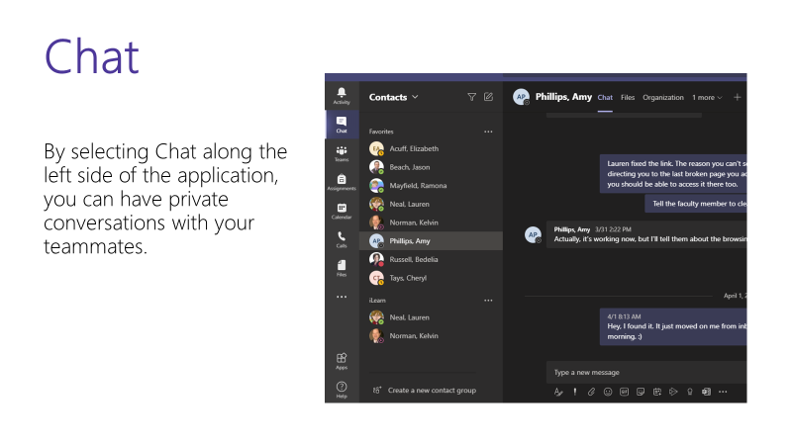
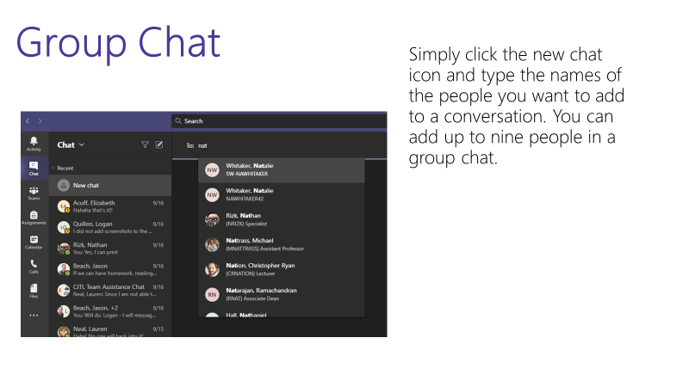
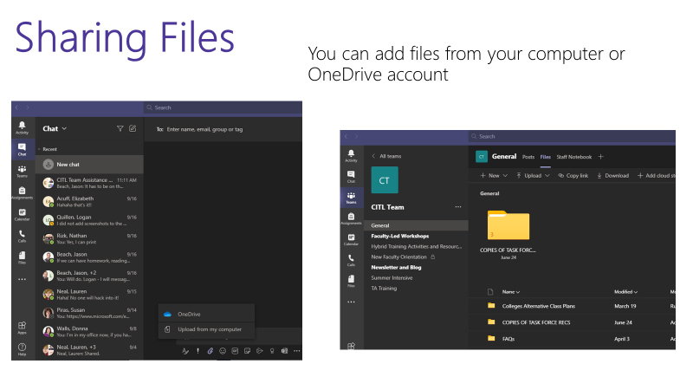
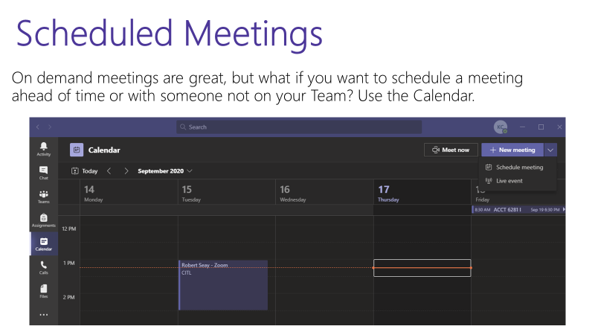
Microsoft Teams

Slide 6
Microsoft Whiteboard

Slide 7
Benefits of
Provides variety to the learners
Makes learning interactive
Motivates learners
More interaction with content = better retention/recall

Slide 8
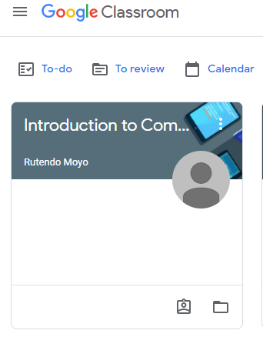
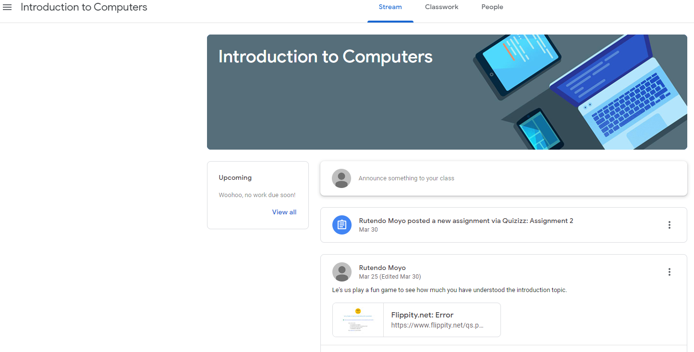
Google Classroom

Slide 9
Convert Google Spreadsheets
https://www.flippity.net/

Slide 10
Thank you!

