Slide 1
Implementing Teams in iLearn
Kelvin Norman, Ed. D.
Lauren Neal

Slide 2

Accessing teams
Access Teams through different methods.
Web Version
  Tech Express - choose the Teams icon
Desktop Version
  Open the Microsoft Teams application and login with TTU credentials.
  Open an Outlook meeting or email link, select to Open Microsoft Teams.
Phone Apps
  Download and login with TTU credentials.
The Desktop application is our recommended option for presenters.

Slide 3

Teams – Web Version
Benefits of the Web Version
Easy to access from any computer
Simplified
Updates are automatically applied
Access to meeting chats, recordings, and attendance

Slide 4

Teams - Web version
Features not available in the Web Version
Custom backgrounds
Background blur
Breakout Rooms (join only)
Live Captions
Limited Whiteboard capability
Spotlight
Take control (only with PPT)
Share system audio
Noise Suppression
Features work best in Chrome or Edge. Some are only available in Edge.
Many are not available in other browsers

Slide 5
Teams – Desktop Version
The desktop application has more features.
Add a virtual background
Blur your background
Create Breakout rooms
Can share computer audio (for video/audio on PC)
Spotlight a specific speaker (including yourself)
Reduce background noise in the audio settings
Live captions available in video meetings
Transcriptions
Attendance report

Slide 6
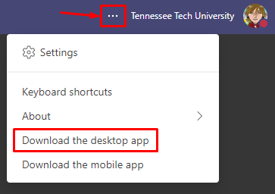
Download and Install Teams
You can install the Desktop version on your Tech computer or Personal computer.
Tech-Owned Computers should have the software by default.
Personal computer:
Go to the web version from Tech Express.
Select the … at the top right by Tennessee Tech University
Select Download the desktop app

Slide 7
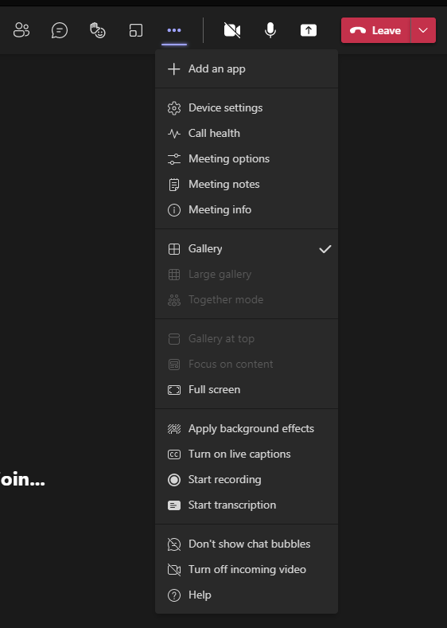
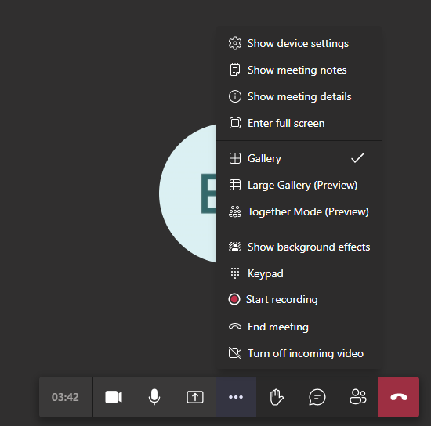
Web Version vs desktop application
Desktop Version
Web Version

Slide 8
Common features
These are common features used in Teams
Chat (one-on-one or group)
Video calls (one-on-one or group)
Share screen
Breakout Rooms
Recording/Transcription
Live Captions (individual)

Slide 9

Chat
Chat is text based and is a great for
Office hours
Q&A during video meeting
Group chats for collaboration
Quick messages or conversations
Sharing files

Slide 10
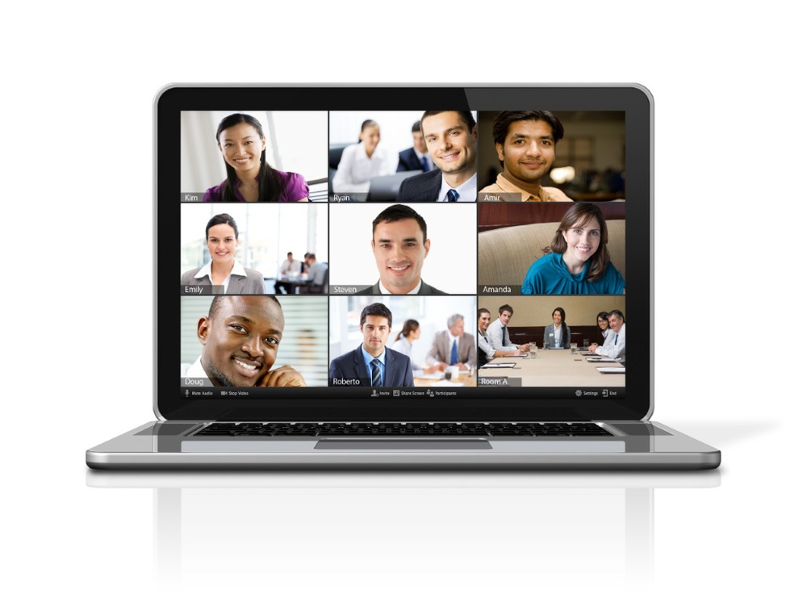
Video Calls and meetings
Video calls/meeting work well for
Office hours
Study sessions
Group work
Online lectures
Conversations that work best in person
Using video calls allows you to record the meeting or session for later viewing.

Slide 11
Share Screen
What you can share
  Documents
  Resources
  Presentations
  Videos (make sure to share system audio)
Why share?
  For assistance
  To show examples
  Collaboration

Slide 12
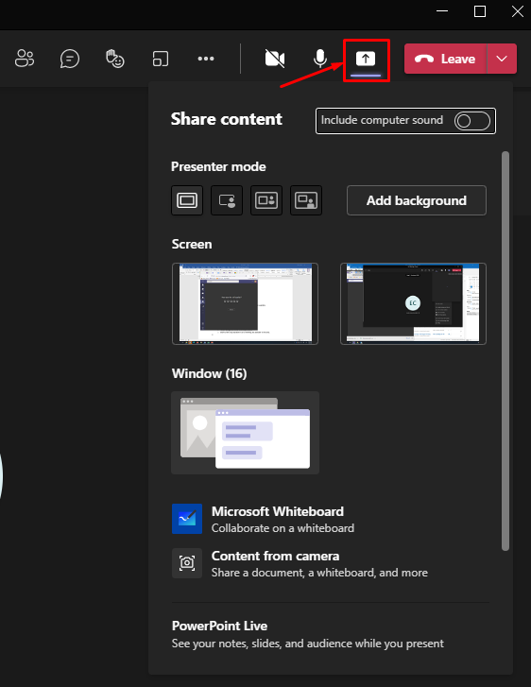
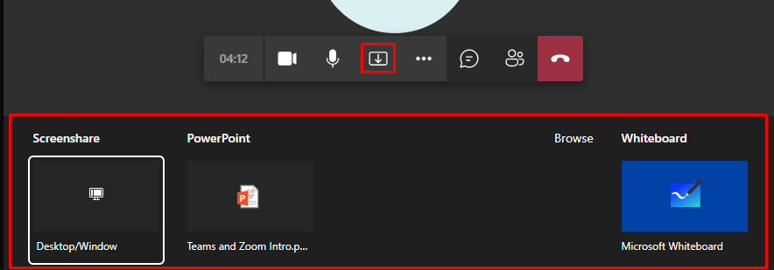
Share Screen
Desktop Version
Web Version

Slide 13
Breakout rooms
Breakout rooms work great for group work.
Can only create in the Desktop application
  Choose number of rooms
  Assign participants
    Automatically
    Manually
Participants can join in any version
Learn more about creating breakout rooms.

Slide 14
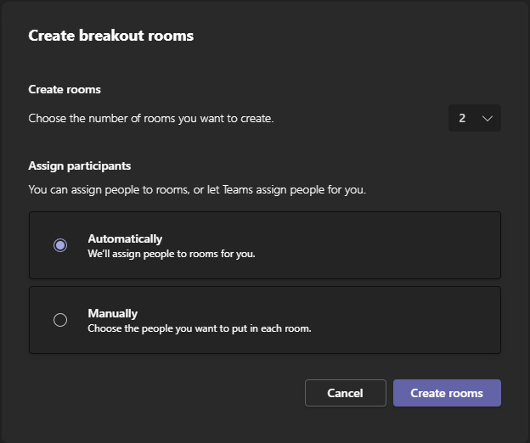
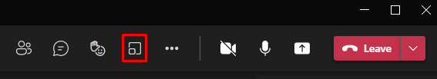
Breakout Rooms

Slide 15

Recording and Transcription
REC
Recording your class meeting can allow students to re-visit lectures or view ones they missed.
Select Start Recording in the Options menu
Can select to Auto Record in the meeting options
Where do recordings go?
  Using a link through iLearn or Outlook?
    OneDrive/Recordings folder
  Using a Team?
    SharePoint/General/Recordings folder

Slide 16
Recording and Transcription
In the Desktop application, transcription will be enabled automatically when Start Recording is selected.
Transcription is
  a running transcription during the meeting.
  available to download for all participants, except external.
  used to create captions on the video.
    Only available for 60 days.
    Use YuJa for extended availability of captions

Slide 17
Recording and transcription
Desktop Version
Web Version

Slide 18
Live Captions
Transcriptions are NOT live captions.
Transcriptions are used to create captions.
Live captions
  Overlay the conversation on the video.
  Are an individual option.
  Only available in the desktop application.
  Are only available during the meeting.

Slide 19
Common reasons for using Teams in iLearn
Office hours
One-on-one help
Group help sessions
Lectures
Guest lectures
Student presentations
Screen sharing
Recording sessions

Slide 20
Methods for Implementing Teams
Option 1 Teams Link
  No team to create or join
  A single link can be created for all class meetings at any time
  A simple link that can be shared with whoever needs access to the meeting
Option 2 Creating a course team through iLearn integration
  Enables students to access an iLearn course through a team
  Has the following benefits:
    Students can create channels for group work
    File sharing
    Recorded meetings
    Chat

Slide 21
How to create a meeting link
Go to iLearn
Select your course
Go to Course Materials – Content
Select the module where you would like to put this link
  If you do not already have one, you can create a Module for class meetings or class information
Select the Existing Activities button to the right
Choose MS Teams Meeting

Slide 22
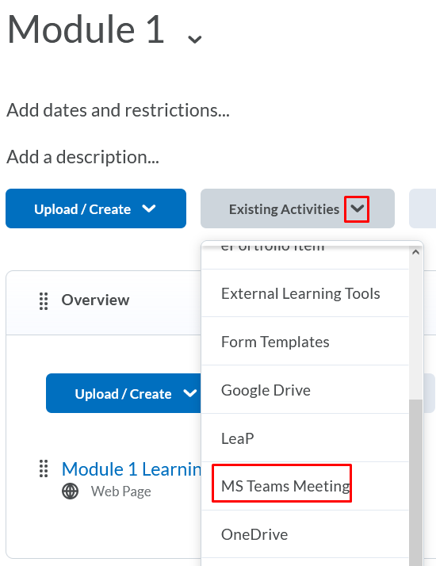
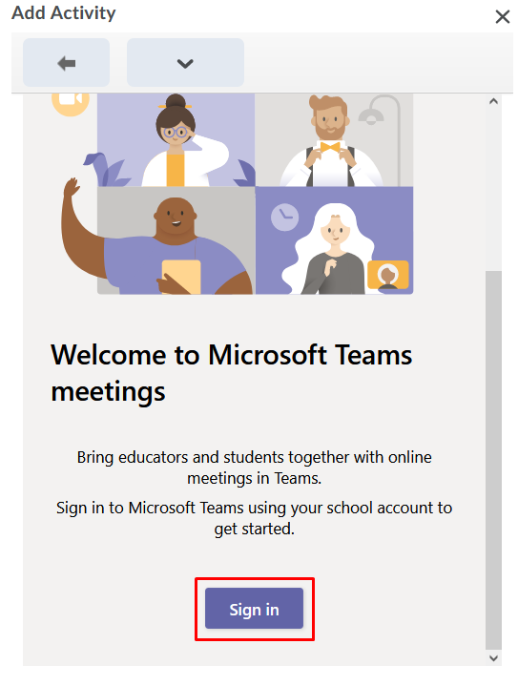
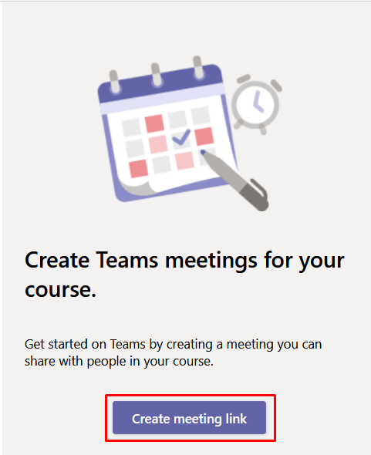
How to create a meeting link

Slide 23
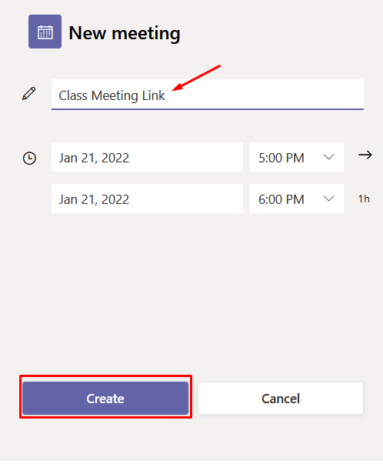
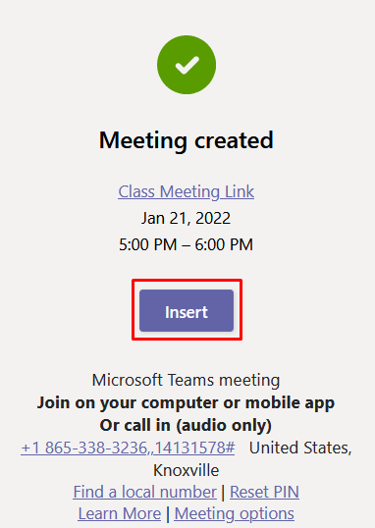
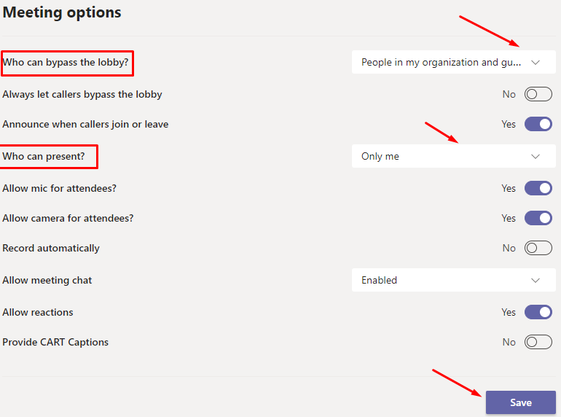
How to Create a Meeting Link

Slide 24
Using meeting links in iLearn
Lectures
  Instructors click on the meeting link to start the meeting
  Students will join the meeting by clicking on the meeting link
  Instructors can share their application or desktop screen and record the session
  Recorded sessions are saved in a One Drive folder
Discussions
  Open topic discussions
    A meeting link is created for the topic
  Open topics with group or section restrictions
    A separate meeting link is created for each individual topic
    Specific groups will have access to the individual topic meeting links

Slide 25
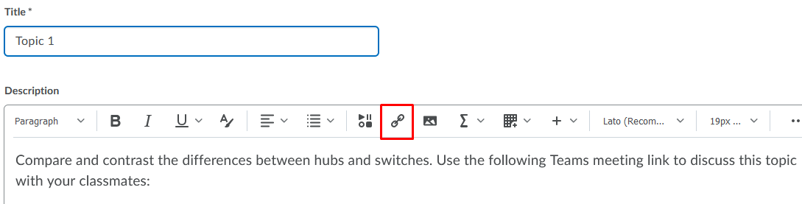
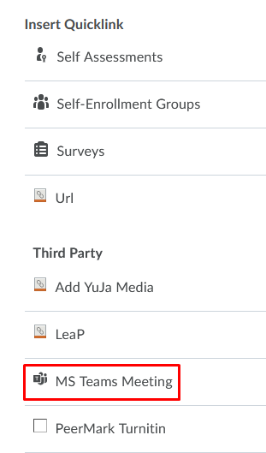
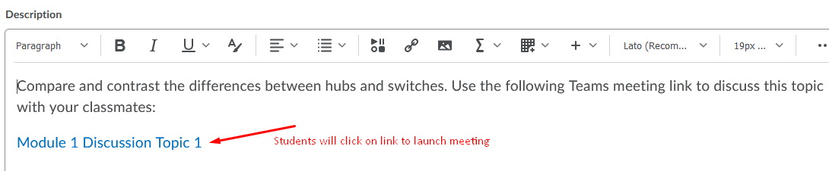
Teams Links in Discussions

Slide 26
How to create a team through iLearn integration
Step 1 Set MS Teams Homepage
  Select the Course Management link in the upper navigation bar
  Then select Course Admin from the drop-down menu
  Select the Homepages link
  Select the Active Homepage drop-down
  Choose the TTU-Course Home-MS Teams option
  Click the Apply button
  Select the title of the course at the top of the page to go back to the homepage
Step 2 Create a Course Team
  The widget will appear on the top left side of the course home page
Step 3 Open your team
  Click on the button on the widget

Slide 27
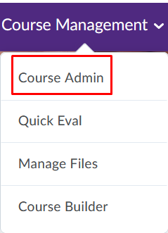
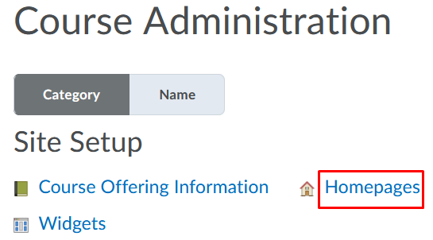
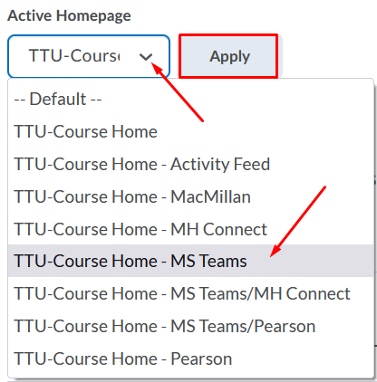
Step 1 Set MS-Teams Homepage

Slide 28
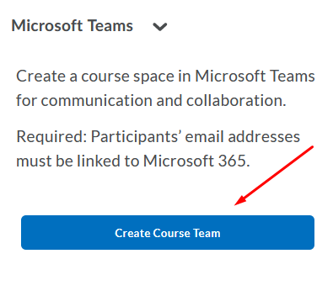
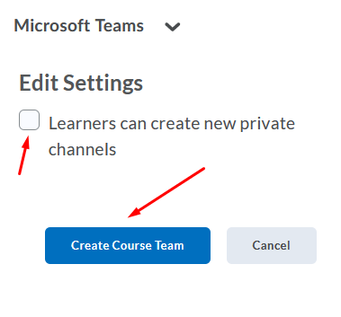
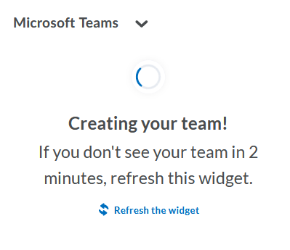
Step 2 Create a Course Team

Slide 29
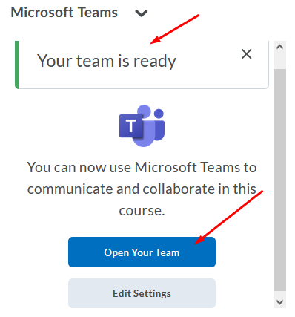
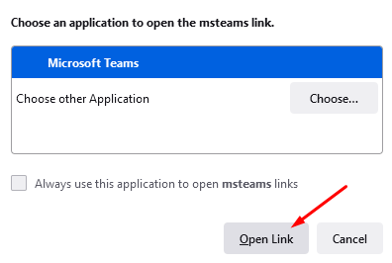
Step 3 Open Your Course Team

Slide 30
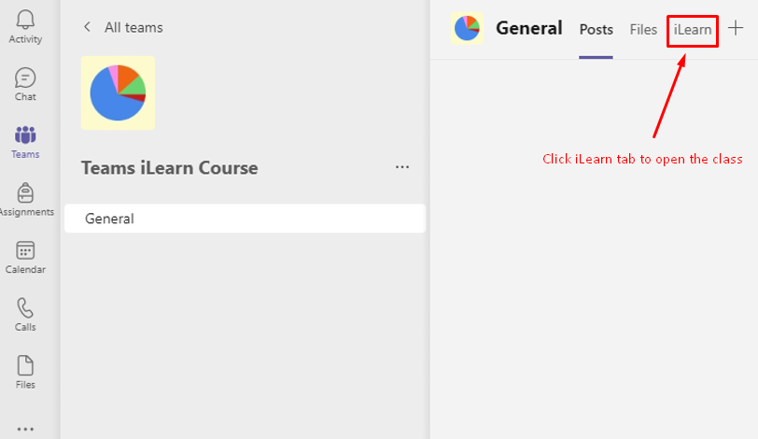
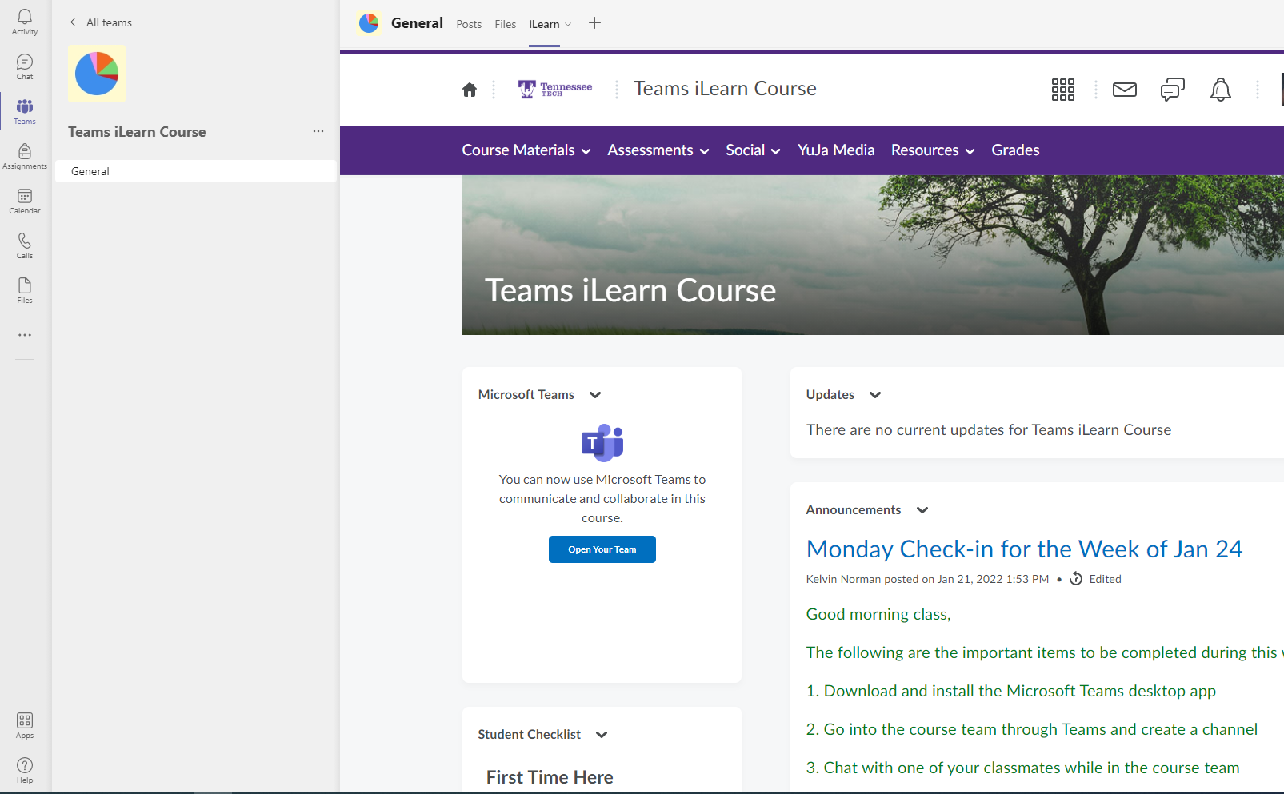
What Students and Instructors will see

Slide 31
Questions?

