Slide 1
Welcome back, students!

Slide 2
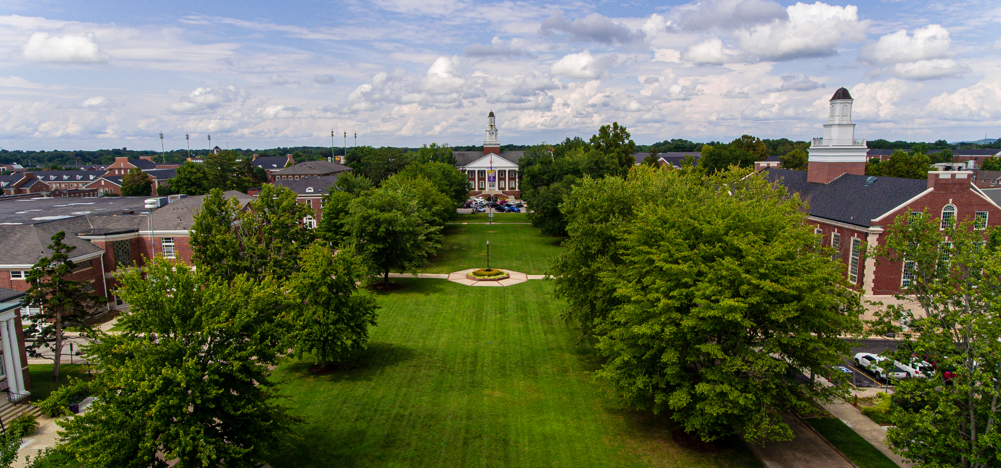
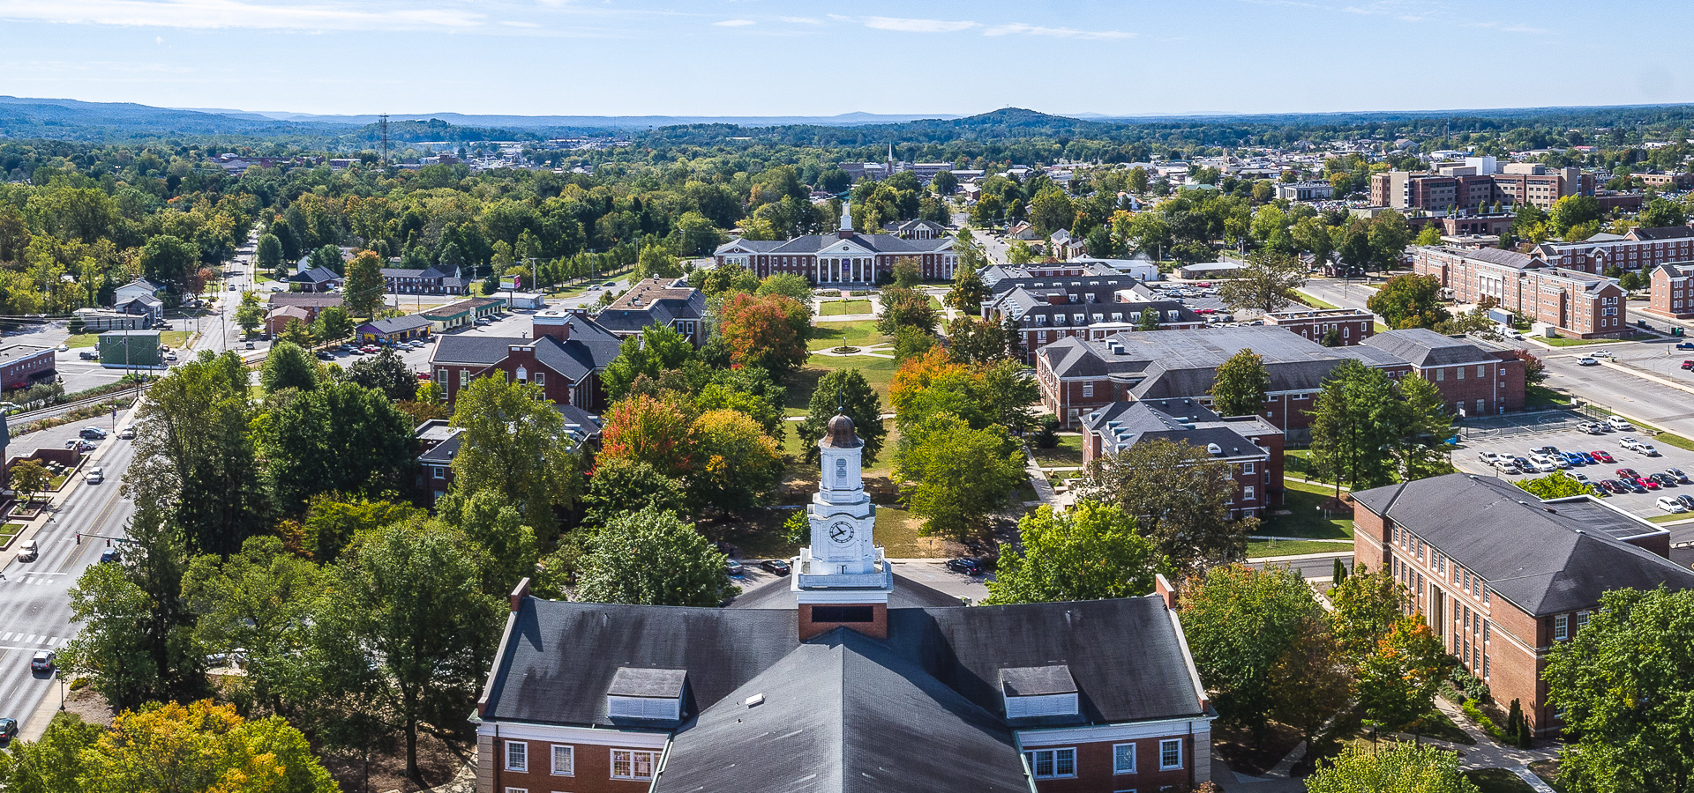

Slide 3
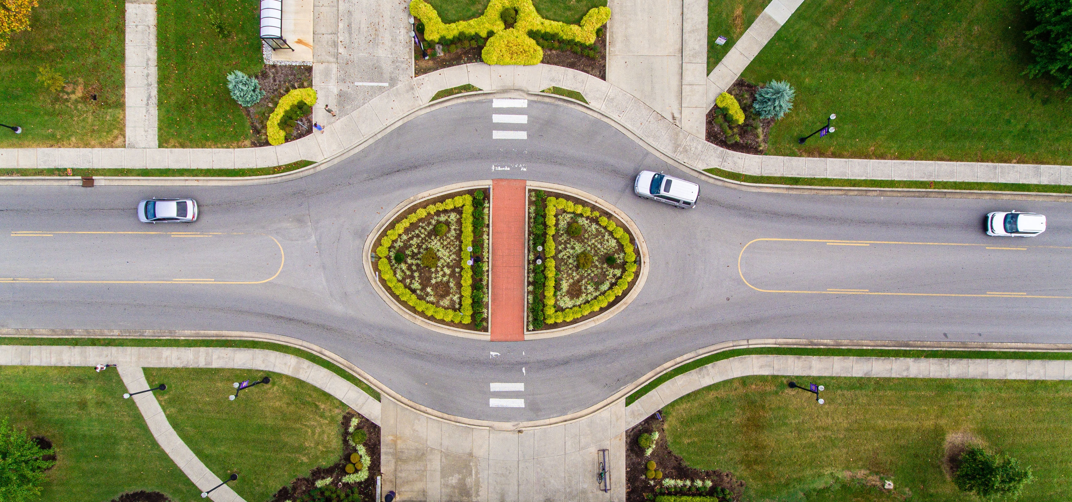

Slide 4
TNTECH.EDU

Slide 5
