Slide 1

University Faculty Meeting August 18, 2025
Provost’s Report Outline
Faculty Promotions and Tenure
Faculty Retirement
New Faculty
New Administrators
Ongoing work: Accreditation and Reaffirmation, Quality Enhancement Plan
Ongoing work: Enhancing Student Experience and Retention
Ongoing work: Enhancing Student Success
Ongoing work: Research and Scholarly Activities
Thanks to All for the Service Work You All Have Been Doing

Slide 2
Faculty Promotions and Tenure
A total of 32 faculty members received promotions
9 promotions to full professors
14 promotions to associate professors
9 lecturers and instructors
13 tenured

Slide 3
Promotion and Tenure – Congratulations!
Name | Department/School | College | New Rank
Sid Bundy | Accounting | Business | Associate Professor
Teddy Burch | Communication and Media | Emerging and Integrative Studies | Associate Professor
Nikki Carter | Biology | Arts and Sciences | Master Lecturer
Amy Chambers | Mathematics | Arts and Sciences | Professor
Tania Datta | Civil and Environmental Engineering | Engineering | Professor
Philip Davis | History | Arts and Sciences | Senior Instructor
Andrew Donadio | Nursing | Whitson-Hester School of Nursing | Associate Professor
Edward (Allen) Driggers | History | Arts and Sciences | Professor
Derrick Edwards | Counseling and Psychology | Education and Human Sciences | Associate Professor
Joshua Field | Art, Craft and Design | Fine Arts | Associate Professor
Rene (Ka) Grimes | Curriculum and Instruction | Education and Human Sciences | Senior Lecturer
Sharon Henry | English | Arts and Sciences | Master Lecturer
James Hensley | Counseling and Psychology | Education and Human Sciences | Master Lecturer
Katherine Hermann-Turner | Counseling and Psychology | Education and Human Sciences | Professor
Colin Hill | Music | Fine Arts | Professor
Adam Holley | Physics | Arts and Sciences | Professor
Erin Hoover | English | Arts and Sciences | Associate Professor
Samantha Hutson | Human Ecology | Agriculture and Human Ecology | Associate Professor
Ryan Matthews | Decision Sciences and Management | Business | Associate Professor
Notes:
4 to Master Lecturer
4 to Senior Lecturer
1 to Senior Instructor
14 to Associate Professor
9 to Professor

Slide 4
Promotion and Tenure – Congratulations!
Name | Department/School | College | New Rank
Benjamin Mohr | Civil and Environmental Engineering | Engineering | Professor
Jonathan Moldenhauer | Chemistry | Arts and Sciences | Senior Lecturer
Hyewon Park | Economics, Finance and Marketing | Business | Associate Professor
Yi Peng | Economics, Finance and Marketing | Business | Associate Professor
Elizabeth Ramsey | Human Ecology | Agriculture and Human Ecology | Associate Professor
Marcus Rogers | Mathematics | Arts and Sciences | Senior Lecturer
Susmit Shannigrahi | Computer Science | Engineering | Associate Professor
Wendy Smith | Mathematics | Arts and Sciences | Master Lecturer
Charles Van Neste | Electrical and Computer Engineering | Engineering | Associate Professor
Padmini Veerapen | Mathematics | Arts and Sciences | Professor
Robert Wilbanks | Accounting | Business | Professor
Seth Williams | Decision Sciences and Management | Business | Senior Lecturer
Lauren Wright | Sociology and Political Science | Arts and Sciences | Associate Professor
Notes:
13 faculty members gained tenure

Slide 5
Retirements – Congratulations!
Name | Department/School | Rank | Years of Service
Toni Roberts | Senior Lecturer | Nursing | 13
Wei Tsun Chang | Professor | Music | 23
Jeffrey Austen | Electrical and Computer Engineering | Associate Professor | 37
Michael Burduck | English | Professor | 40
Stephen Michael Wells | General and Industrial Engineering | Assistant Professor | 45
Notes:
5 faculty retired

Slide 6

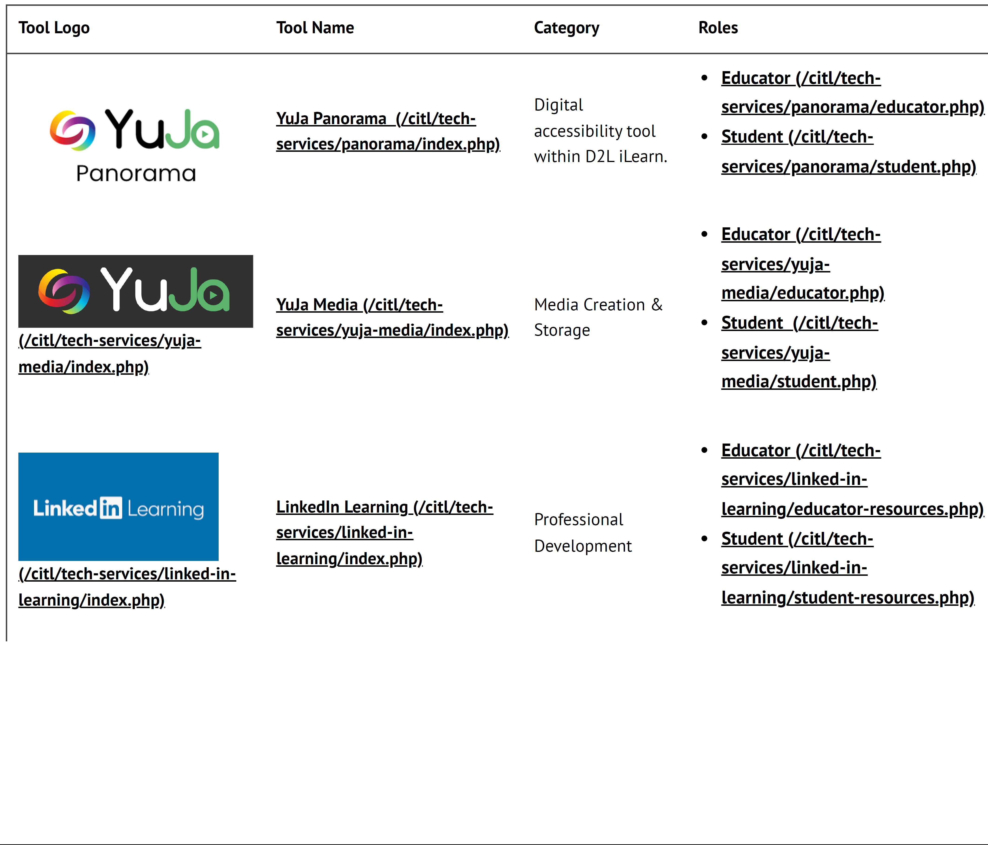
Welcome New Faculty Members!
www.tntech.edu/cafe
47 New Faculty Hires
CAFE
21 Tenured/Tenure Track faculty
26 Lecturers and Instructors
CENTER FOR INNOVATION IN TEACHING & LEARNING
CITL
Notes:
The 47 new faculty titles are as follows:
17 Assistant Professors
2 Associate Professors
2 Professors
12 Instructors
14 Lecturers
These numbers include the new Chair in English and Associate Dean of Business
20 Reappointed Lecturers
6 Reappointed Instructors
1 Reappointed Research Asst. Prof.

Slide 7
Welcome New Faculty!
Department | Name | Title | Last degree from
School of Agriculture | Joshua Reed | Assistant Professor | Penn State University
School of Agriculture | Surya Shrestha | Assistant Professor | Washington State University
School of Human Ecology | Shermineh Afsary | Assistant Professor | University of Kansas
Biology | Alba Frias-De-Diego | Assistant Professor | North Carolina State University
Biology | James Wood | Assistant Professor | University of Georgia
Chemistry | Lac Ha Nguyen | Assistant Professor | Ho Chi Minh Univ. of Technology
English | Steve Thomas | Chair | Pennsylvania State University
History | Christian McCall | Lecturer | Austin Peay University
Mathematics | Cheryl Swafford | Lecturer | Tennessee Tech University
Physics | Kanokporn Chattrakun | Lecturer | University of Missouri
Physics | Susheel Pangeni | Lecturer | Wayne State University
Sociology Political Science | Michelle Johns | Lecturer | Judaic Studies Institute
Sociology Political Science | Ron Johnson | Lecturer | American Military University
Sociology Political Science | Diego Taboada | Instructor | University of Tennessee
College of Business | Coco Wu | Associate Dean | University of Alabama

Slide 8
Department | Name | Title | Degree from
Economics, Finance & Marketing | Shane Parent | Instructor | Florida State University
Counseling and Psychology | Haley Dawson | Assistant Professor | Florida International University
Counseling and Psychology | Sarah Sweezy | Assistant Professor | University of Montana
Curriculum and Instruction | Luke Anderson | Lecturer | Tennessee Tech University
Curriculum and Instruction | Lindsey Braisted | Lecturer | Tennessee Tech University
Curriculum and Instruction | Marlana Lastres | Lecturer | Tennessee Tech University
Curriculum and Instruction | Michael Littrell | Assistant Professor | Tennessee Tech University
Curriculum and Instruction | Kelly Moore | Assistant Professor | Tennessee Tech University
Curriculum and Instruction | Kinsey Simone | Assistant Professor | Tennessee Tech University
Curriculum and Instruction | Annie Smith | Instructor | Tennessee Tech University
Exercise Science | Katie Killman | Instructor | Tennessee Tech University
Exercise Science | Anthony Phillips | Instructor | Tennessee Tech University
Chemical Engineering | Christy West | Associate Professor | Georgia Institute of Technology
Civil Environmental Engineering | Phillip Buell | Lecturer | University of Tennessee
Computer Science | Matthew Billings | Instructor | University of Maryland
Computer Science | Callie Stewart | Instructor | Tennessee Tech University

Slide 9
Department | Name | Title | Degree from
Electrical Computer Engineering | Christopher Johnson | Lecturer | Tennessee Tech University
Manufacturing Engineering Tech | Vivekanand Naikwadi | Lecturer | Tennessee Tech University
Manufacturing Engineering Tech | Ayantha Senanayaka | Assistant Professor | Mississippi State University
Mechanical Nuclear Engineering | Rajni Chahal | Assistant Professor | University of Texas at Arlington
Mechanical Nuclear Engineering | Manish Sharma | Assistant Professor | Missouri University of Sci Tech
Mechanical Nuclear Engineering | Shoaib Usman | Professor | University of Cincinnati
Mechanical Nuclear Engineering | Austin Andrews | Assistant Professor | University of Minnesota
CEROC | Mohamed Shaban | Res Assistant Professor | Alexandria University
Communication and Media | Andrew Allsup | Lecturer | University of Pittsburgh
Communication and Media | Samantha Rippetoe | Assistant Professor | University of Georgia
School of Environmental Studies | Manuel Jara | Instructor | University of Lincoln, UK
School of Music | Cassandra McDonald | Instructor | Boston University
School of Music | Christopher Williams | Instructor | University of Georgia Athens
Nursing | Jason Hurley | Lecturer | Tennessee Tech University
Nursing | Jessica Randolph | Instructor | UT- Chattanooga
Nursing | Michael Turner | Lecturer | Vanderbilt University

Slide 10
Welcome New Administrators!
Jie Cui | Interim Asst. Dean for Acad. Affairs, Engineering | Tennessee Tech
Maanak Gupta | Associate Chair, Computer Science | Tennessee Tech
Alfred Kalyanapu | Interim Chair, Electrical & Computer Engineering | Tennessee Tech
Peter Lee | Interim Chair, Earth Sciences | Tennessee Tech
Jeanette Luna | Interim Asst. Dean for Research & Graduate Studies, Arts and Sciences | Tennessee Tech
Steve Thomas | Chair, English | Wagner College
Lauren Wright | Interim Chair, Sociology & Political Science | Tennessee Tech
Coco Wu | Associate Dean, Business | Central Washington University
Matthew Younglove | Associate Director, Music | Tennessee Tech
Lindsey Roberts | Director, Honors Program | Tennessee Tech
Notes:
10 administrators

Slide 11
A Vision of Academic Excellence
Enhance student success as reflected in four-year and six-year graduation rates, student job placement, median starting salaries, graduate and professional school enrollments, and national awards
Strengthen student-first culture and experience as reflected in student retention
Innovate in academic programs as reflected in high relevance to future economy and labor force, student enrollment, and as a top destination school in the state
Increase research funding, scholarship and national reputation, and experiential learning opportunities

Slide 12
Ongoing Work This Year
1. SACSCOC Accreditation and Reaffirmation
2016
Reaffirmation of Accreditation
2026
10-Year Cycle
2022
5th Year Interim Report
Two documents required by SACSCOC:
Compliance Certification Report (78 standards in 14 categories) - due to SACSCOC in September 2025
Quality Enhancement Plan (QEP) – due to SACSCOC in January 2026
Three reviews:
Off-site Review in Fall/Winter 2025
On-site Review in Spring 2026
SACSCOC Board of Trustees review in Dec. 2026
Two documents
Compliance Certification (subset of 22 standards)
Quality Enhancement Plan Impact Report
One review
Off-site review

Slide 13
Thanks to the Committees
Compliance Certification Report Writing Team
Compliance Committee
Faculty Credentials Committee
Institutional Effectiveness and Assessment Committee
Dr. Sharon Huo, Chair
Dr. Alice Camuti
Dr. Mike Gotcher
Dr. Kevin Harris
Dr. Amy Hill
Prof. Sharon Holderman
Dr. Barbara Jared
Dr. Allan Mills
Dr. Kumar Yelamarthi
Dr. Lisa Zagumny
Dr. Curtis Armstrong, Chair
Dr. Chris Wilson
Dr. Jeannette Luna
Dr. Michael Allen
Dr. Colin Hill
Dr. Scott Christen
Dr. George Chitiyo
Dr. Rachel Hall
Dr. Dennis Duncan
Dr. Kevin Harris, Chair
Ms. Lindsay Young
Dr. Ashley Akenson
Dr. Mike Gotcher
Dr. Barbara Jared
Dr. Lori Maxwell
Dr. Linda Null
Dr. Mohan Rao
Dr. Martin Sheehan
Dr. Matthew Trengove
Prof. Kimberly Winkle
Ms. Sandra Storie
Dr. Melinda Anderson
Dr. Stephen Robinson
Dr. Kumar Yelamarthi
Institutional Effectiveness (IE) Reports
Additional 47 faculty and staff serve as IE Report Facilitators and are actively engaged in preparing the 2024–25 IE Reports.

Slide 14

Ongoing Work This Year Quality Enhancement Plan (QEP)
Durable Life Skills and Career Readiness
Thanks to Dr. Lenly Weathers and the committee members!

Slide 15
Ongoing Work This Year
2. Record High First-Year Retention Rate
Thanks to our faculty and staff for your efforts and dedication in teaching, advising, and helping students succeed.
Continued efforts
Notes:
Right hand table is lagging indicator, We need to focus on leading indicators. How are our students progressing toward degree completion NOW?

Slide 16
Ongoing Work This Year
3. Enhancing Student Success
4-yr graduation rate
6-yr graduation rate
15-to-finish
Interns and Co-op
Career planning and QEP
Job placement
Graduate and professional schools
Earnings potential

Slide 17


Tennessee Tech Earned the Designation of “Opportunity University” by Carnegie and American Council of Education (ACE)
Higher Access
Higher Earnings
Notes:
479 Opportunity schools in the whole country

Slide 18
Only Three Universities in Tennessee Are Higher Earnings Universities
 | Access | earnings
Tennessee Tech | Higher | Higher
UT-Knoxville | Lower | Higher
Vanderbilt University | Lower | Higher

Slide 19
Ongoing Work This Year 4. Research: Record Level of Funding Activations
Dollar amounts in Millions

Slide 20
Wings Up 100 Recognition
Number of Faculty Obtaining at least $100,000
Thanks to the dedication of our faculty

Slide 21
Research Expenditures Lag but Follow the Pattern of Research Funding (in Millions)

Slide 22
Carnegie Research Activity Rankings
and NSF Research Expenditure Rankings
 | Number of Schools
1) R1 (Very high research activity) | 187
2) R2 (High research activity) | 139
3) Research | 216
Total | 542
NSF Research Expenditure Rankings
2020 | 2021 | 2022 | 2023 | 2024
14.0 | 15.4 | 16.4 | 20.8 | 36.4
308 | 306 | 317 | 304 | 249 (not final)

Slide 23
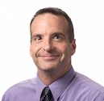
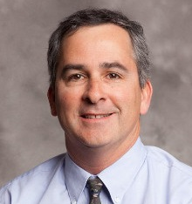

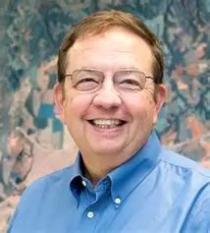
Recently Approved University Research Centers
Machine Intelligence and
Data Science Center
(MInDS)
Center for Addiction Prevention and Support (CAPS)
Advanced Scalable Computing, Extreme Networks & Data (ASCEND)
Doug Talbert & William Eberle
Steven Seiler
Anthony Skjellum
Artificial Intelligence
Behavioral Health
HPC and Quantum Computing

Slide 24
Ongoing Work: Scholarly Activities
Increase research funding to a goal of $55 million this year
Increase research infrastructure: HPC, core facilities, startup packages
Increase collaborative work
Increase scholarly output: Publications, books, presentations, products, demonstrations, exhibitions, performance, clinical work, etc.
Increase faculty support
Internal Faculty Funding Program, up to $20K/project
Rural Reimagined Grant Program, up to $20K/project
Commercialization Proof of Concept Program, up to $10K/faculty
Explore sabbatical opportunities for mid-career faculty

Slide 25
Ongoing Work: Service Work
Thanks to our faculty and staff for your great work in enhancing student recruitment, student experience, retention and success
Thanks to Faculty Senate for shared governance and contributions to the success of the university and success of our students
Thanks to various divisions of the university for collaborative work

Slide 26
Questions
Thank you!

