Slide 1
Hands On
Therapy Glove
Téa Phillips - Ashley Wheeler - Sergio Ramirez

Slide 2
Téa Phillips
Mechanical Engineering
Developed Inner Mechanism
Ashley Wheeler
Chemical Engineering
Explored Prototype Materials
Sergio Ramirez
Nursing
Provided Medical Knowledge

Slide 3
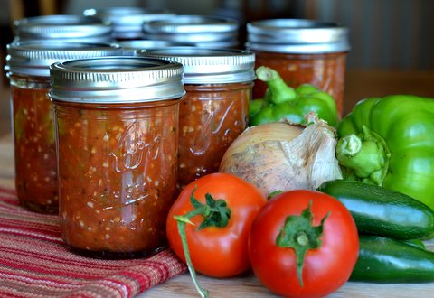

Slide 4
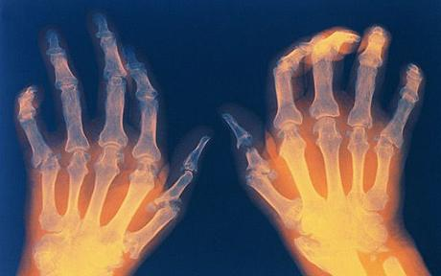
54.4 MILLION AMERICANS
STIFF JOINTS
PAIN
LOSS OF MOBILITY

Slide 5
CURRENT METHODS
EXPENSIVE
INEFFECTIVE
ADDICTIVE
physical therapy
compression gloves
opioids

Slide 6
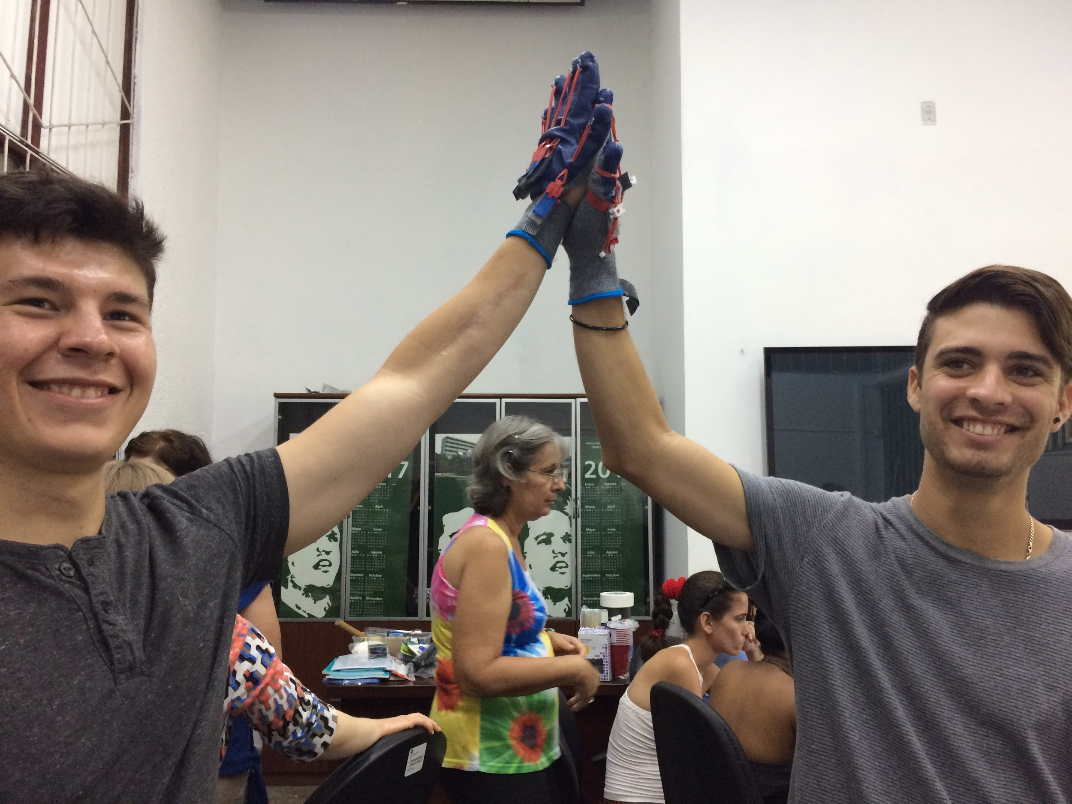

HANDS ON IS CREATED
MAY 2017
CUBA

Slide 7
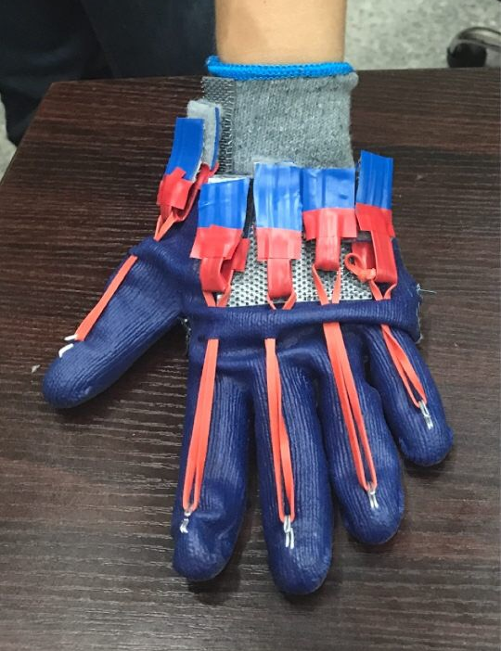
ADJUSTABLE RESISTANCE BANDS
GRIP STRENGTHENING
COMPRESSIVE FABRIC
PAIN REDUCTION
EXTENDS LIFE OF JOINTS

Slide 8


COST PER GLOVE
MARKETING
SALE PRICE $30
PRODUCTION $14.95
PROFIT $15.05

Slide 9
SALES PROJECTIONS
YEAR NEW CUSTOMERS REVENUE
1 1772 $79,727
2 5813 $261,605
3 7198 $323,892

Slide 10
HANDS ON FUTURE
OUTSOURCE MANUFACTURING
Labor is the largest production cost
LICENSE TO ESTABLISHED COMPANY
TN is the second-largest U.S. exporter of
medical devices and supplies

Slide 11
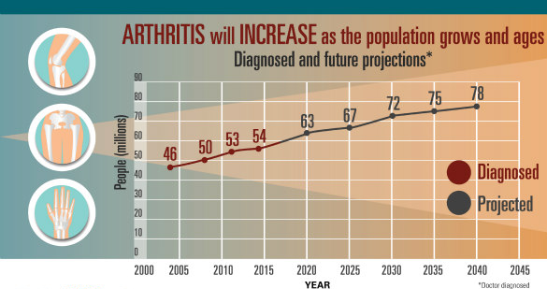
LOOKING FORWARD
FURTHER SHIFT FROM PHARMACEUTICALS
78 MILLION BY 2040

Slide 12
THANK YOU

